Slide 1
Town of Fort Erie Official Plan Review
Statutory Public Open House
June 2, 2025

Slide 2
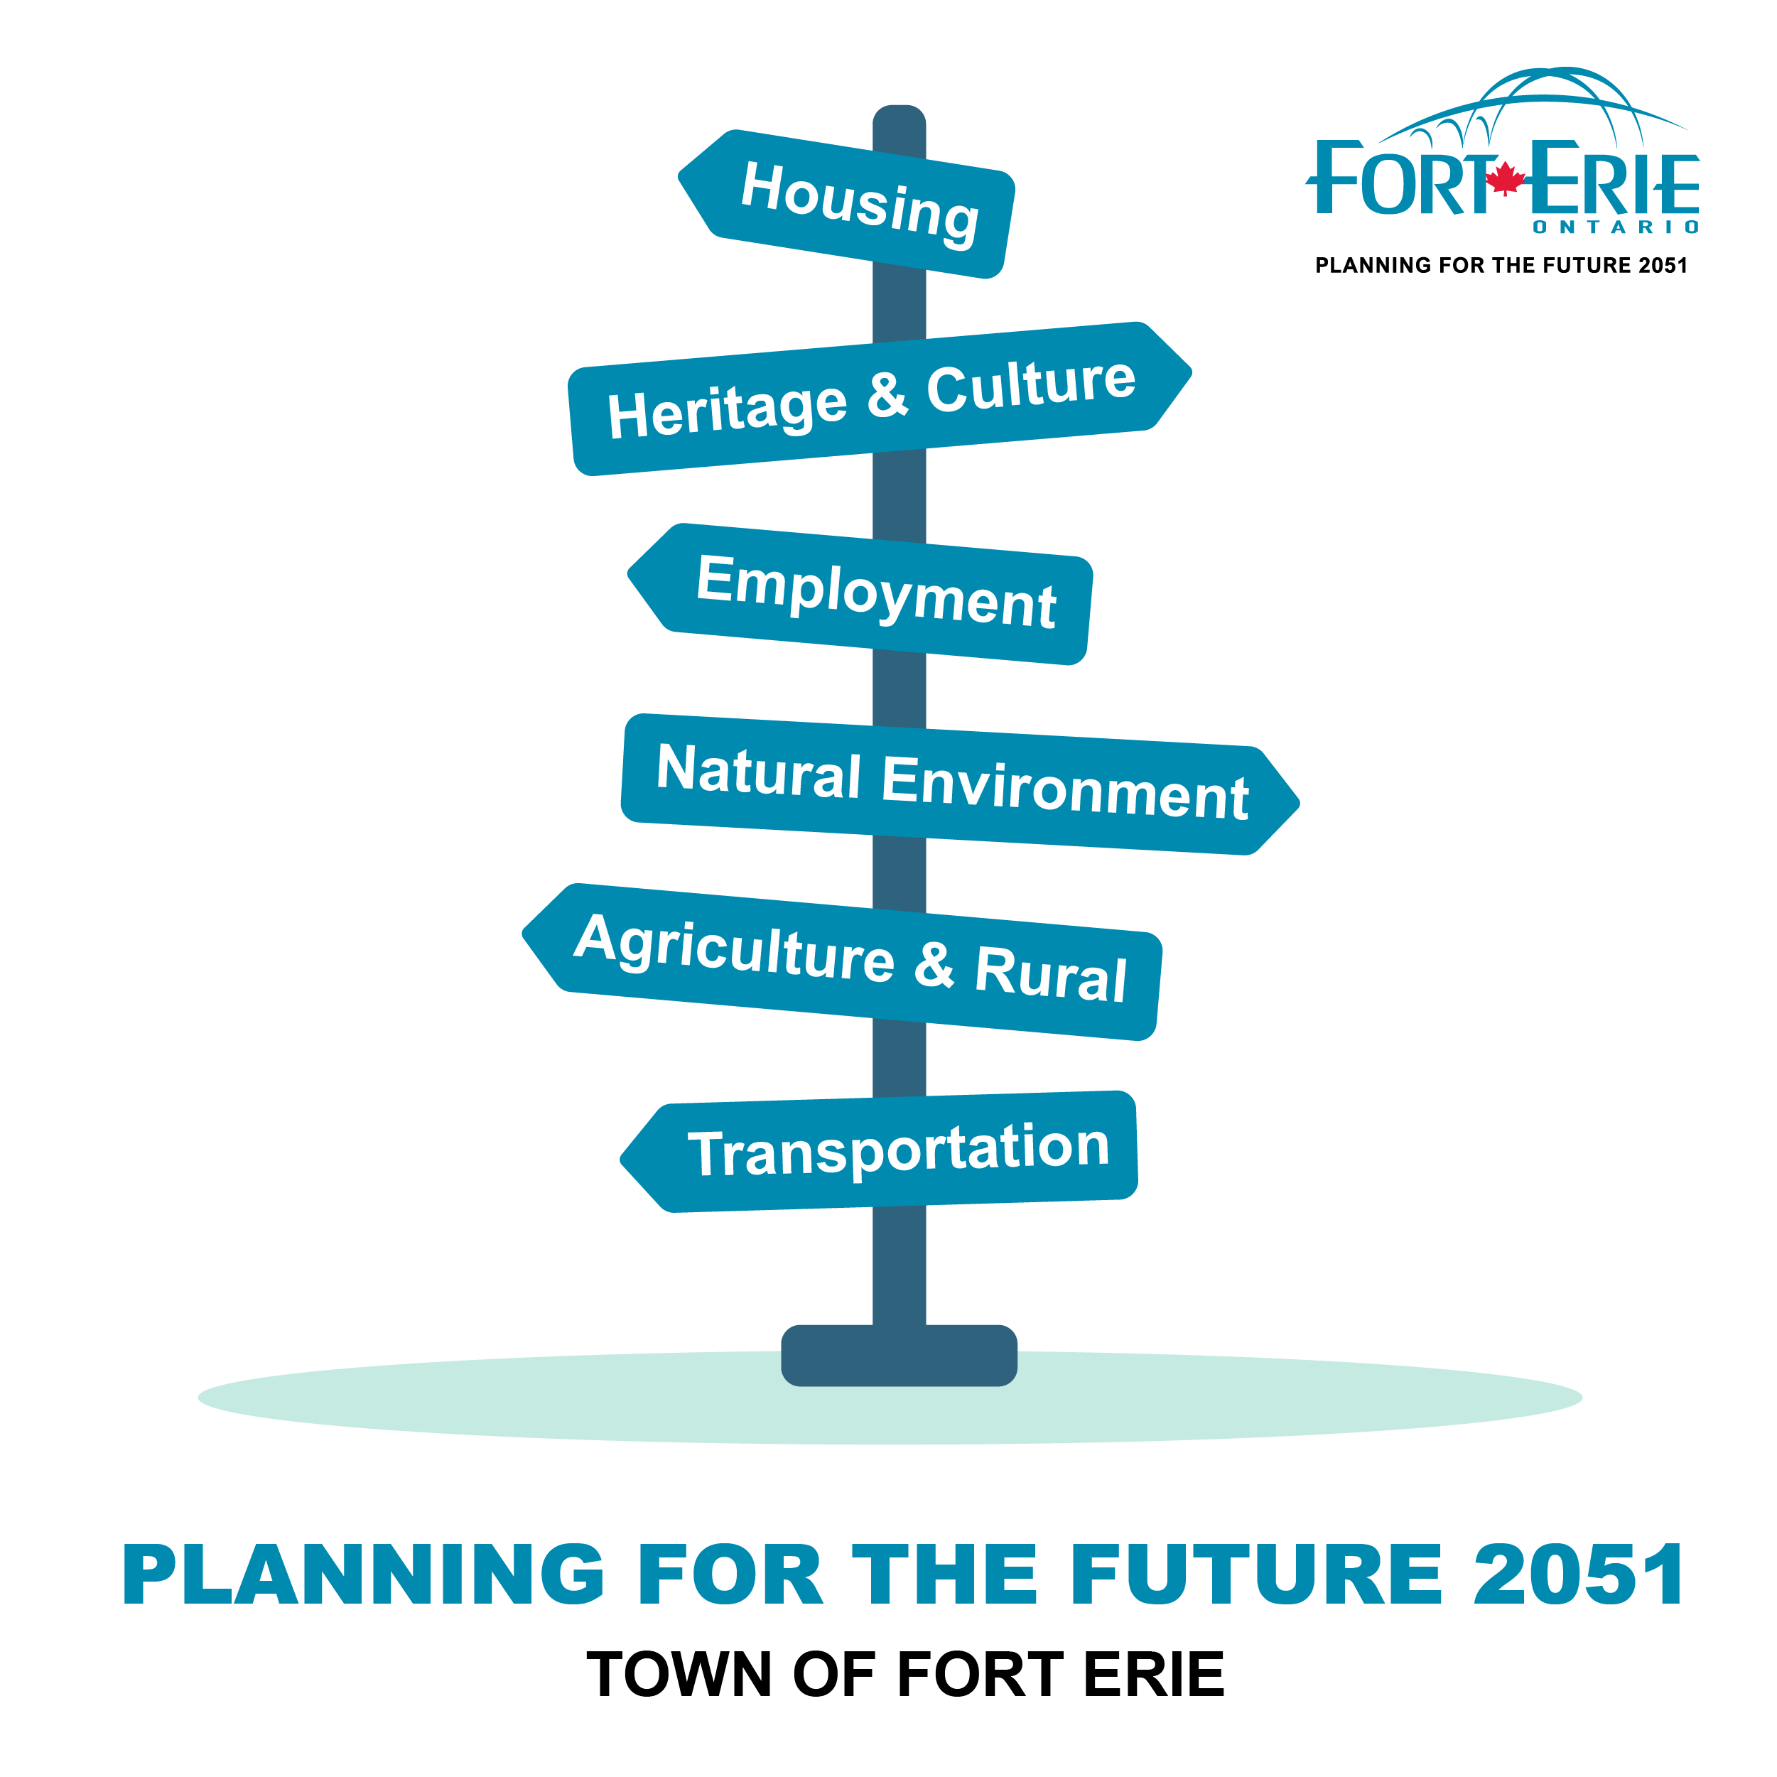
Today’s Public Open House
Required under the Planning Act
1
Receive feedback from the community
2
For informational purposes only
3

Slide 3
Presentation Outline
Official Plan Review Background and Status
Review of Draft Official Plan
Next Steps
Discussion

Slide 4
Official Plan Review

Slide 5
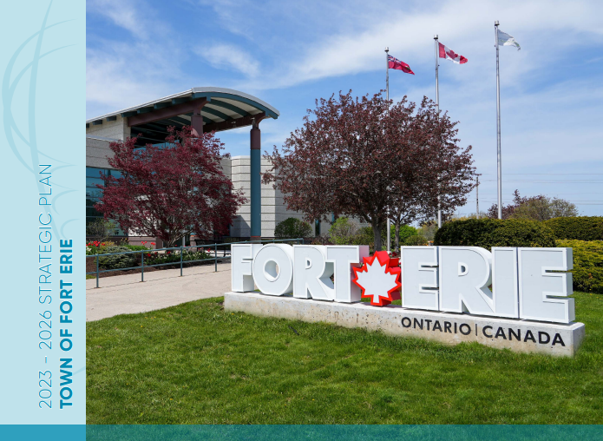

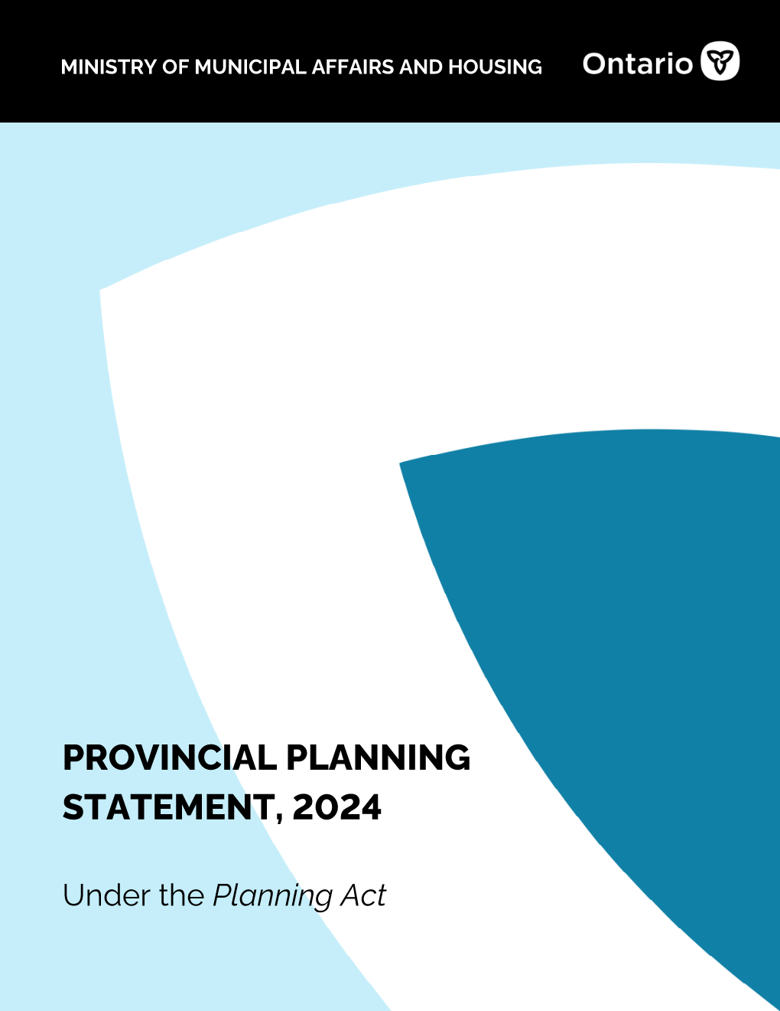
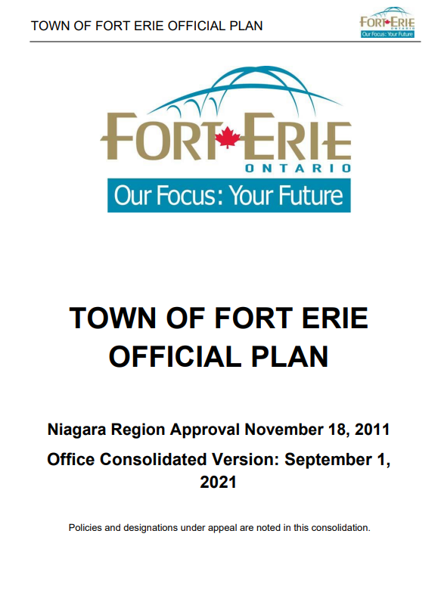
Purpose of the Official Plan Review
The Town’s current Official Plan was approved in 2011. The Planning Act mandates a review every 10 years and every 5 years thereafter.
Since 2011, many changes have occurred that impact land use planning in Fort Erie, such as demographic changes and the policy environment.
As of April 1, 2025, Niagara became an upper-tier municipality without planning responsibilities.
The Official Plan Review will result in updated policies that address evolving community needs, establishing a new vision for growth and change until 2051.

Slide 6




Official Plan Review Work Program
Phase 1
Phase 2
Phase 3
Engagement and Background Research
Background Research Report
Engagement Summary
Policy Development
Draft Official Plan
Public & Council Review and Phase 2 Engagement Report
Final Official Plan & Adoption
Council Adoption
Approval of the Final Official Plan
Fall 2023 – Spring 2024
Spring – Winter 2024/2025
Spring / Summer 2025
  We Are Here!

Slide 7
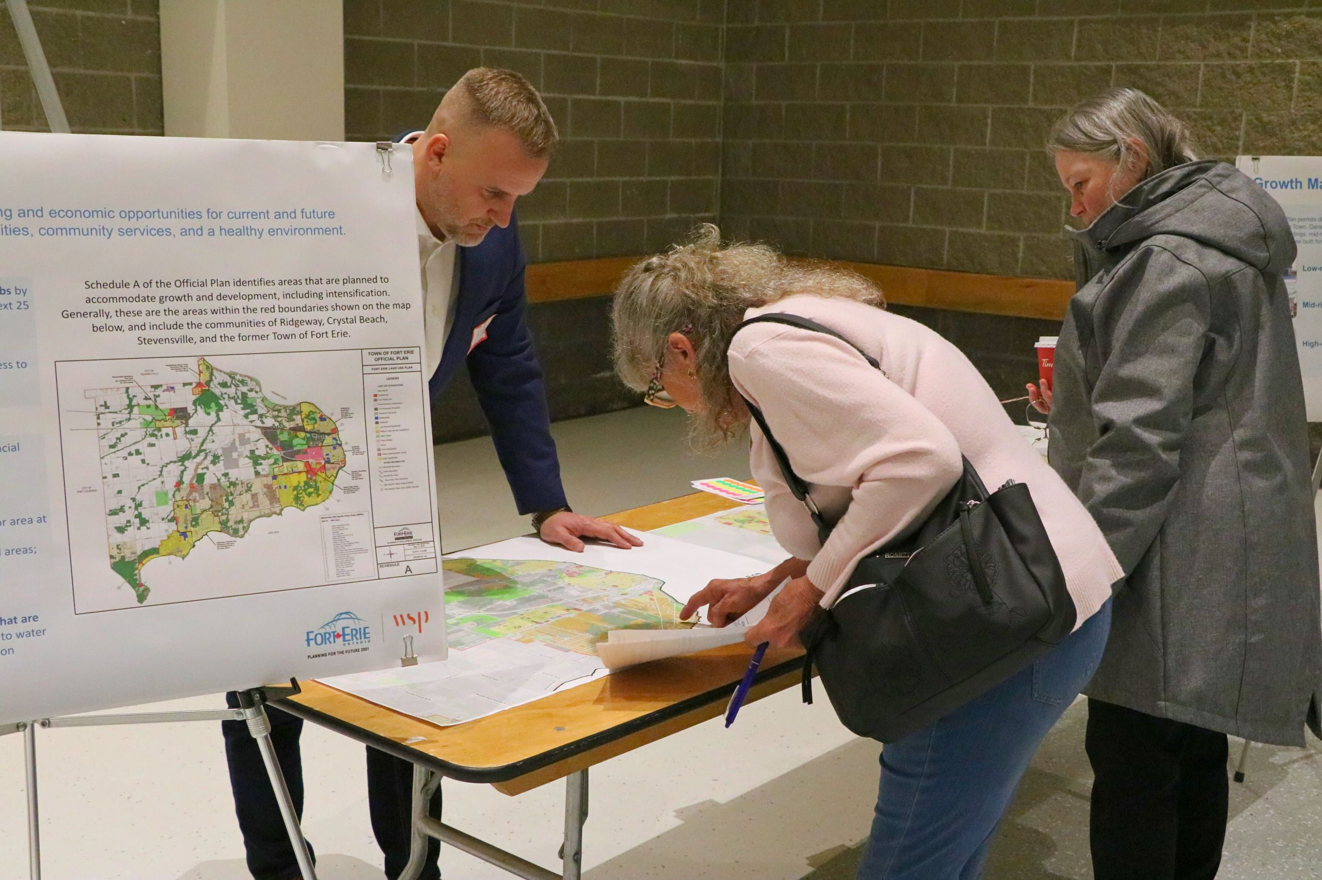

Consultation Overview
Consultation Activities
  Dedicated project webpage
  Vision Workshop and Survey
  Five (5) Planners in Public Spaces
  Public Open House
  Indigenous Consultation
  Technical Consultation with Region and Conservation Authority
  Phase 1 and Phase 2 Engagement Summary Report

Slide 8
Draft Official Plan

Slide 9
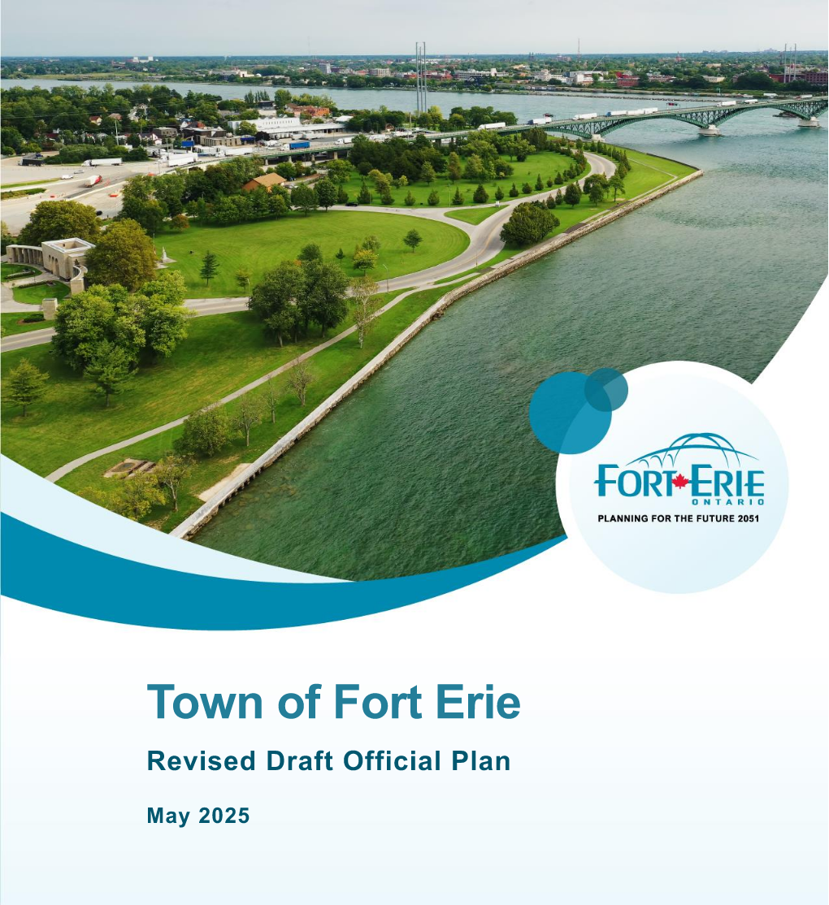
Draft Official Plan
General Overview and Organization
Components of the Official Plan:
Part A – Introduction
Part B – Vision and Guiding Principles
Part C – Growth Management
Part D – Land Use Designations
Part E – Complete Community
Part F – Implementation
Part G – Site Specific Policy Areas
Appendix I and Appendix II
Schedules A to M

Slide 10
Draft Official Plan
Part A: Introduction
What is Important:
Land Acknowledgement
Context on Fort Erie and the history of the Town
“Purpose of this Official Plan”, highlighting the role of the Official Plan in managing growth and change to the Year 2051
Organization of the Official Plan, with a section that describes how the Official Plan is organized
Interpretation of the Official Plan

Slide 11
Draft Official Plan
Part B: Vision and Guiding Principles
The Vision and Guiding Principles will establish broad direction for desirable land use planning matters outcomes in the Town of Fort Erie.
Vision Statement
  “Fort Erie will be an inclusive, welcoming and diverse community that balances growth with the natural environment and the agricultural base. The Town will promote walkable communities that support convenient access to retail and parks while enhancing connectivity throughout the Niagara Region. This Plan will guide the creation of accessible and safe spaces that promote a sense of community and recognize the Town’s unique history and heritage, while building a prosperous economy and providing a range of housing and employment options.

Slide 12






Draft Official Plan
Part B: Goals and Objectives
The Goals and Objectives of this Plan reflect the aspirations and priorities of the Fort Erie community and provide general direction for planning and development within the Town. The key policy areas are:
Housing
Natural Environment
Heritage and Culture
Agriculture and Rural
Employment
Transportation

Slide 13
Draft Official Plan
Part C: Growth Management
Managing Growth
What has changed?
The Town is projected to grow to 48,050 residents and 18,430 jobs by the year 2051
Need to plan for and accommodate 15,230 new residents between 2021 and 2051
That is about 508 new residents annually for 30 years
Over then next 30 years, the Town will require a greater range and mix of housing options
Dwelling Type | New Units Needed to Accommodate Growth 2021-2051
Single/Semi | 4,060
Row | 2,700
Apartment | 600
Total | 7,360

Slide 14

Draft Official Plan
Part C: Growth Management
Town Structure
Town Structure:
Settlement Areas
Rural Settlement Area
Countryside (Agriculture and Rural)
Natural Environment System
Conceptual Transit Corridor
Niagara to Greater Toronto Area Corridor
The Town structure functions as a framework to manage growth and development within the Town, directing development and land use activities in a manner that supports implementation of the Growth Management Strategy

Slide 15
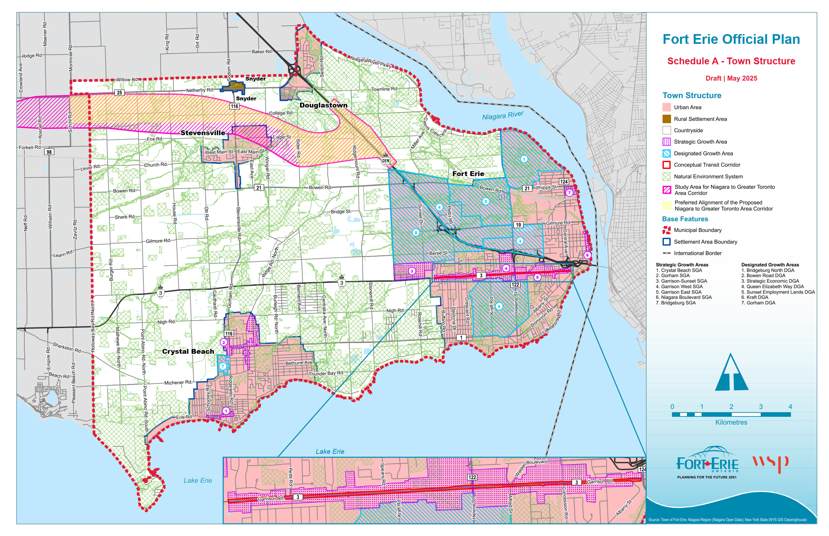

Slide 16
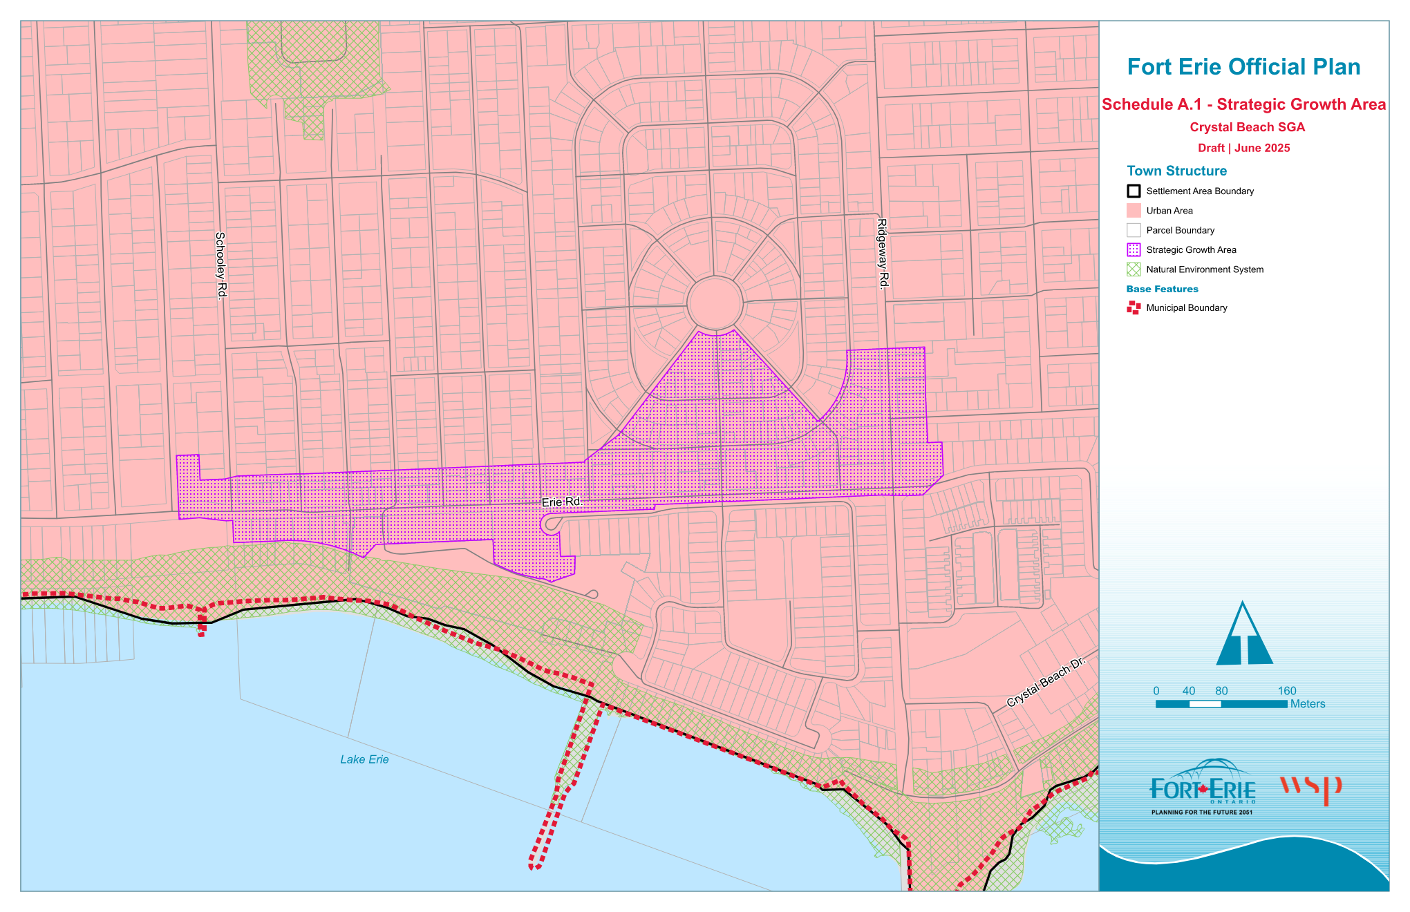
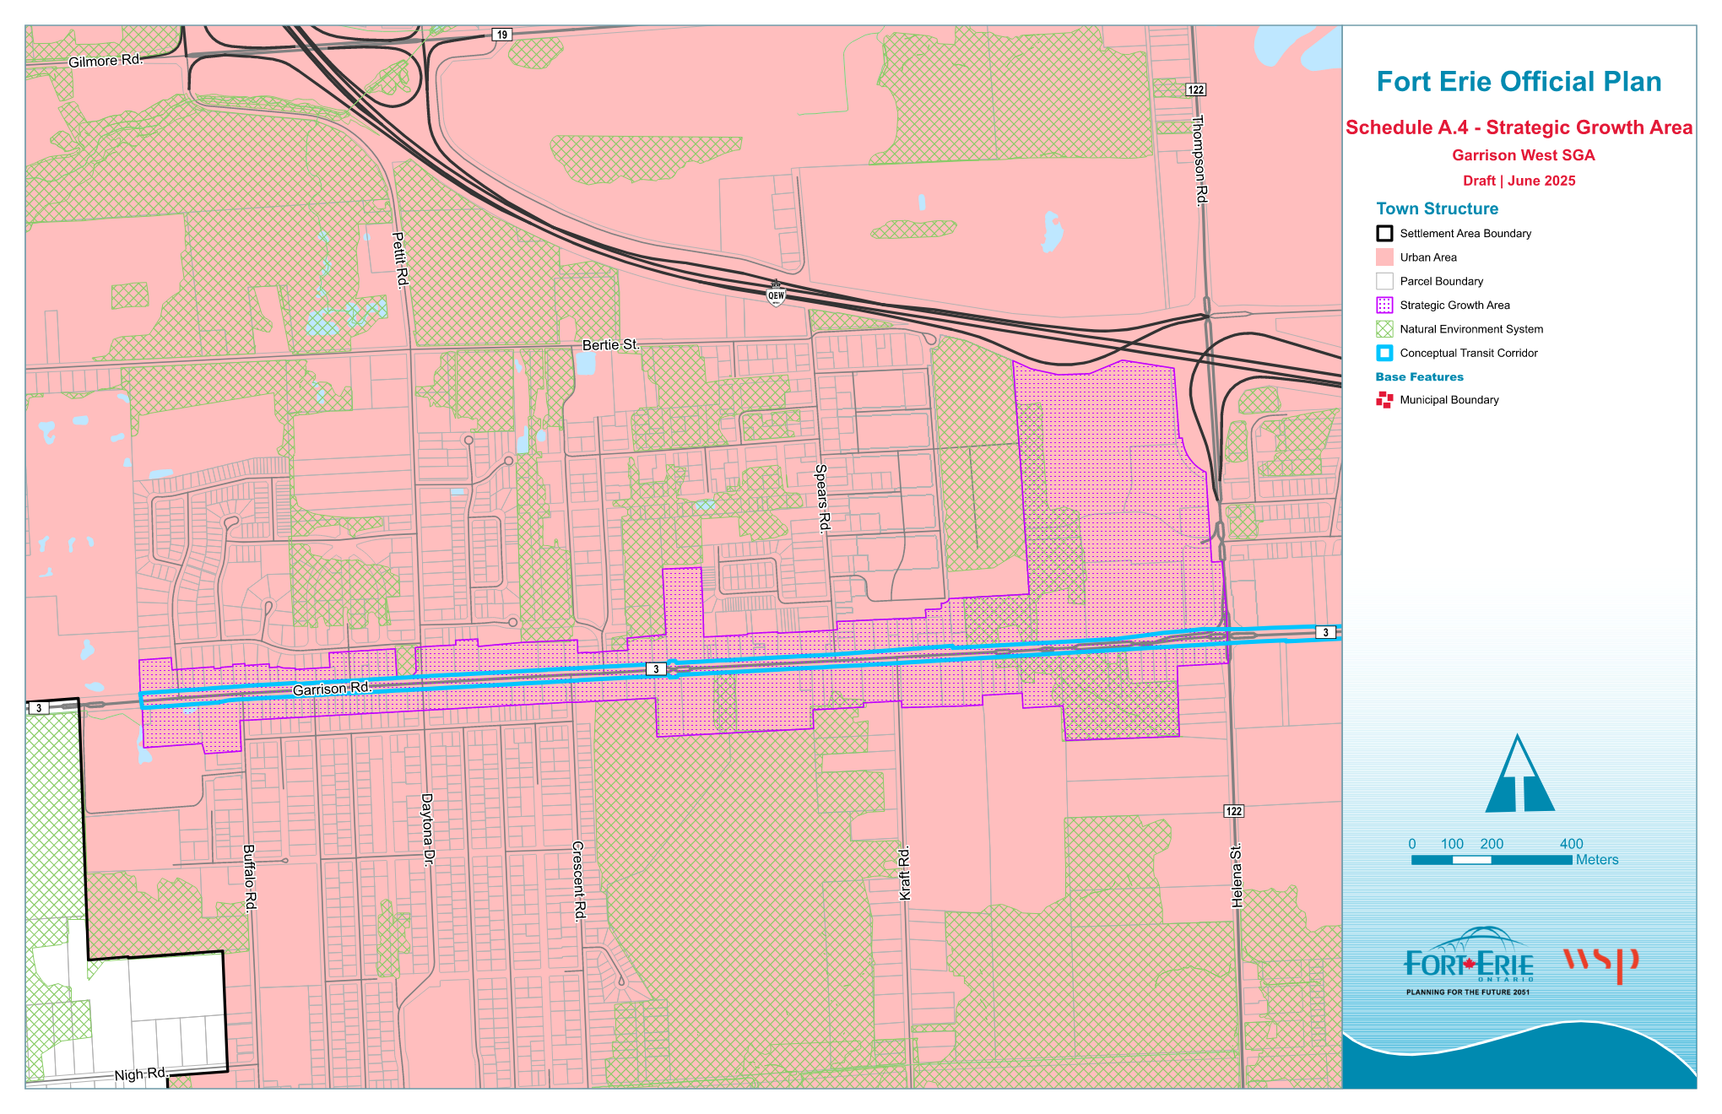
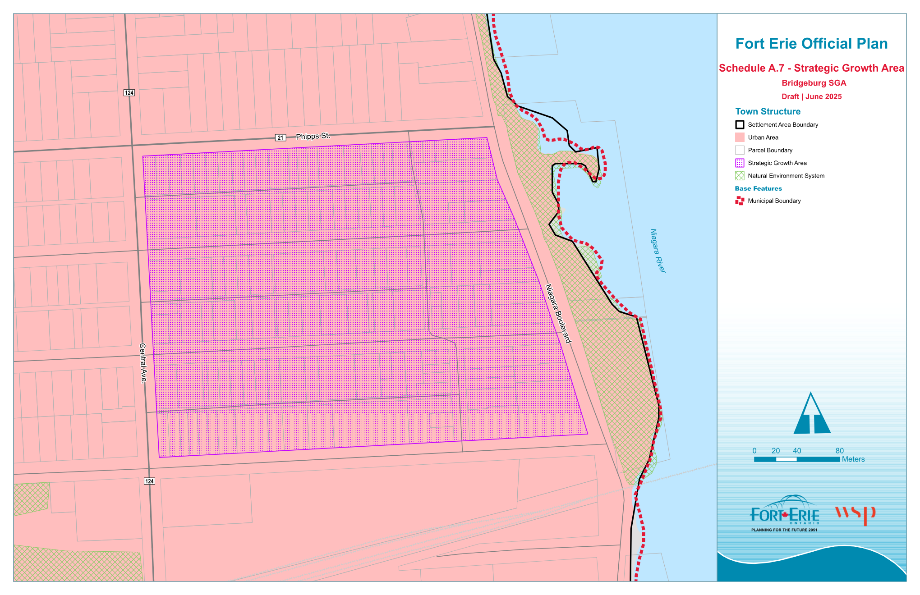
Draft Official Plan
Part C: Growth Management
Strategic Growth Areas
What is Important:
There are a total of seven Strategic Growth Areas proposed as shown on Schedules A, A1 to A7
Accommodate development, redevelopment and intensification
Planned as compact, complete, walkable communities with a concentration and mix of land uses, including everyday amenities
Provision of full municipal servicing and access to planned or existing transportation network
Additional opportunities for the Town to support implementation

Slide 17
Draft Official Plan
Part C: Growth Management
Built Form
What is Important:
Focuses more on appropriate scale, massing, setbacks, and design; all relative to surrounding land use context
Built Form is principally guided based on height and road classification, but is also subject to specific development criteria
The Built Form policies would take precedence over all Secondary Plans, except for the Crystal Beach Secondary Plan
Policy C.5.2
Road Classification | Permitted Built Form | Maximum Permitted Height
Local | Low-rise | Up to 3-storeys
Collector | Mid-rise | Up to 6-storeys
Arterial or Regional | High-rise | Up to 8-storeys*
* In the Garrison Road Strategic Growth Area and the Strategic Economic Area land use designation the maximum permitted height is 10-storeys.

Slide 18
Draft Official Plan
Before establishing a Community Planning Permit Area (CPPA) through a By-law, an Official Plan Amendment is needed.
This amendment must:
Identify the CPPS area;
Define the delegated authority;
Specify CPPA goals and policies;
Outline criteria and conditions, identify exempt developments;
Establish built form provisions, as well as affordable housing goals; and
List application requirements.
The Town may then establish a CPPS for one or more CPPAs via a By-law enacted by Council
Part C: Growth Management Planning Tools
Community Planning Permit System
The draft Official Plan enables a Community Planning Permit System (CPPS)
The CPPS is an additional implementation tool that may be used by the Town to ensure the goals, objectives and policies of the Official Plan are implemented.
The CPPS is intended to be a flexible planning tool that combines zoning, Site Plan Approval, and minor variance processes into a single development application

Slide 19
Draft Official Plan
Part D: Land Use Designations
Designations
Land use designations are shown on Schedule B
They are largely organized around the Town Structure
Provide direction to where lands will:
  Accommodate growth and redevelopment, including mixed use development
  Provide housing opportunities in residential community areas
  Permit commercial, employment and institutional uses
  Protect farmland and permit agriculture supportive uses
  Conserve, protect, and enhance the natural environment
  Provide for parkland and open spaces

Slide 20
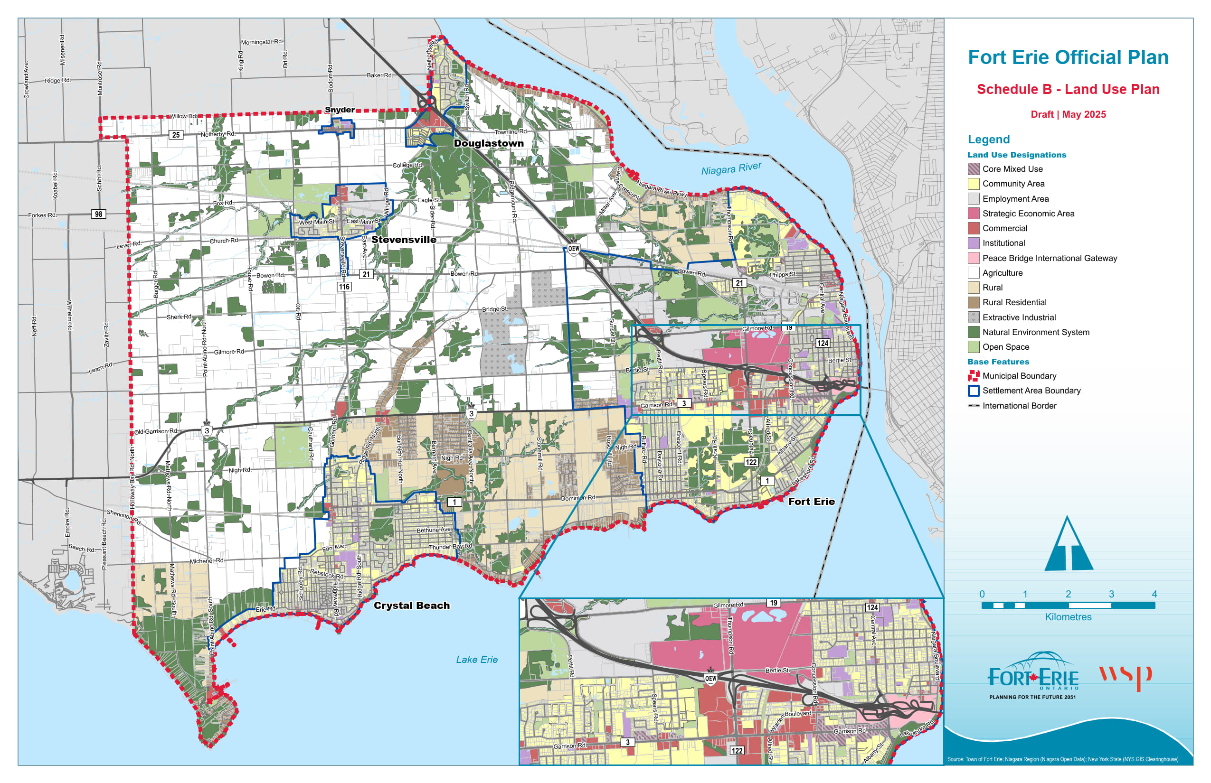

Slide 21
Draft Official Plan
Part D: Land Use Designations
Natural Environment System
Shown on Schedules C and D
Involved consultation with environmental planners, the Conservation Authority, and the Region
Comprised of different natural features, such as woodlands, wetlands, dunes, and supporting linkages, among others
Promotes conservation, enhancement, and restoration
Protects the natural environment system from incompatible development
Permits normal farm practices, as well as conservation related activities
Comprehensively reviewed and updated to align with Provincial direction and reflect an approach that recognizes the priorities of the community.

Slide 22
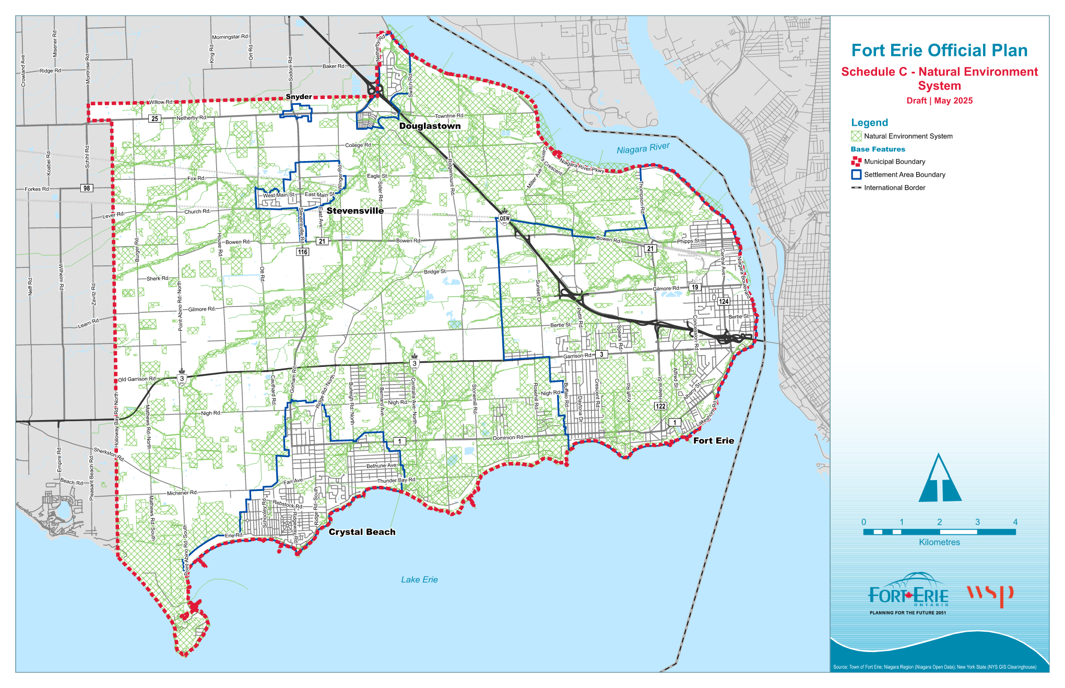

Slide 23
Draft Official Plan
Part E: Town-Wide Policies
Housing
What is Important:
Promotes a range of housing options to accommodate the evolving housing needs of the community
Policies on affordable housing to support the development of affordable and attainable housing
Encourages additional needs housing
Regulates short-term rental accommodations
New policies regarding additional residential units in alignment with provincial direction
Housing is an important priority for the community, as identified at the Visioning Workshop. The draft Official Plan includes many opportunities for the Town to increase housing options.

Slide 24
Draft Official Plan
Part E: Town-Wide Policies
Employment
What is Important:
Policies to align land use planning with economic development strategies to retain and attract investment
Updated policies to ensure employment areas have the necessary infrastructure and services
Updated minimum density targets for the employment areas
Ensure land use compatibility between employment areas and non-employment lands, in accordance with provincial direction
The draft Official Plan contemplates the long-term protection of employment areas from incompatible development that would hinder their planned function.

Slide 25
Draft Official Plan
Part E: Town-Wide Policies
Climate Change
What is Important:
Promote a compact built form, active transportation, and energy efficient design
New policies to protect the Town's tree canopy
Support the supply of water quantity and water quality, as well as energy conservation
Encourage the development of energy supply-related infrastructure facilities to accommodate current and projected needs
Policies of the draft Official Plan provide direction on opportunities through land use planning to respond to a changing climate through mitigation and adaptation.

Slide 26
Draft Official Plan
Part E: Town-Wide Policies
Cultural Heritage
What is Important:
Policies regarding a Municipal Heritage Register which includes all properties that are of significant cultural heritage value or interest
Identifies requirements for a Heritage Impact Assessment for alterations to heritage properties
Updated policies to identify and protect archaeological resources including new archaeological mapping, new requirements for the completion of an Archaeological Assessment, and a commitment to work with First Nations and Indigenous Communities
Feedback emphasized creating guidelines to identify heritage buildings and providing guidance to owners of designated heritage properties.

Slide 27
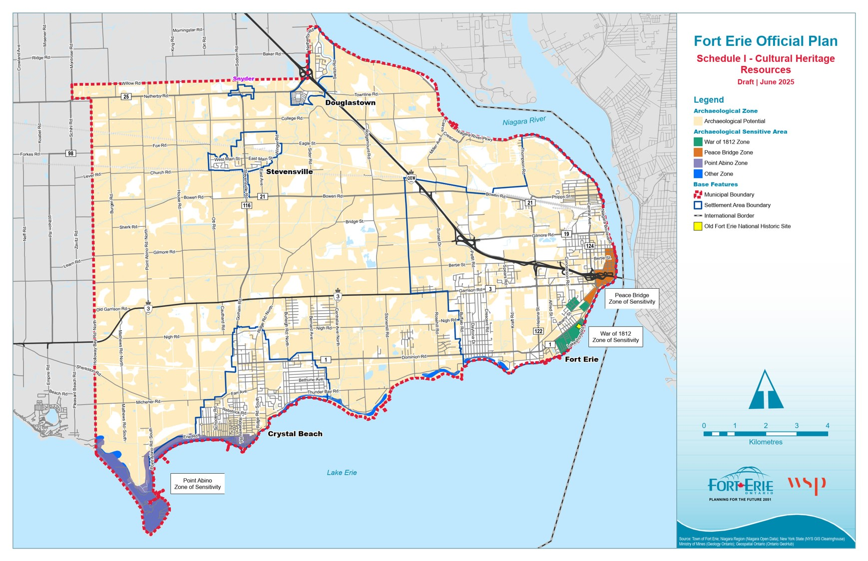
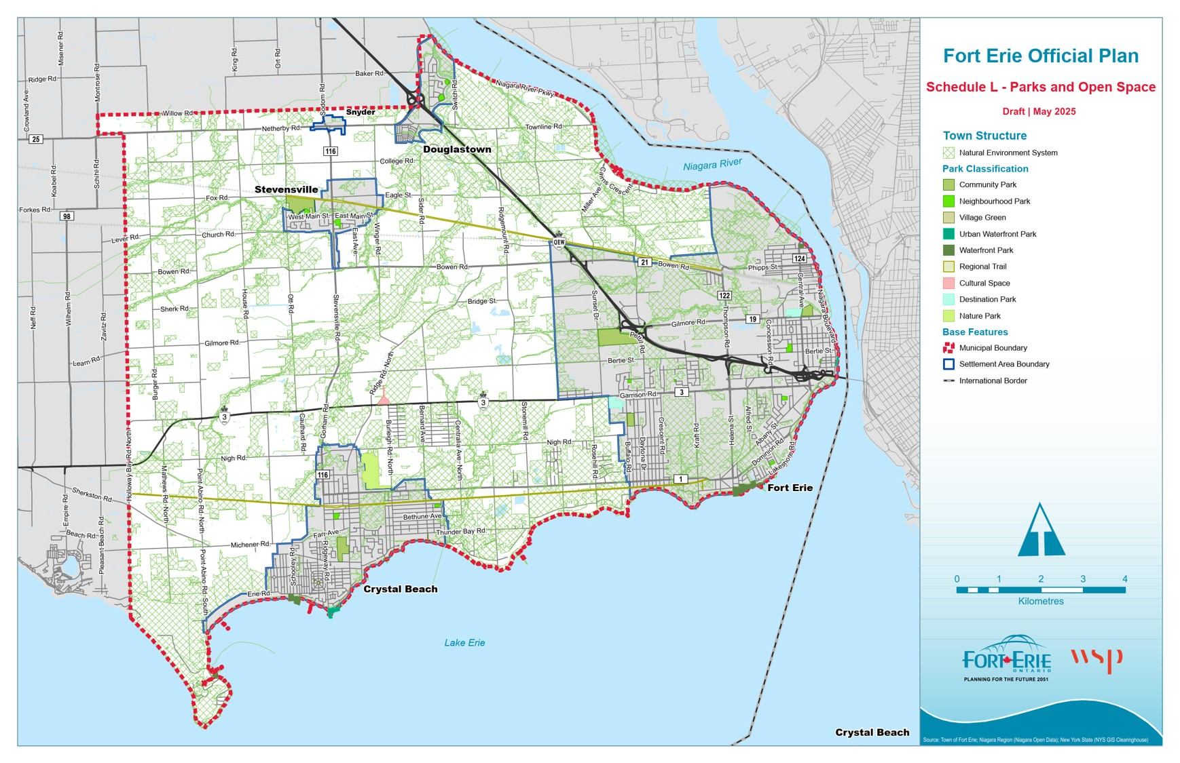
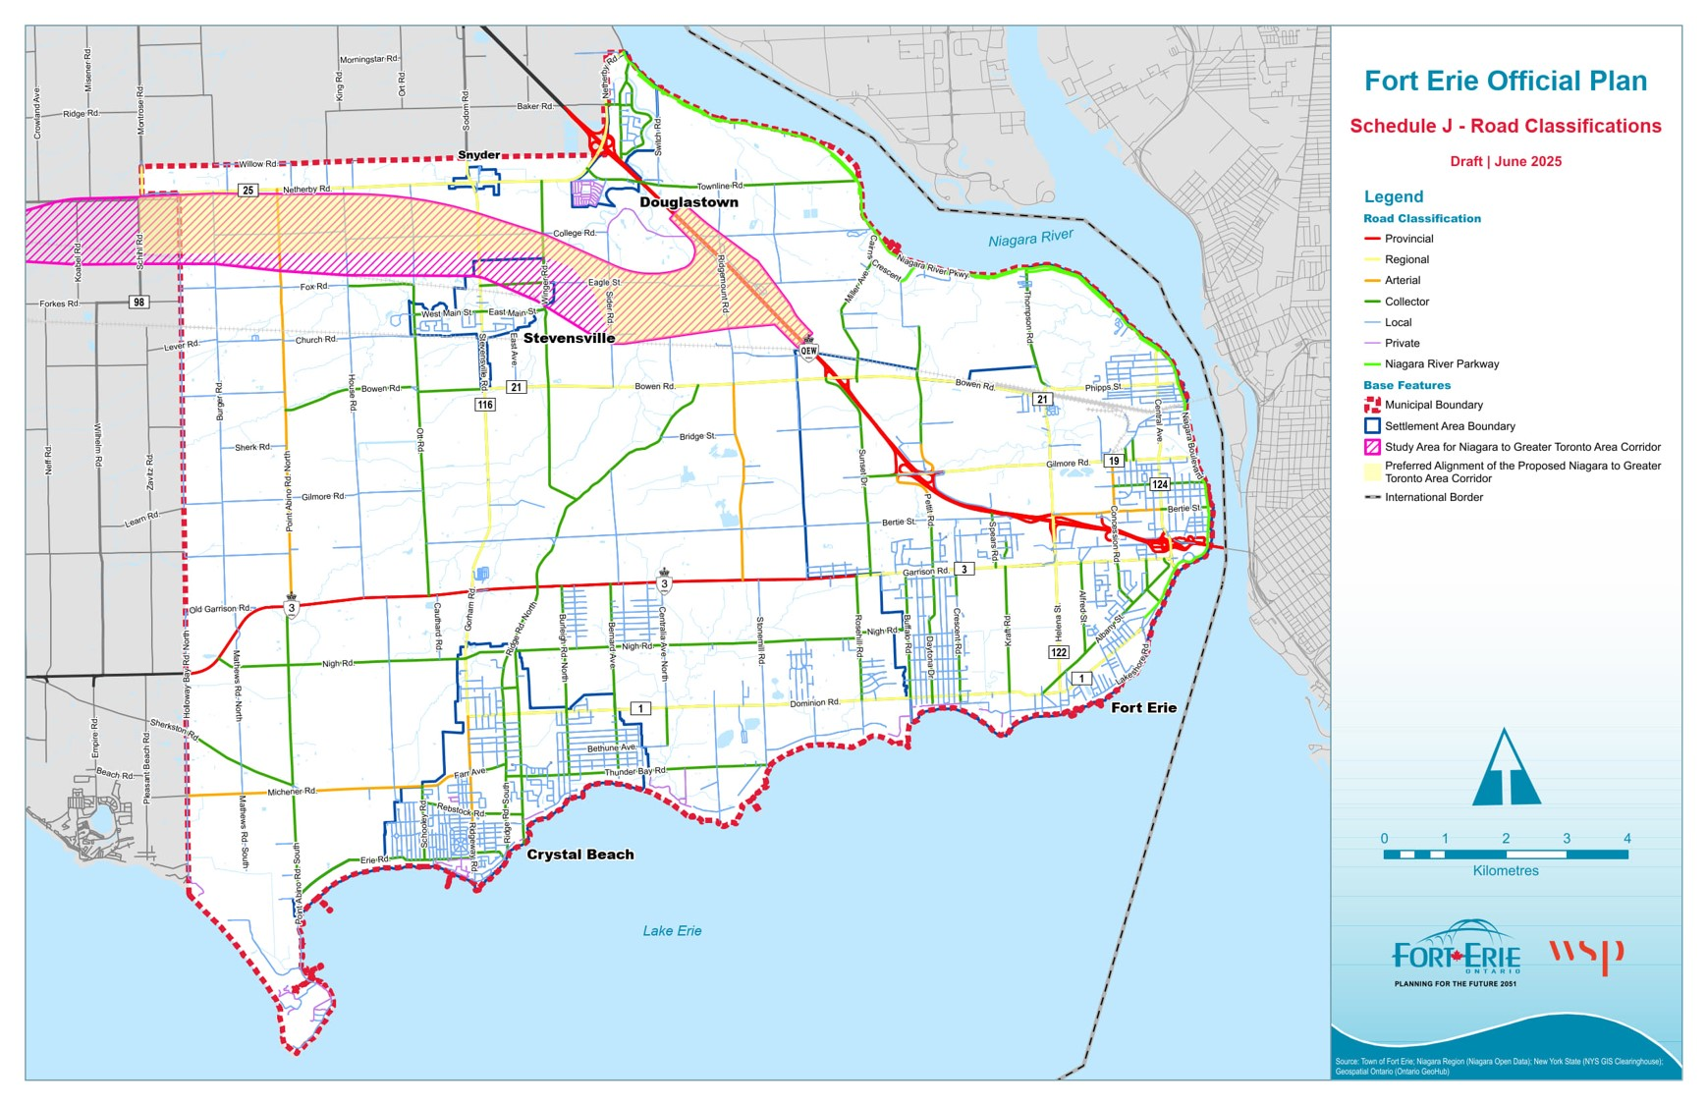
Draft Official Plan
Part E: Town-Wide Policies
Additional Policies
What is Important:
Agriculture
Community Design
Open Space and Parkland
Transportation and Mobility
Infrastructure and Servicing
Community and Public Service Facilities
Natural and Human Made Hazards

Slide 28
Draft Official Plan
Part F: Implementation
What is Important:
Duty to Consult, Public Participation and Public Meetings
Settlement Area Boundary Expansion criteria to align with Provincial direction
Implementation tools, such as community planning permit system (CPPS)
Complete Application Requirements, and Planning Act applications
Official Plan monitoring, review, and update
Interpretation and glossary

Slide 29
Next Steps

Slide 30
Next Steps
Statutory Public Meeting (June 9, 2025)
Review public comments and feedback
Final Official Plan for Council Adoption (Summer 2025)
Submit to Province for approval

Slide 31
Thank You!

