Slide 1

Town of Fort Erie Official Plan Review
Welcome to tonight’s Visioning Workshop!
February 27, 2024

Slide 2
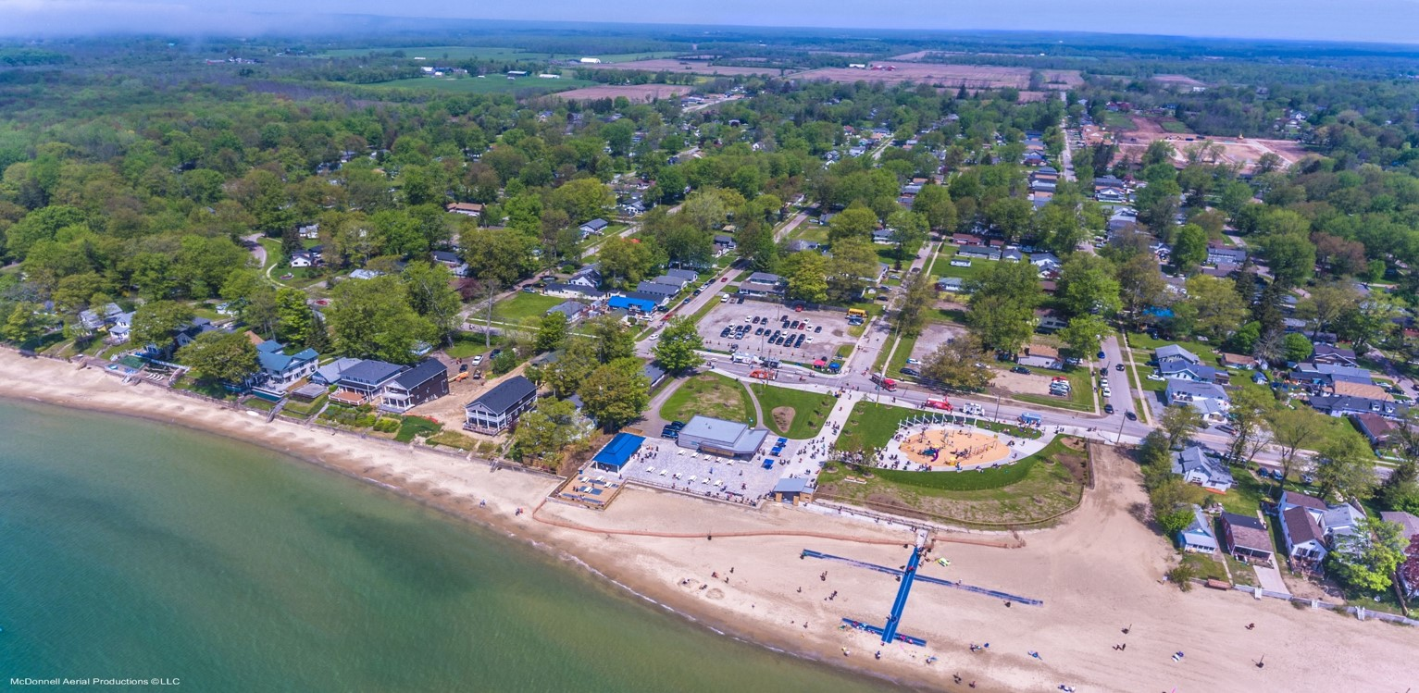
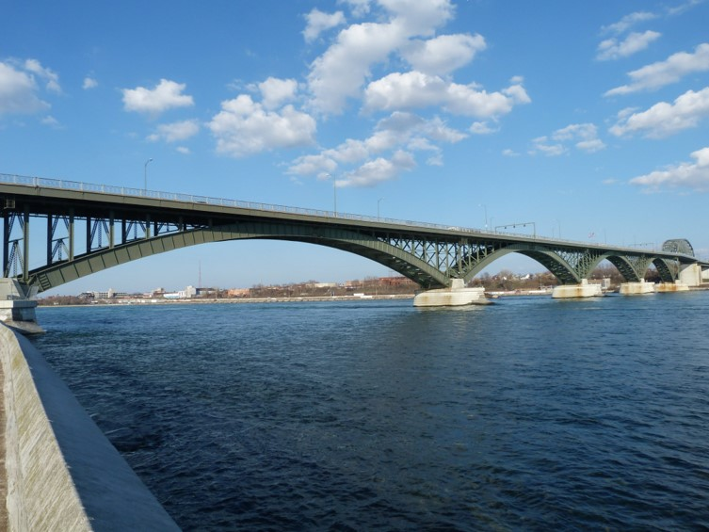
Tonight’s Agenda
Welcome: 5:00p.m. – 5:15p.m.
Presentation: 5:30p.m. – 5:50p.m.
Visioning Activities: 5:15p.m. – 6:50p.m.
Closing Remarks: 6:50p.m. – 7:00p.m.

Slide 3




The Project Team
Town of Fort Erie
WSP
(Lead Consultant)
Daniel & Partners LLP
(Sub-Consultant)
Parcel Economics
(Sub-Consultant)

Slide 4
Purpose of Today’s Workshop
Introduce the Town of Fort Erie Official Plan Review
1
Update on worked completed so far
2
Hear from you!
3

Slide 5





What is an Official Plan?
An Official Plan is a strategic land use planning policy document that contains a series of goals, objectives, and policies that work together to shape development and guide land use planning decisions. It addresses a range of topics, including, but not limited to:
  Housing
  Employment
  Agriculture
  Natural heritage
  Economic
  development
Official Plan policies are accompanied by a series of maps or schedules which show where different policies apply.
An Official Plan is required to be consistent with the Provincial Policy Statement (PPS) and conform with all applicable Provincial and Regional plans and policies.

Slide 6
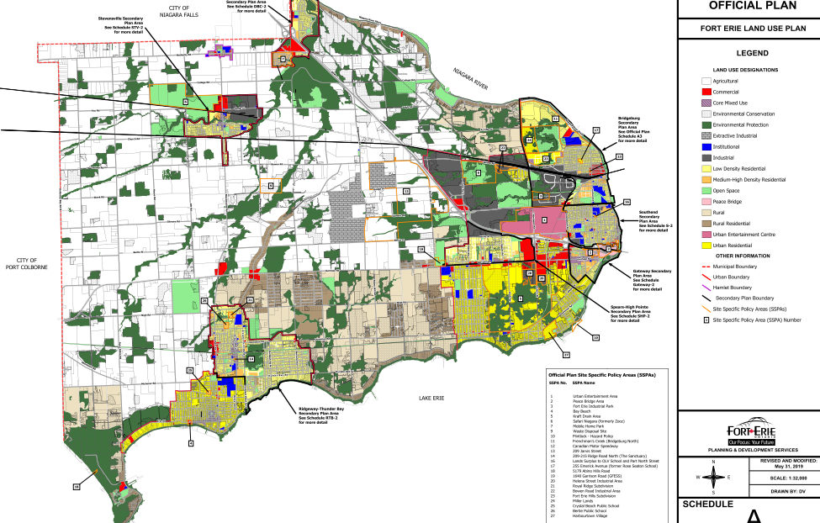
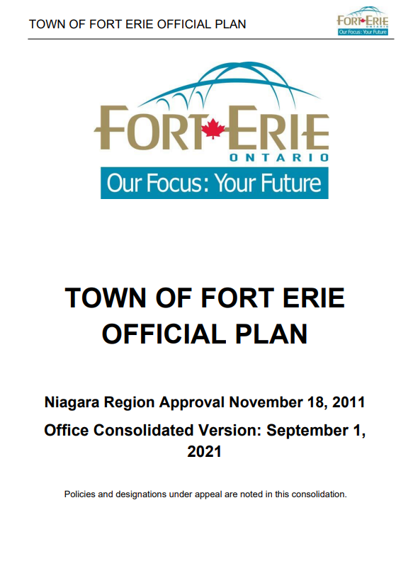
Current Official Plan
The Town’s current Official Plan was approved in 2011. It identifies 12 key policy areas and develops a series of goals and objectives for each one. These include objectives related to urban design, neighbourhood plans and the protection of agriculture. Each objective is supported by specific policies.
The Plan provides policies to guide decisions related to:
Development;
Roads and transportation;
Archaeological resources and built heritage;
Aggregate and petroleum resources; and,
Application processing policies.
The schedules in the Plan illustrate:
Land Use;
Mineral Aggregate and Petroleum Resources;
Natural Heritage Features;
Natural Hazards & Fish Habitats;
Cultural Heritage Archeological Zones; and
Transportation Plans

Slide 7
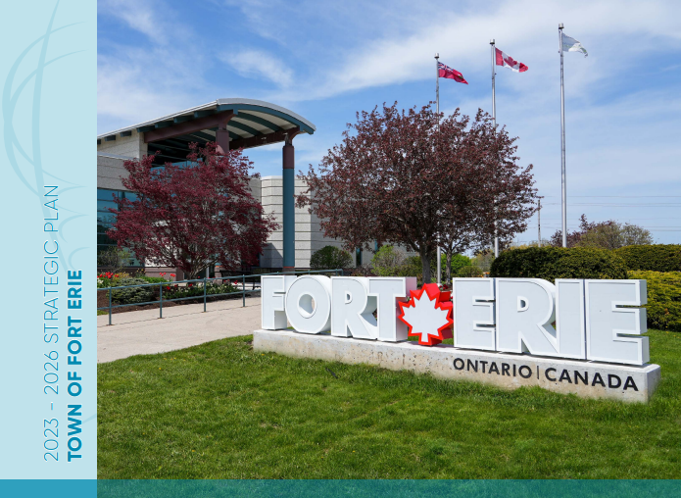
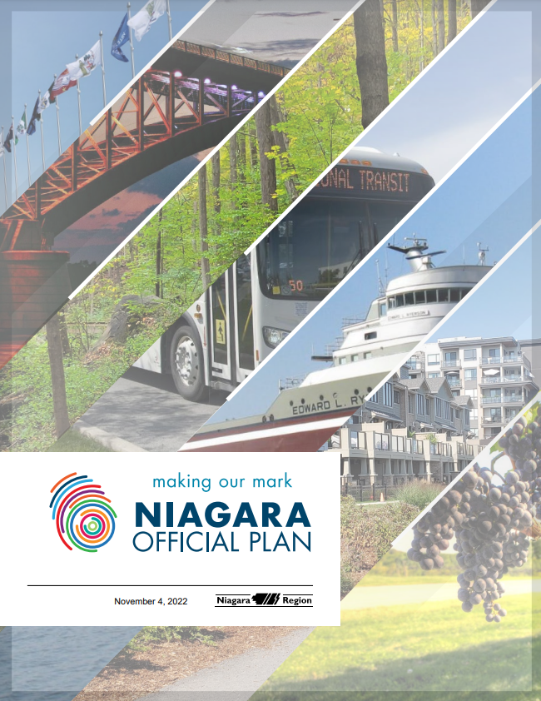
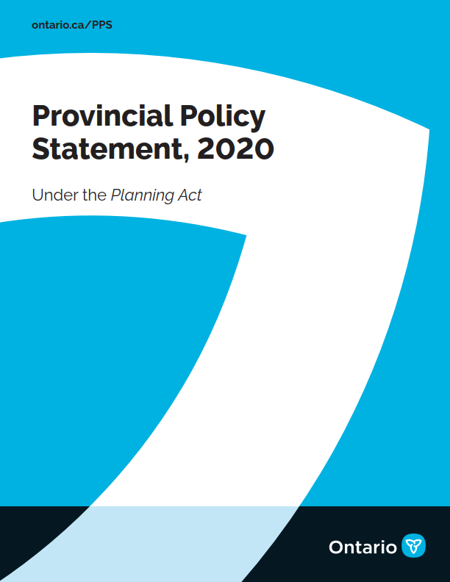
Purpose of the Official Plan Review
The Planning Act requires a review of a new plan no less than 10 years after it comes into effect, and every 5 years thereafter.
Changes to provincial and regional land use planning policy has occurred since the Town’s Official Plan was adopted in 2011, such as the Niagara Official Plan approved in November 2022.
This project represents an opportunity to review the entire document to ensure that it aligns with the most recent direction.
The Official Plan Review also creates an opportunity to consider the changing local context and ensure that the evolving needs and priorities of the community are met.
The Town’s updated Official Plan will establish a new vision and supporting policy framework for how growth and change will be managed to the year 2051.

Slide 8




Official Plan Review Work Program
Phase 1
Phase 2
Phase 3
Engagement and Background Research
Background Research Report
Engagement Summary
Policy Development
Draft Official Plan
Public & Council Review and Phase 2 Engagement Report
Final Official Plan & Adoption
Council Adoption
Approval of the Final Official Plan
Fall 2023 – Spring 2024
Spring – Summer 2024
Fall – Winter 2024
  We Are Here!

Slide 9
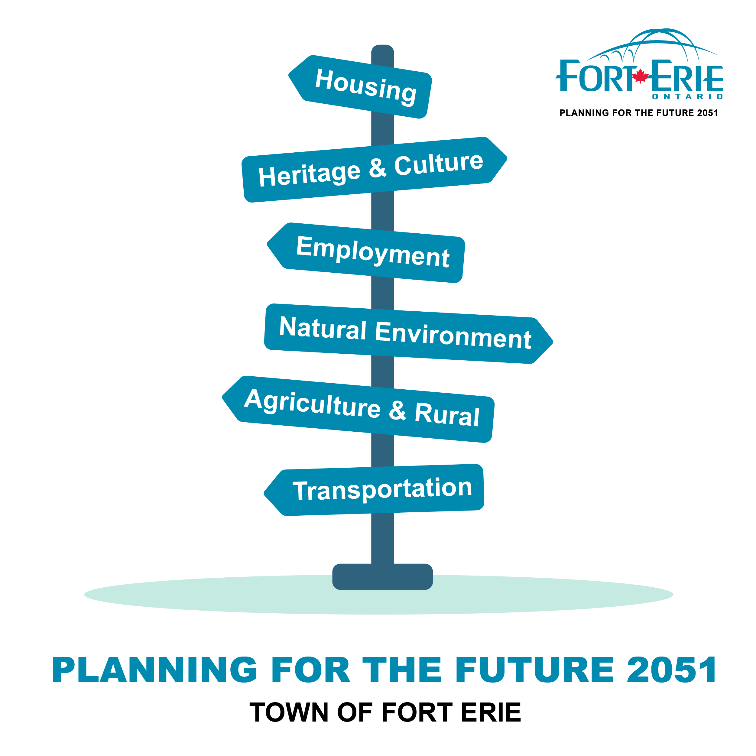
Work Completed to Date
Phase 1: Background Research and Reporting
  Online public launch – October 13, 2023
  Background Review Report underway, which will include:
    Big Moves (Issues & Options Themes)
    Conformity Review/Gaps & Opportunities Analysis
    Vision and Guiding Principles
    Rationalize Population, Employment and
    Household Growth Forecasts
    Affordable Housing Analysis
    Engagement Summary

Slide 10
Official Plan Review Engagement Strategy
Phase 1 Consultation Cluster
Phase 2
Consultation Cluster
Phase 3
Consultation Cluster
Online webpage launch
Indigenous community outreach
Agency and Ministry meetings
Visioning workshop and survey
Webpage updates
Indigenous community outreach
Public Open House
Webpage updates
Indigenous community outreach
Statutory Public Open House

Slide 11
Vision and Guiding Principles
A vision statement and guiding principles express the intent of future change and provide a basis for policy development – ensuring that all aspects of an Official Plan work together.
A vision statement tells a story about a community’s long-term views and aspirations for the future. It reflects core values, qualities, and characteristics of a community.
To realize the vision statement, guiding principles set out more specific directions or goals for enhancing or protecting the community’s core values, qualities, and characteristics over the long-term.
Vision Statement
Guiding Principles
Official Plan Policies

Slide 12
Today’s Workshop
There are a series of stations throughout the room, where you will be asked to provide your ideas and input. The Project Team will be available for questions and discussion!
Some questions which you may want to reflect on…
What is your vision for the future of Fort Erie?
What are your favourite things about Fort Erie today?

Slide 13
Next Steps
Online Vision Survey
Release of Background Report and Phase 1 Engagement Summary
Prepare Draft Official Plan
Phase 2 Consultation

