Slide 1
Town of Fort Erie Official Plan Review
Welcome to the Statutory Public Open House
June 2, 2025
Please Sign-in and Join Us

Slide 2
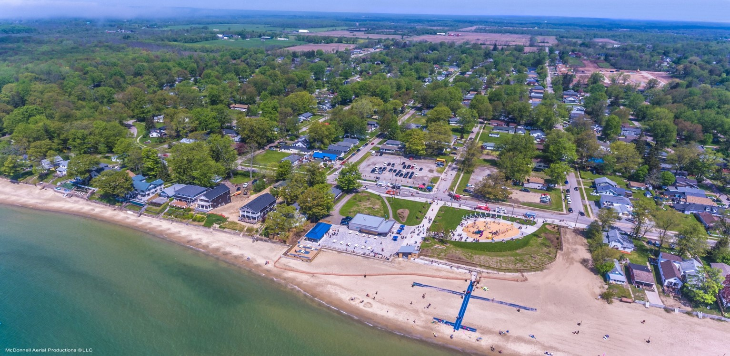
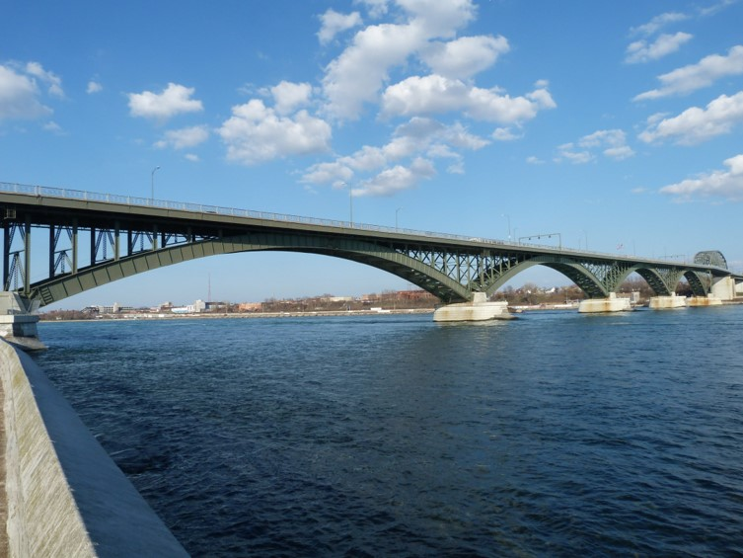
Tonight’s Agenda:
Town of Fort Erie
Official Plan Review
Welcome: 6:00pm – 6:15pm
Presentation: 6:15pm – 6:45pm
Open House: 6:45pm – 8:00pm
Members of the Project Team are in attendance to answer questions. You are also encouraged to complete the comment form.

Slide 3
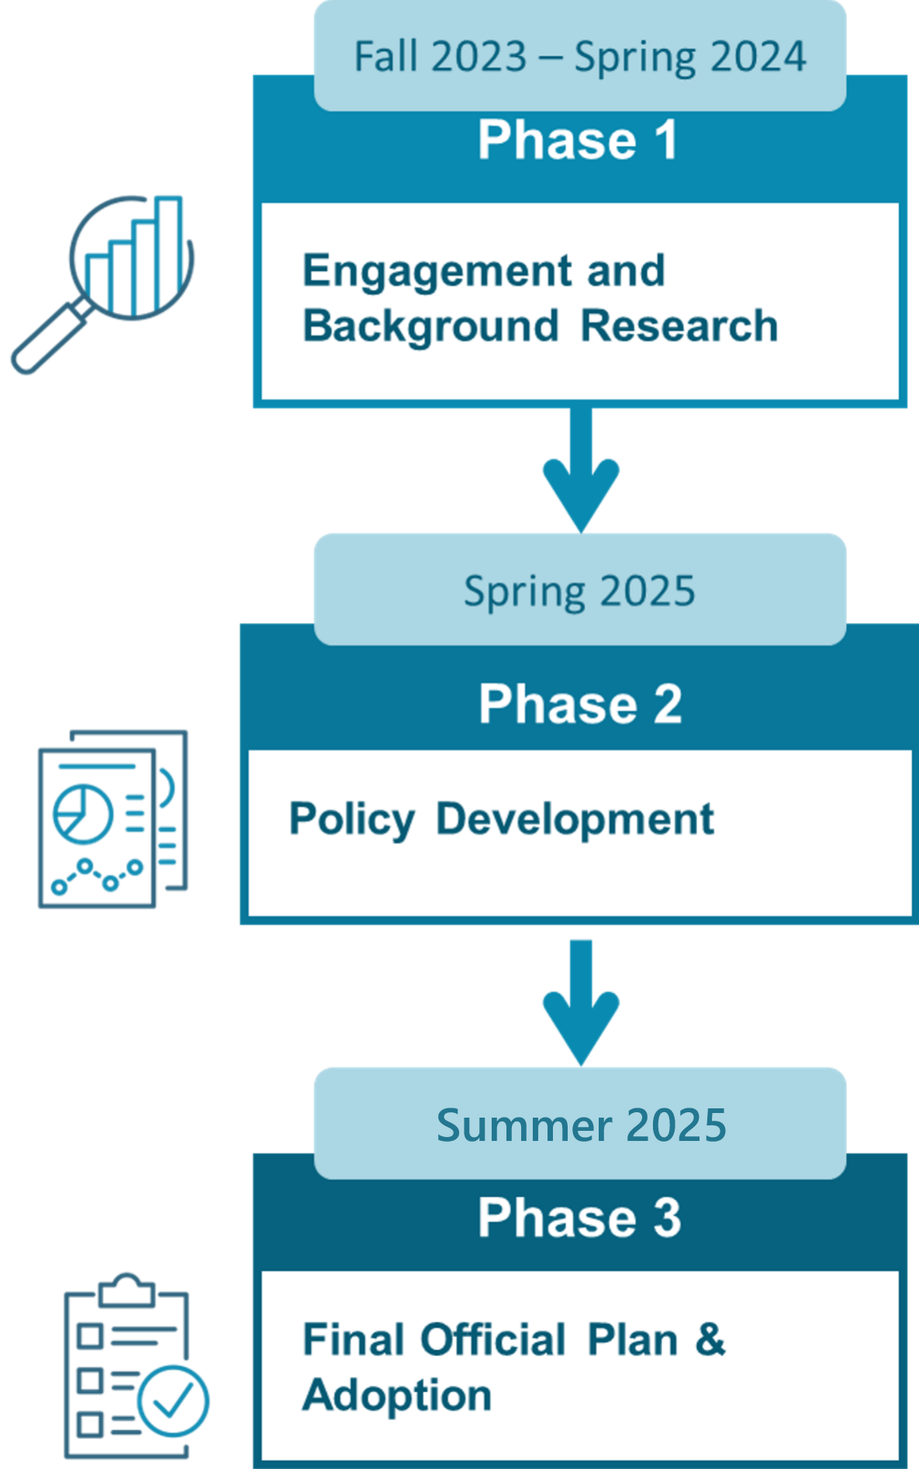

Project Work Plan and Milestones
Previous Milestones
Phase 1
Background Report
Growth Management and Housing Needs Assessment
Visioning Workshop
Phase 1 Engagement Summary
Phase 2
Draft Official Plan
Public Open House
Council Workshop
Phase 2 Engagement Summary
Draft Official Plan
  We Are Here!

Slide 4
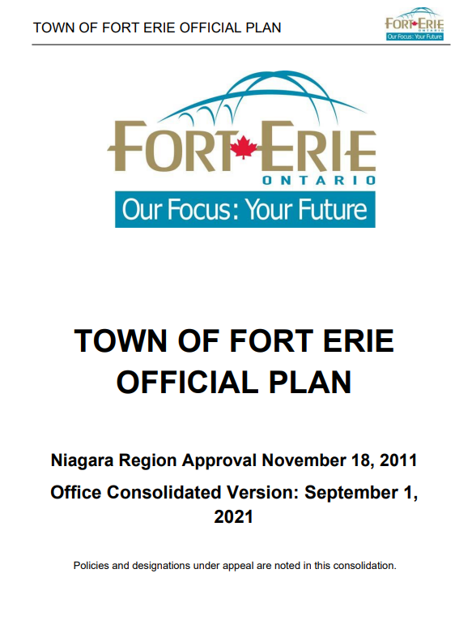
What is an Official Plan?
Provincial Planning Statement, 2024
On October 20, 2024, the Province released the Provincial Planning Statement, 2024 (PPS).
The PPS provides direction to planning authorities across the Province regarding matters of provincial interest regarding land use, such as housing, employment, infrastructure, agriculture, the environment, and climate change, among others.
The Province is the approval authority for the Town’s updated Official Plan, and policies of the Official Plan must be consistent with the PPS.
What is an Official Plan?
An Official Plan is a strategic land use planning policy document that contains goals, objectives, and policies that guide and manage growth and development over the long term. In other words, an Official Plan helps shape our communities and makes them great places to live, work, and play as the community continues to grow and evolve.
  Why Undertake the Official Plan Review?
  The Town’s current Official Plan was approved in 2011. It provides direction on matters such as what types of land uses are permitted and where, housing, economic development, agriculture, and the protecting the natural environment, among other important community building topics.
  The Official Plan Review provides an opportunity to consider the changing local context and ensure that the evolving land use planning priorities of the community are considered, such as housing, the environment, and climate change, for example. The updated Official Plan will ensure that the Town’s land use planning framework is aligned with Provincial direction, including the Provincial Planning Statement, 2024.

Slide 5


Part B: Vision for the Town of Fort Erie
The Vision and Guiding Principles will establish broad direction for desirable land use planning outcomes in the Town of Fort Erie.
The Proposed Vision Statement reads:
  “Fort Erie will be an inclusive, welcoming and diverse community that balances growth with the natural environment and the agricultural base. The Town will promote walkable communities that support convenient access to retail and parks while enhancing connectivity throughout the Niagara Region (“Region”). This Plan will guide the creation of accessible and safe spaces that promote a sense of community and recognize the Town’s unique history and heritage, while building a prosperous economy and providing a range of housing and employment options.”

Slide 6
Part B: Official Plan Goals and Objectives
The Goals and Objectives of the Official Plan reflect the aspirations and priorities of the Fort Erie community and provide general direction for planning and development within the Town.
1
2
3
Housing: The Town of Fort Erie offers a range and variety of housing options required to meet the current and future needs of its residents.
Heritage and Culture: The Town of Fort Erie celebrates its built heritage resources and cultural heritage landscapes and plans for their conservation and long-term preservation.
Employment: The Town of Fort Erie is comprised of a prosperous, and robust economy that provides meaningful employment opportunities while contributing to the quality of life of its residents.
4
5
6
Natural Environment: The Town of Fort Erie is home to a healthy, diverse, and resilient natural environment system that will be safeguarded over the long-term and is recognized as integral to climate change adaptation and mitigation.
Agricultural and Rural: The Town of Fort Erie values the agricultural and rural land base as an economically thriving, and sustainable industry, while being integral to the local food network and broader provincial agricultural system.
Transportation: The Town of Fort Erie seeks to ensure communities and neighbourhoods are well connected through a multi-modal transportation system that contributes to the safe and efficient movement of people and goods.

Slide 7

Part C: Growth Management
Projected Population, Employment and Household Growth to the Year 2051
What is Growth Management?
Simply put, growth management is an approach to ensure that the Town continues to grow in a responsible manner, having regard for the everyday needs and priorities of the community, including housing, employment, the natural environment, and human services, among others, all while doing so in a fiscally sustainable manner.
The Town is Growing…
The Town of Fort Erie is projected to grow to 48,050 residents and 18,430 jobs by the year 2051.
This means the Town will need to:
Plan and accommodate future household and employment forecasts.
Encourage a range and mix of housing options, employment opportunities, and everyday amenities to be a complete, inclusive, and accessible community.
Population and Employment Growth to 2051
Population | 48,050
Employment | 18,430
Households | 21,510
Dwelling Type | New Units Needed to Accommodate Growth 2021-2051
Single/Semi | 4,060
Row | 2,700
Apartment | 600
Total | 7,360

Slide 8
Part D: Town Structure
Components of the Town Structure such as Settlement Areas, Strategic Growth Areas, and the Natural Environment System are shown on Schedule A. Components of the Town Structure include:
Settlement Areas are planned to accommodate most of the Town’s growth to the year 2051. Settlement Areas are generally where the necessary infrastructure and services are available, or are planned to be available, to accommodate projected growth.
Strategic Growth Areas are intended to accommodate the greatest range and mix of land uses in a more compact built form.
Over the long-term, some growth may need to be accommodated in Designated Growth Areas​. These areas are generally planned to be further studied through a separate process and are not planned for development in the near term.
The Countryside protects agricultural lands from incompatible development while promoting farming and diversified farming businesses​. Lands within the Countryside are planned to ensure that the agriculture-system remains viable and prosperous over the long-term.
The Natural Environment System ​recognizes natural areas and specific features that are to be protected from development.
The Town Structure also shows lands within the Niagara to Greater Toronto Area Corridor Conceptual Area and the Preferred Alignment.

Slide 9
Part D: Strategic Growth Areas
What are Strategic Growth Areas?
Strategic Growth Area (SGA) is a growth management approach that aims to make efficient use of infrastructure and land, while mitigating adverse impacts to the environment and farmland.
These are areas within the Town that are planned to accommodate growth through a concentration and mix of land uses.
Strategic Growth Areas are planned as compact, walkable, and complete communities.
Strategic Growth Areas are shown on Schedule A, and in more detail on Schedules A1 through A7.
The Strategic Growth Areas include:
Crystal Beach
Gorham
Garrison-Sunset
Garrison West
Garrison East
Niagara Boulevard
Bridgeburg
In the Garrison West and Garrison East SGA, the draft Official Plan identifies a conceptual transit corridor along Garrison Road.

Slide 10
Placeholder for Schedules A, and A1 – A7
Notes:
SGA/SEED – ag/rural/natural env

Slide 11
Part C: Land Use Designations
Schedule B: Land Use Designations identifies the various land use designations within the Town. A description of the land use designations is below:
Core Areas are lands that have historically functioned as a downtown or areas that are planned to evolve into a more urbanized and compact built form.
Community Areas include the majority of the Town’s residential areas, including more traditional or ‘stable’ neighbourhoods. Some Community Areas may evolve over time to accommodate additional housing options.
The Strategic Economic Area applies to lands in vicinity of the Fort Erie Racetrack. These lands are envisioned to develop into a dynamic hub of employment, residential, and entertainment, functioning as a catalyst for local economic development.
The ​Commercial designation permits a broad range of commercial uses to meet the everyday needs of residents and support a complete community​.
The Institutional designation permits a range of public service facilities, such as community centres, schools, libraries, and healthcare facilities, among other similar uses.
The Peace Bridge International Gateway designation includes lands within the vicinity of Peace Bridge.
The Rural and Agriculture designations protect the integrity and long-term function of the agricultural system. This designation also protects farmland from fragmentation and incompatible development.
The Open Space designation recognizes the role of open space in providing the community with recreational and leisure opportunities, promoting overall wellbeing​
The Extractive Industrial designation recognizes existing aggregate operations, such as quarries.
Notes:
SGA/SEED – ag/rural/natural env

Slide 12
Part C: Natural Environment System
The Natural Environment System is shown on Schedules C and D. It includes the Natural Environment System as a cohesive, connected system, as well as individual but complementary features that comprise the system itself.
The Natural Environment System as a cohesive, connected system is shown on Schedule C.
The draft Official Plan recognizes that the Natural Environment System is to be protected from incompatible development that would adversely impact the integrity of the system.
The draft Official Plan also contemplates that the Natural Environment System is to be maintained, restored, and enhanced over the long-term.
The draft policies propose a comprehensive process for undertaking studies where development or site alteration has the potential to adversely impact the natural environment and its features.
Agricultural uses and normal farm practices are expressly permitted to continue within the Natural Environment System.
The individual natural environment features that are mapped are shown on Schedule D.
The individual natural environment features are unique, but collectively function as a connected, integrated system that offer many benefits to the community, including fresh air, clean water, climate change mitigation, recreation, and leisure.
Natural features that are mapped include:
  Wetlands
  Woodlands
  Areas of Natural and Scientific Interest
  Dunes
  Endangered Species and wildlife habitat
  Valleylands and streams
  Fish habitat
  Linkages
Notes:
SGA/SEED – ag/rural/natural env

Slide 13
Placeholder for Schedules B, C, and D
Notes:
SGA/SEED – ag/rural/natural env

Slide 14



Part D: Town Wide Policies
Housing, Employment and Community Design
Part D establishes policies that apply Town-wide and further support the Vision, Guiding Principles, and Objectives of the draft Official Plan, as well as the land use designations. Overall, the Town-wide policies contribute to Fort Erie being a complete community.
Housing
Policies to support and promote a range of housing options within the Town, including affordable housing and special needs housing.
New policies regarding additional residential units that align with Provincial direction and support more housing options within the Town.
Regulations for short-term rental accommodations.
Employment
Policies to align land use planning with economic development strategies to retain and attract investment and support economic resilience and growth within the Town.
Updated policies to ensure employment areas have the necessary infrastructure and services to support long-term employment growth.
Community Design
Policies to promote excellence in urban design, creating a high-quality built form that contributes to the Town’s unique sense of place, heritage, and history.
Updated policies that promote excellence and innovation in design, while supporting attractive, walkable, accessible, diverse, and functional communities for all ages and abilities.
Policy direction regarding infill and intensification to support development that is more complementary and harmonious with adjacent and surrounding land uses.

Slide 15




Part D: Town Wide Policies
Agriculture and Cultural Heritage
Agriculture
Policies to support and enhance a geographically continuous land base for farming and farming supportive land uses over the long-term.
Policies to support the agri-food network in Fort Erie, as an important component of the Provincial agri-food system and contributor to the local economy, and to provide fresh, local, nutritious food to the community..
Cultural Heritage
Recognizing the cultural heritage resources and the contribution they make to the character, history, civic pride, tourism, and economic benefits, the Town will ensure the protection and conservation of cultural heritage resources.
Direction that Indigenous communities, public and stakeholders will be engaged in the conservation of cultural heritage and archaeological resources.
Open Space
Strengthened policies for shorelines and beaches as an important community resource for recreation, leisure, and tourism.
Updated policies to reflect the Parks and Open Space Master Plan​.
Revised parkland dedication policies to align with Provincial direction, and the Town’s Parkland Dedication By-law.
Climate Change
Policies that recognize the important role of land use planning in mitigating and adapting to climate change, including policies that protect the Town’s tree canopy.
Policies that promote compact built form, active transportation, transit-supportive development, and energy efficient design, all of which contribute to mitigating and adapting to climate change.

Slide 16



Part D: Town Wide Policies
Transportation, Infrastructure, and Public Service Facilities
Transportation & Mobility
Updated policies to ensure that promote the principles of Complete Streets.
Policies that support Fort Erie’s Active Transportation Network and the Fort Erie Active Transportation Master Plan.​
A commitment to work with the Region and the Niagara Transit Commission to plan for Garrison Road to evolve into a transit corridor over the long-term.
Public Service Facilities
Revised policies that support the co-location of public service facilities, with priority given to maintaining and adapting existing public service facilities​.
Updated policies to ensure available services are appropriate and equitable to the community, supporting the improvement and addition of public service facilities in areas that are underserved.
Updated policies to ensure that public service facilities are designed to a high standard for safety, size, location, orientation and comfort
Infrastructure & Servicing
Updated policies to ensure infrastructure planning, development and asset management is aligned with and supports the Town’s growth management policies​.
Revised policies to assist in the coordination of infrastructure (e.g., municipal servicing) with the Region.
New policies for utilities and telecommunications, in particular, policies that support the Town with the development of a telecommunications protocol to provide guidance on matters related to the location of telecommunications facilities, as well as the role of public participation in the decision-making process.

Slide 17

Part F: Implementation
What is Important:
  New and updated policies regarding Duty to Consult, public participation, and guidance on public meetings.
  Implementation tools including the Community Planning Permit System (CPPS).
  Direction on complete development application requirements and required studies.
  Clarifying the interpretation of the official plan policies and schedules.
  Direction on monitoring the official plan and undertaking a review and update of the policies.
  Glossary of defined terms to support interpretation.
What is a CPPS?
A CPPS is a land use planning tool that combines various steps into one development application and approval process.
Before adopting a Community Planning Permit System (CPPS) through a By-law, an Official Plan Amendment is needed.
This amendment must:
Identify the CPPS area;
Define the delegated authority;
Specify CPPA goals and policies;
Outline criteria and conditions, identify exempt developments;
Establish built form provisions, as well as affordable housing goals; and
List application requirements.
The Town may then establish a CPPS for one or more areas by a By-law enacted by Council.

Slide 18
Part G: Site Specific Policy Areas
Lands subject to Site Specific Policy Areas are shown on Schedule M.
Site Specific Policy Areas apply specific policies and development criteria to certain lands within the Town. For example, these policies may:
Establish specific development criteria, such as maximum density or maximum height.
Apply conditions that must be satisfied before development may proceed.
Permit additional types of land uses that are not otherwise permitted by the official plan.
The policies are intended to be read and interpreted in conjunction with the official plan in its entirety, including the schedules
The draft Official Plan contains a total of 36 site-specific policies. In most cases, these site-specific policies have been carried over from the current official plan on the basis that:
The site-specific policies are consistent with the Provincial Policy Statement, 2024; and
They align with the policies of the draft Official Plan.
A new site-specific policy is proposed for the Fort Erie Waterfront Area, referenced as G.36 in the draft Official Plan and on Schedule M.
This site-specific policy reflects a recent decision by the Ontario Land Tribunal regarding lands located along the shoreline of Fort Erie, generally located between Port Albino Road and Helena Street.

Slide 19
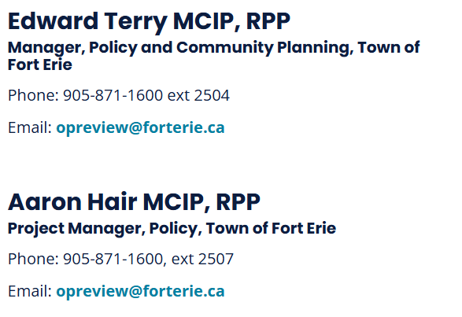

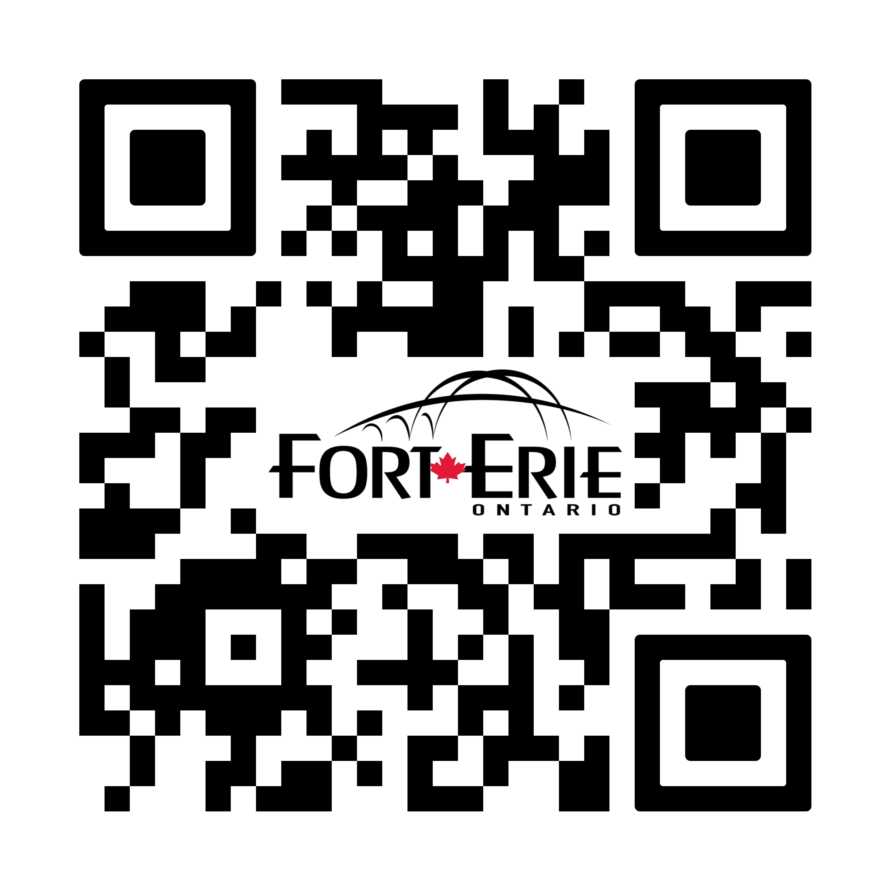
Thank you for participating!
What is next?
We Want to hear from You!
Review Comments and Feedback
Final Official Plan for Council Adoption (Summer 2025)
Statutory Public Meeting (June 9, 2025)
Submit to Province for Approval
Visit letstalk.forterie.ca/official-plan-review-and-update for project updates!

