Slide 1
Town of Fort Erie Official Plan Review
Welcome to the Vision Workshop!
Please sign-in and join us!

Slide 2
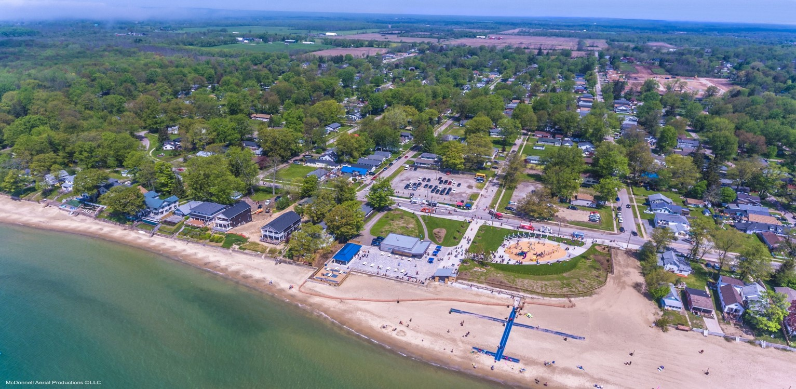
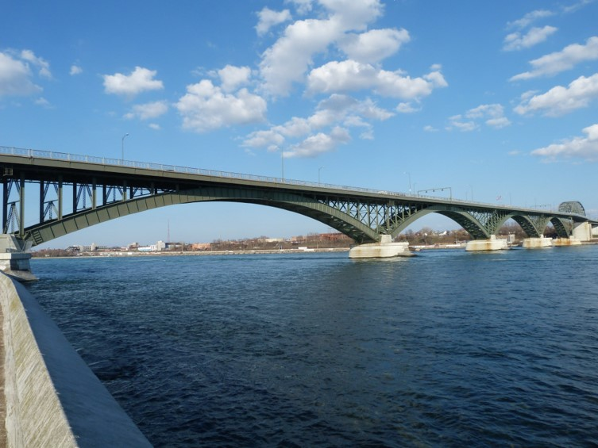
Tonight’s Agenda:
Town of Fort Erie
Official Plan Review
Welcome: 5:00pm – 5:15pm
Presentation: 5:30pm – 5:50pm
Visioning Activities: 5:15pm – 6:50pm
Closing Remarks: 6:50pm – 7:00pm
Thank you for participating in tonight’s workshop. Members of the Project Team are available for further discussion or to answer questions at any time.

Slide 3
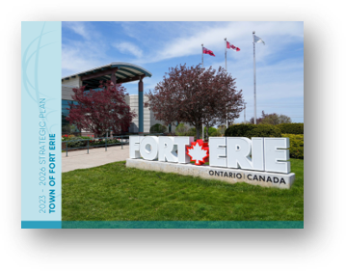
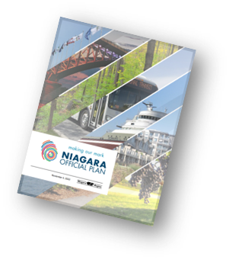
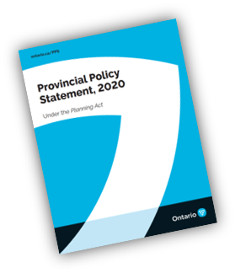
Purpose of the Official Plan Review
The Planning Act requires a review of a new plan no less than 10 years after it comes into effect, and every 5 years thereafter. ​
Changes to provincial and regional land use planning policy has occurred since the Town’s Official Plan was adopted in 2011, such as the Niagara Official Plan approved in November 2022.​
This project represents an opportunity to review the entire document to ensure that it aligns with the most recent direction.​
The Official Plan Review also creates an opportunity to consider the changing local context and ensure that the evolving needs and priorities of the community are met. ​
The Town’s updated Official Plan will establish a new vision and supporting policy framework for how growth and change will be managed to the year 2051.

Slide 4
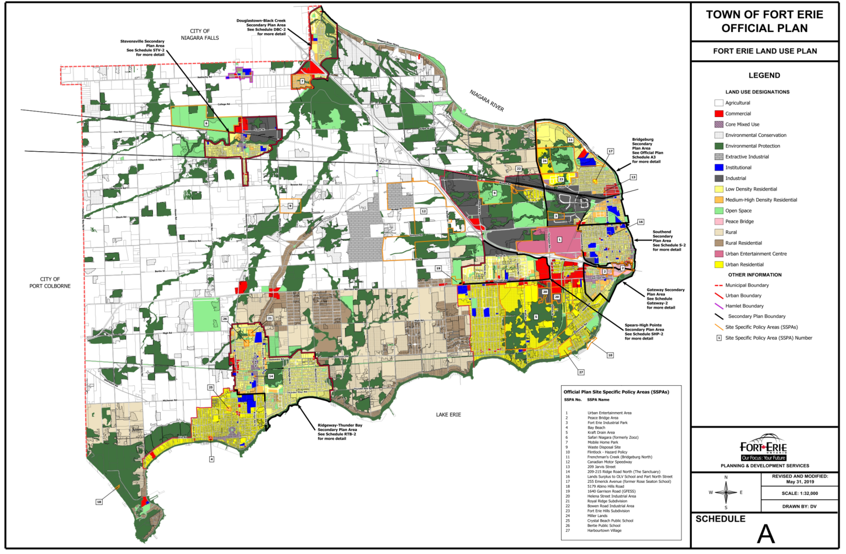
Growth Management
Responsible growth management involves planning for housing and economic opportunities for current and future residents, while ensuring they have access to everyday amenities, community services, and a healthy environment.
  The Town is projected to grow to a population of 48,050 residents and 18,430 jobs by 2051. This represents significant population and employment growth over the next 25 years, and the Official Plan has a key role in managing this growth.
  An updated Official Plan will therefore provide land use planning direction on matters that affect everyday life within the Town; where we live and work, access to everyday amenities and community services, how we move around, a strong agricultural sector, and a healthy, thriving natural environment.
Schedule A of the Official Plan identifies areas that are planned to accommodate growth and development, including intensification. Generally, these are the areas within the red boundaries shown on the map below, and include the communities of Ridgeway, Crystal Beach, Stevensville, and the former Town of Fort Erie.
  The updated Official Plan will address the current and future changes in provincial policy and legislation, to guide future growth and development, and address emerging opportunities and issues in the Town.
  Intensification represents an important opportunity to manage growth. Intensification is described by the Official Plan as developing a property, site or area at a higher density than currently exists through either, redevelopment; the development of vacant and/or underutilized lots within previously developed areas; infill development; and the expansion or conversion of existing buildings.
The Official Plan broadly directs development and intensification to areas that are already built up, offer housing and employment opportunities, have access to water and wastewater, and are close to everyday amenities, including transportation options.
Notes:
Add rental and ownership

Slide 5
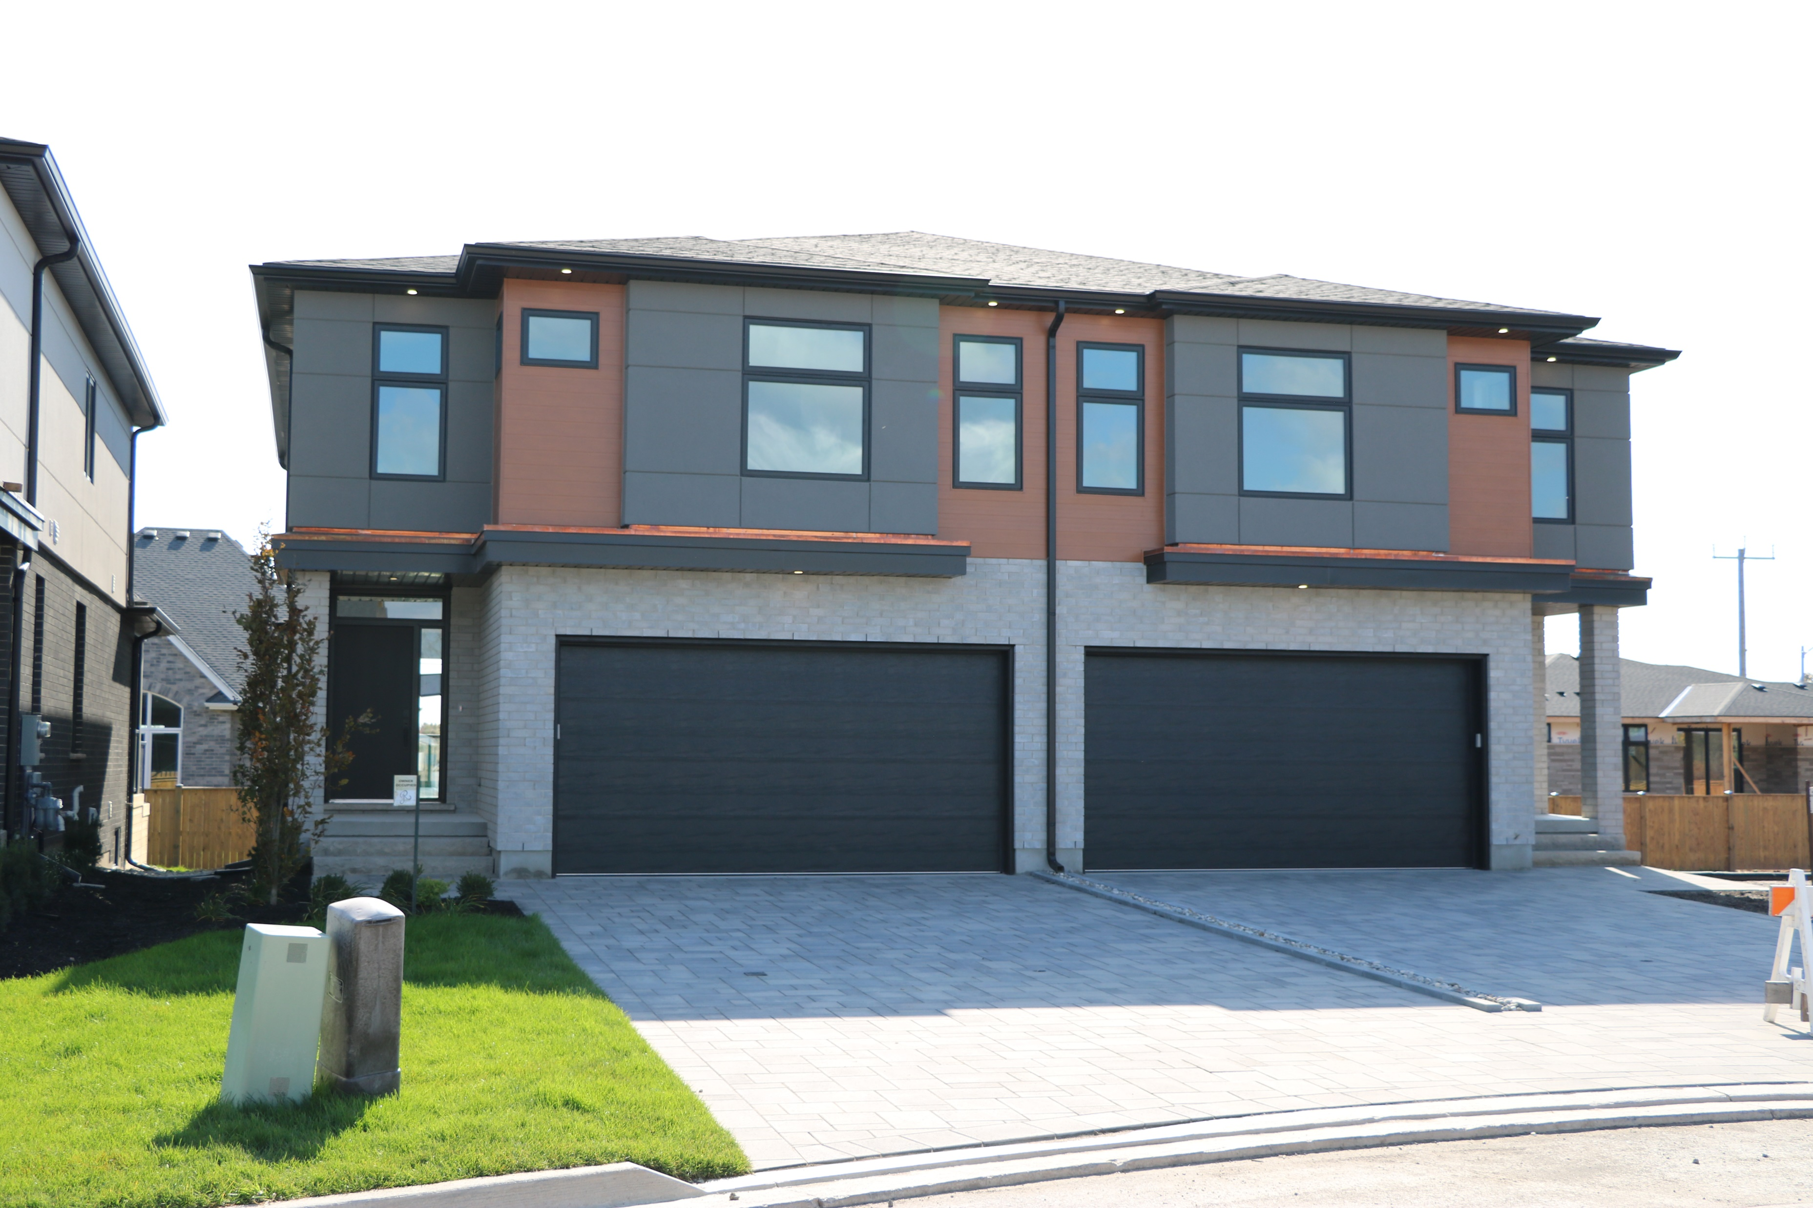
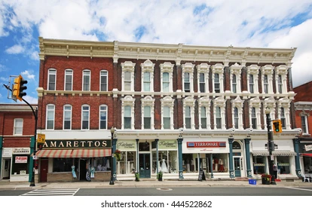

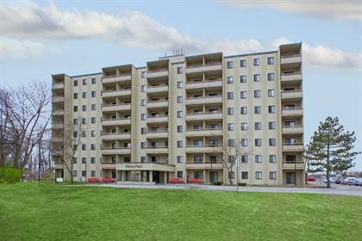
Growth Management
  The Official Plan permits different built forms and densities throughout the Town. Generally, these built forms can be thought of as low-rise buildings, mid-rise buildings, and high-rise buildings. Examples of these built forms are shown below.
  Give your input!
  Each colour dot below matches different potential built forms as contemplated by the Official Plan, as shown to the left.
  Using the maps, please place coloured dots in areas where you think growth should be directed in Fort Erie.
Low-rise Built Form (1-3 Storeys)
Mid-rise Built Form (3-6 Storeys)
Low-Rise Built Form
Mid-Rise Built Form
High-Rise Built Form
High-rise Built Form (6+ Storeys)

Slide 6
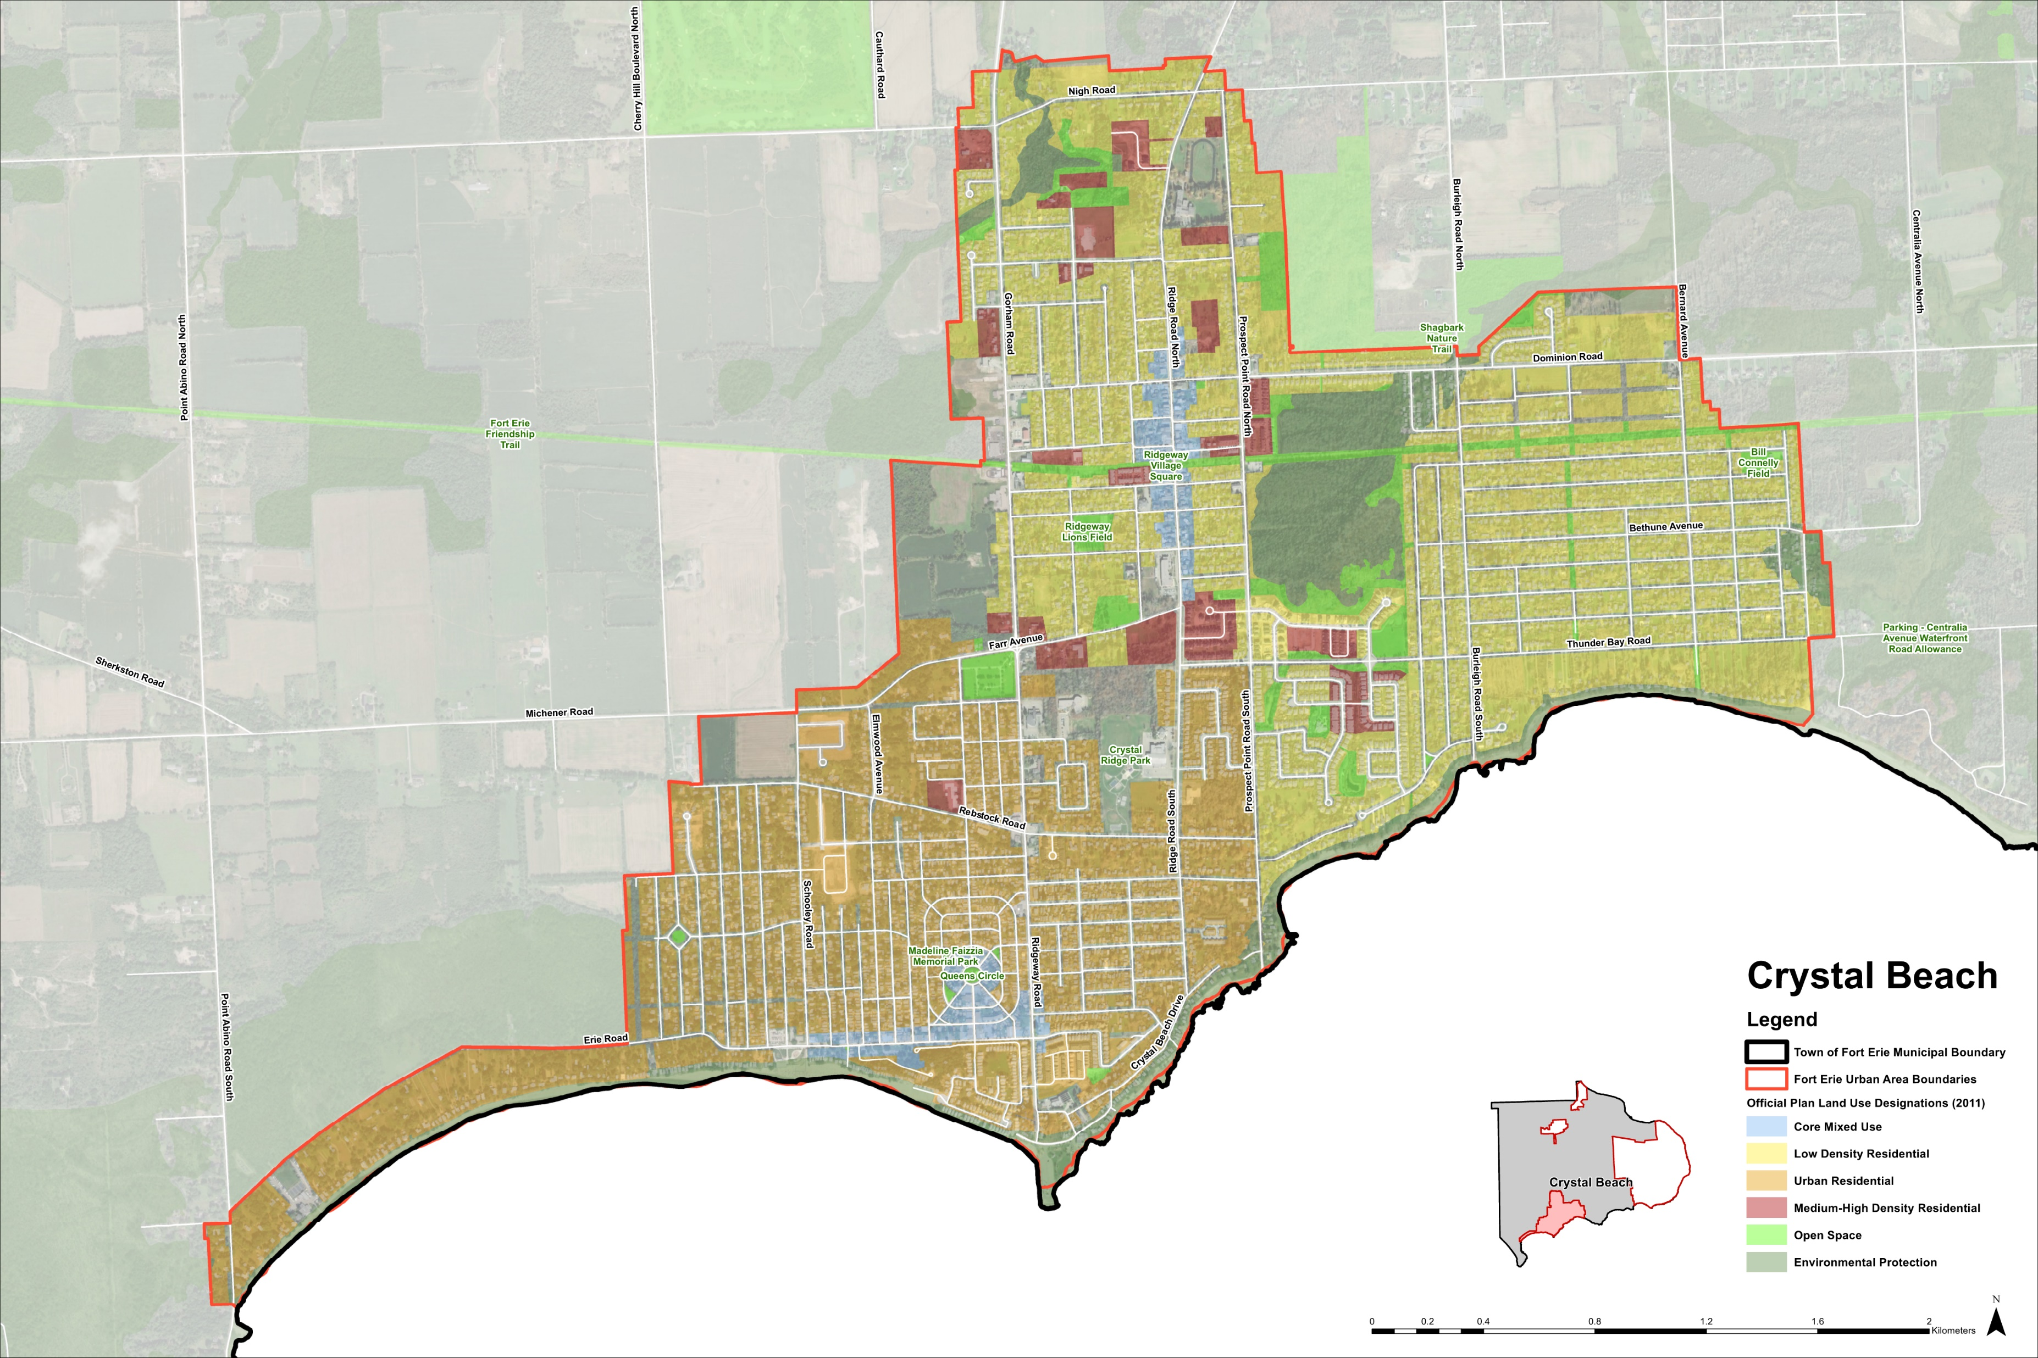

Slide 7
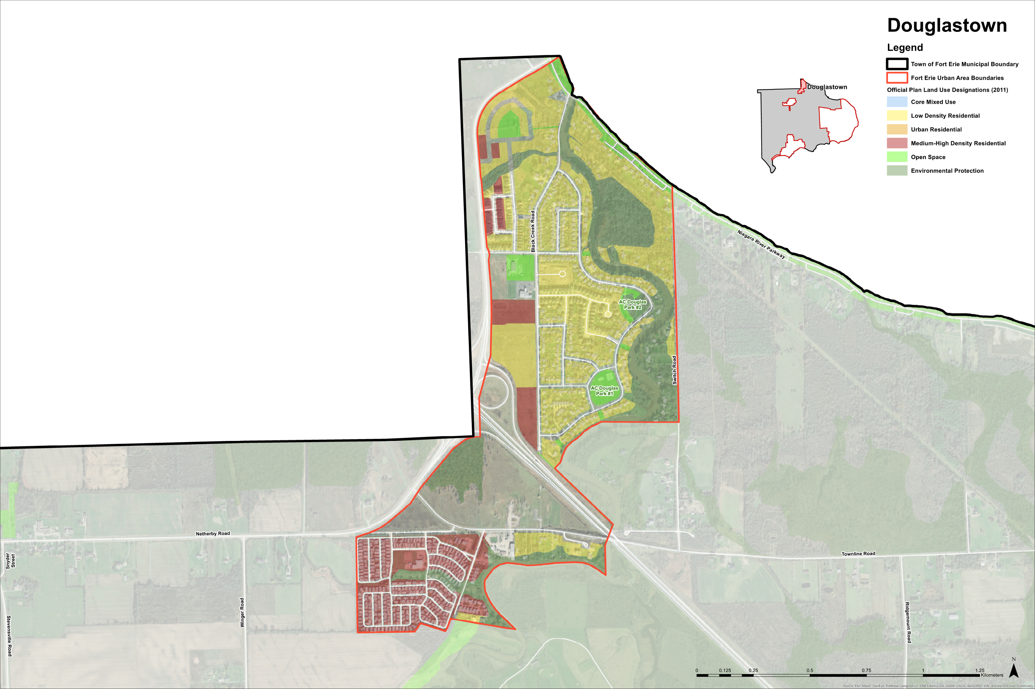

Slide 8
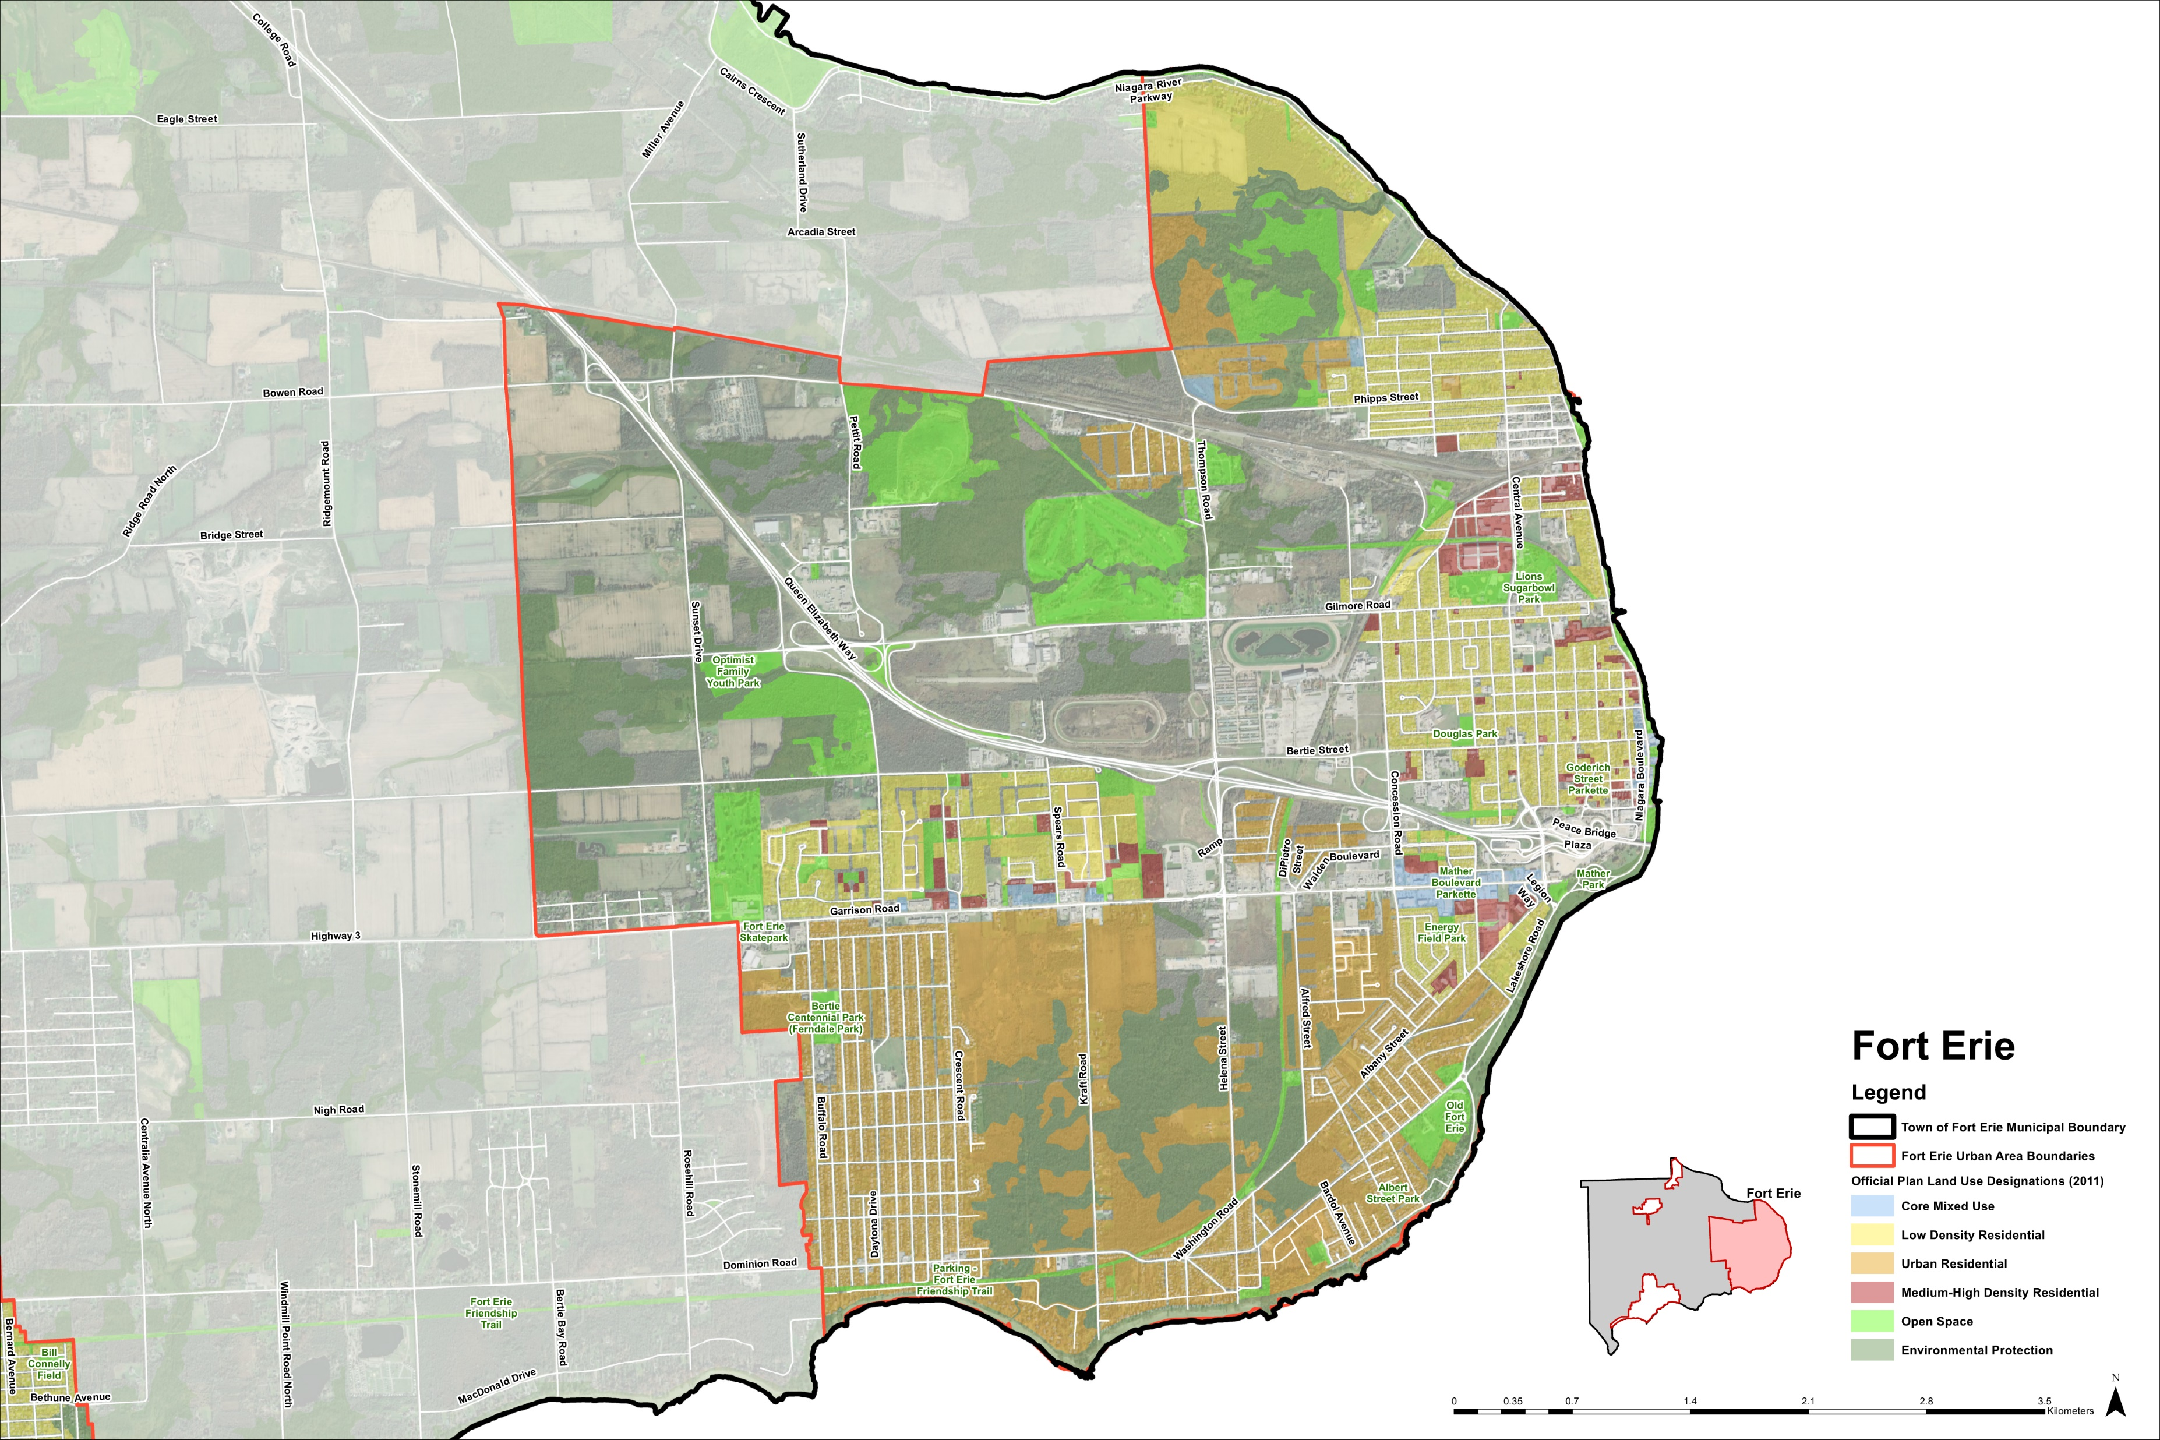

Slide 9
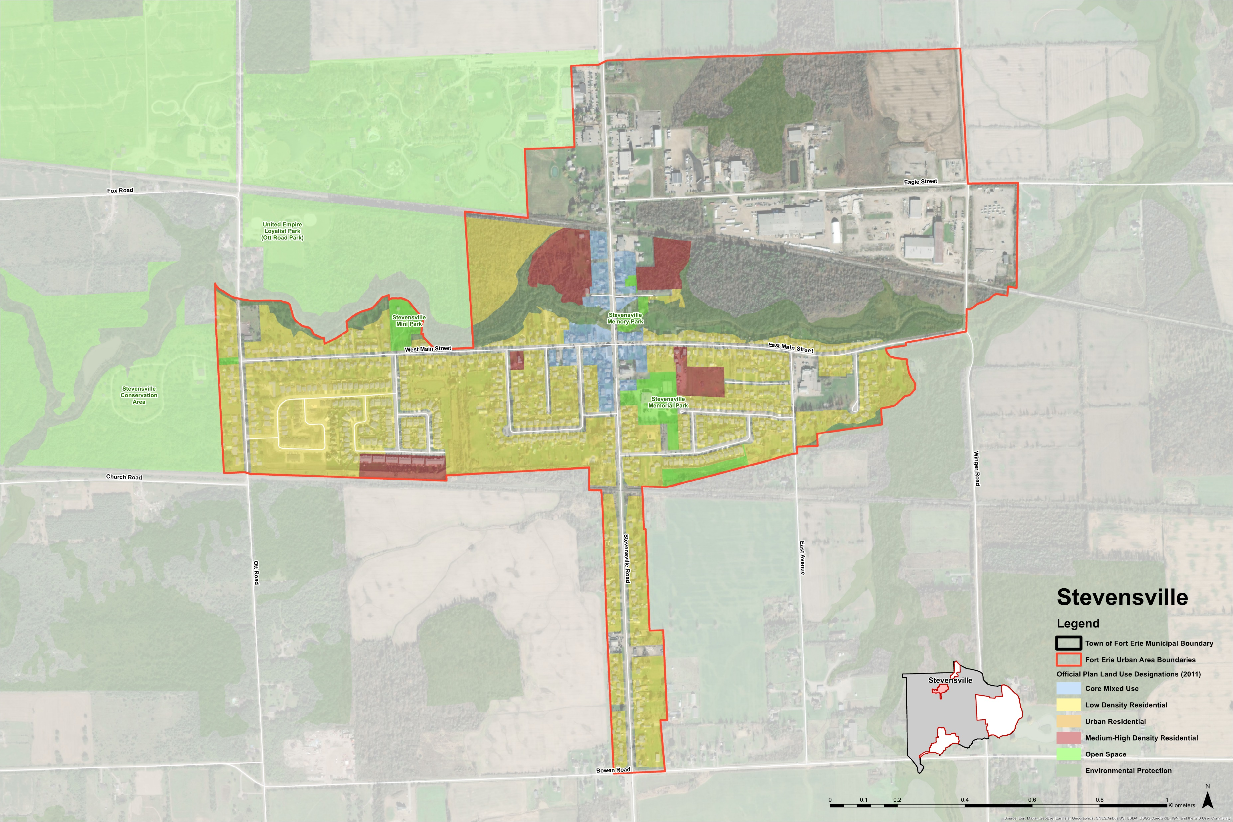

Slide 10
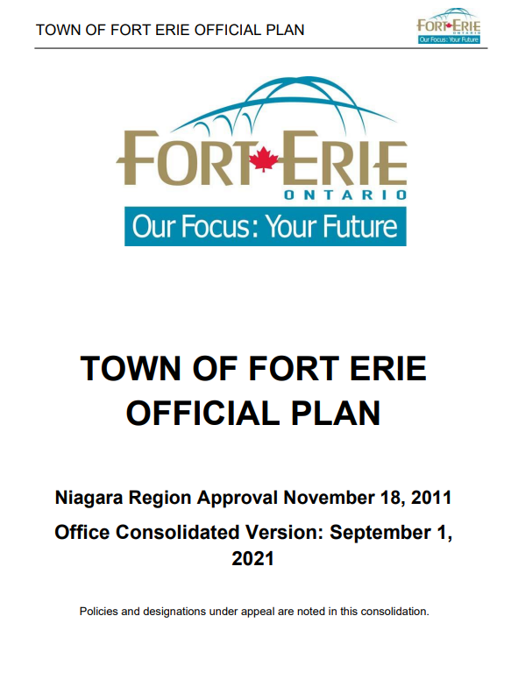
What is an Official Plan?
  The Town’s current Official Plan was approved in 2011. It provides direction on matters such as what types of land uses are permitted and where, housing, economic development, agriculture, and protecting the natural environment, among others. There are two main components to the Official Plan: the policies and the schedules.
An Official Plan is a strategic land use planning policy document that contains goals, objectives, and policies that work together to shape development and guide land use planning decisions. In other words, the Official Plan helps to shape our communities and make them great places to live, work, and play.
The Official Plan establishes policies related to:
Managing development;
Housing and employment;
Agriculture;
Protecting the environment;
Roads and transportation;
Archaeological resources and built heritage;
Aggregate and petroleum resources; and,
Implementation of the policies.
The Official Plan schedules show:
Where the policies of the Official Plan apply;
Where certain land uses are permitted;
Agricultural system;
Transportation and connectivity;
Natural environment system; and,
Cultural heritage resources.
  An Official Plan is required to be consistent with the Provincial Policy Statement (PPS) and conform with all applicable Provincial and Regional plans and policies.
  The Official Plan Review also creates an opportunity to consider the changing local context and ensure that the evolving needs and priorities of the community are met.
  The Town’s updated Official Plan will establish a new vision and supporting policy framework for how growth and change will be managed over the next 25+ years.

Slide 11
Housing in Fort Erie
The Town has completed a Housing Needs Assessment that identifies several local housing priorities. The Housing Needs Assessment highlights important findings on what is driving housing demand, as well as what housing gaps exist, as presented below.
What is driving housing demand within the Town?
Population Growth: Population growth in Fort Erie between the 2016 and 2021 census (+4.5%) was greater than between the previous census (+2.2%), but lower than in Niagara Region (+5.9%) and Ontario (+6.7%).
Demographics: Approximately two of every five (37%) Fort residents are over the age of 60. This will drive the need for seniors-friendly housing (smaller, accessible units, dedicated seniors housing, and long-term care facilities) to allow these residents to age in place.
Migration: Migration to Niagara Region (including Fort Erie) is largely from municipalities with higher average household income and house prices.
Income: Fort Erie has a higher share of lower-income households (<$100,000 per year) than Niagara Region and Ontario which may be due, in part, to the availability of affordable housing options in the Town.
  Current state of housing within the Town:
  Most households in Fort Erie own their home (80%). The balance (20%) of households rent.
  A lack of purpose-built rental units in the Town means renter households are increasingly relying on the secondary rental market.
  Single-detached houses, typically the largest and most expensive type of housing, make up most of the housing stock (83%).
  Housing in Fort Erie tends to be large compared to household sizes. Approximately one out of every two households are “over housed”, that is, the number of bedrooms exceeds the number of people in the household.
  Non-market (community housing) and seniors housing (dedicated seniors housing, long-term care facilities) in the Town is currently limited.
Based on the above, the following housing gaps have been identified within the Town:
Affordable Housing - Purpose Built Rental Housing - Smaller Housing Units - Seniors Housing & Long-Term Care
Notes:
Add rental and ownership

Slide 12
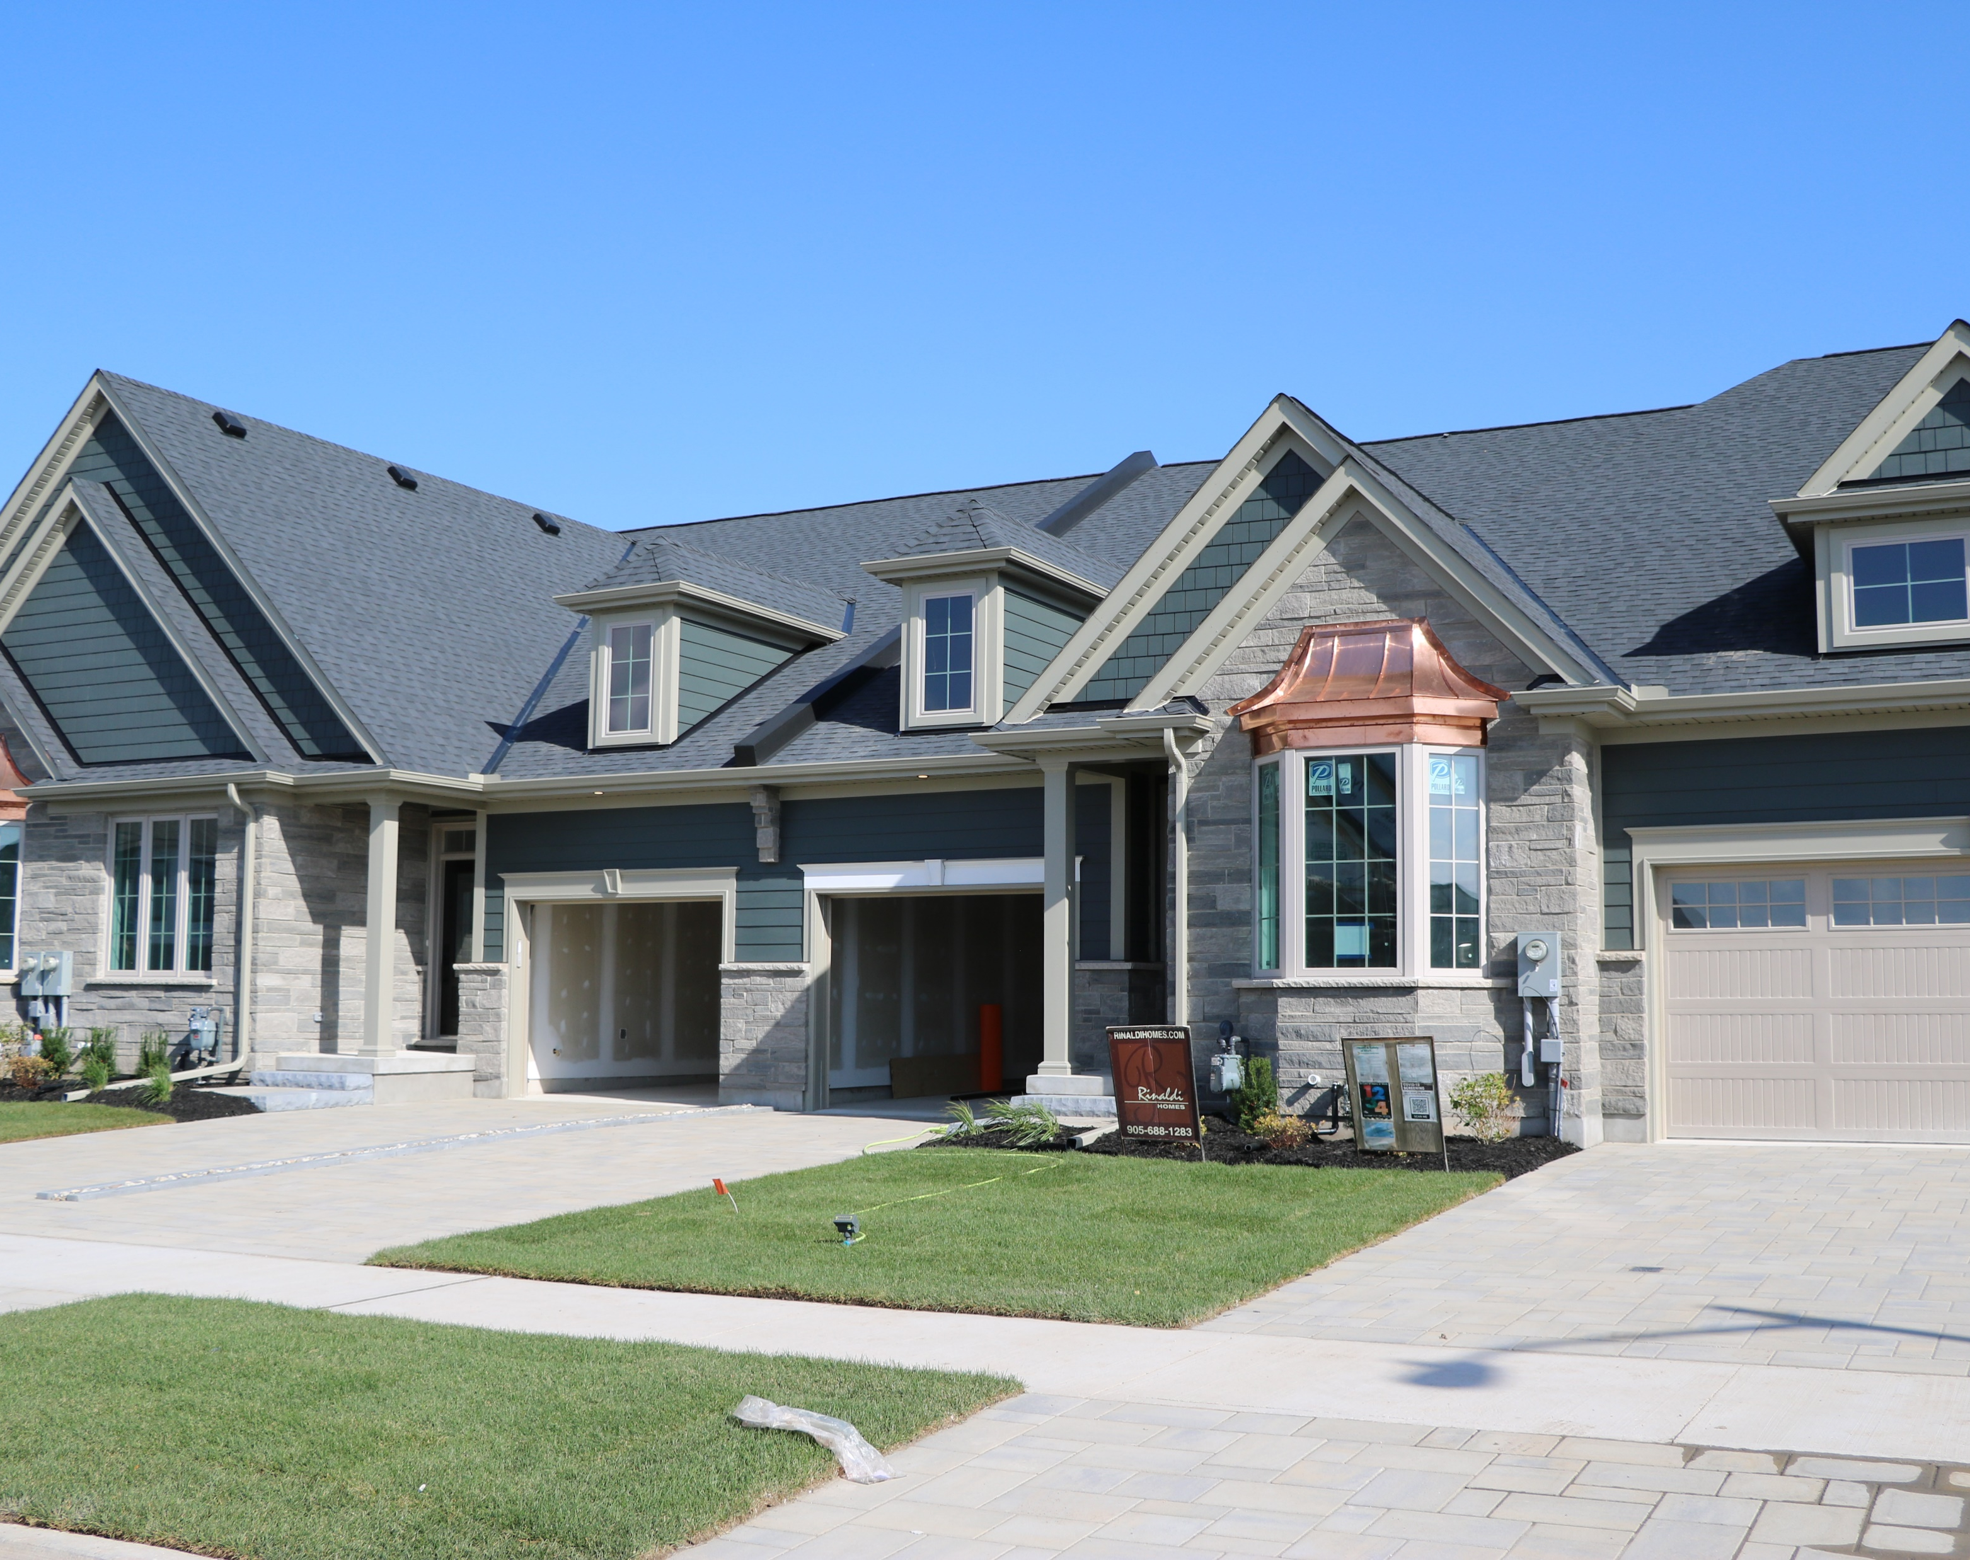

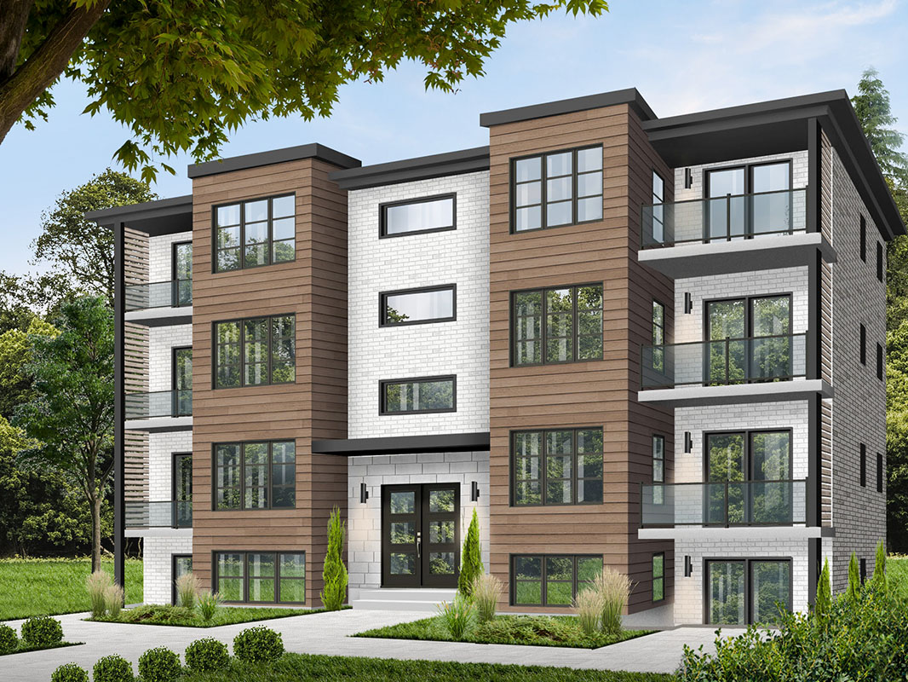
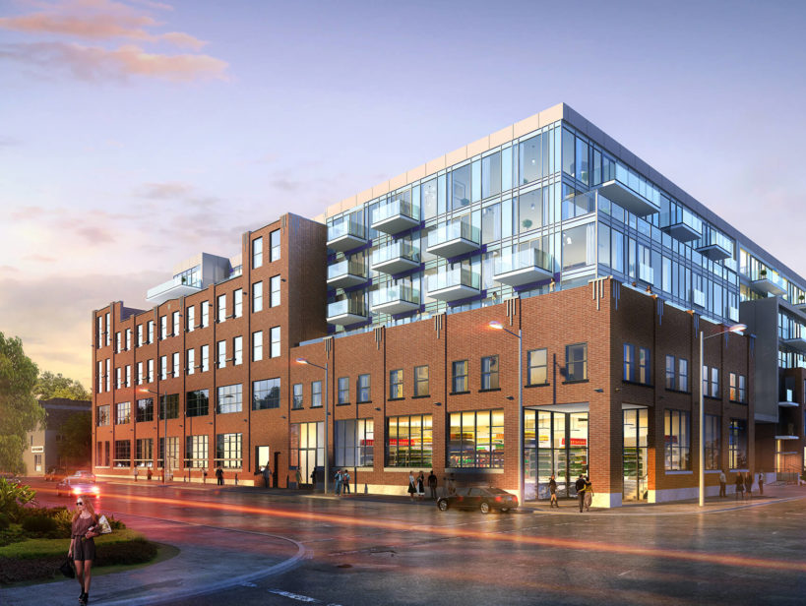


Housing in Fort Erie
The Official Plan has an important role in planning for a mix of housing options and opportunities for current and future residents of the Town. Housing not only provides a place for people to call home, but it is also contributes to developing complete communities by encouraging a broad range of housing options to residents.
What do you think?
What do you think?
Place a sticky dot under which housing types you think best addresses the Town’s housing needs:
Using the post-it notes, provide your response to the following questions and then place it in the box:
How can the Town plan for a greater mix and range of housing choices?.
Townhouses
Detached and semi-detached dwellings
Low-rise apartment building
More housing opportunities are needed within the Town’s existing neighbourhoods.
High-rise apartment building
Mid-rise apartment building
Rental Housing
Home Ownership
Notes:
Add rental and ownership

Slide 13
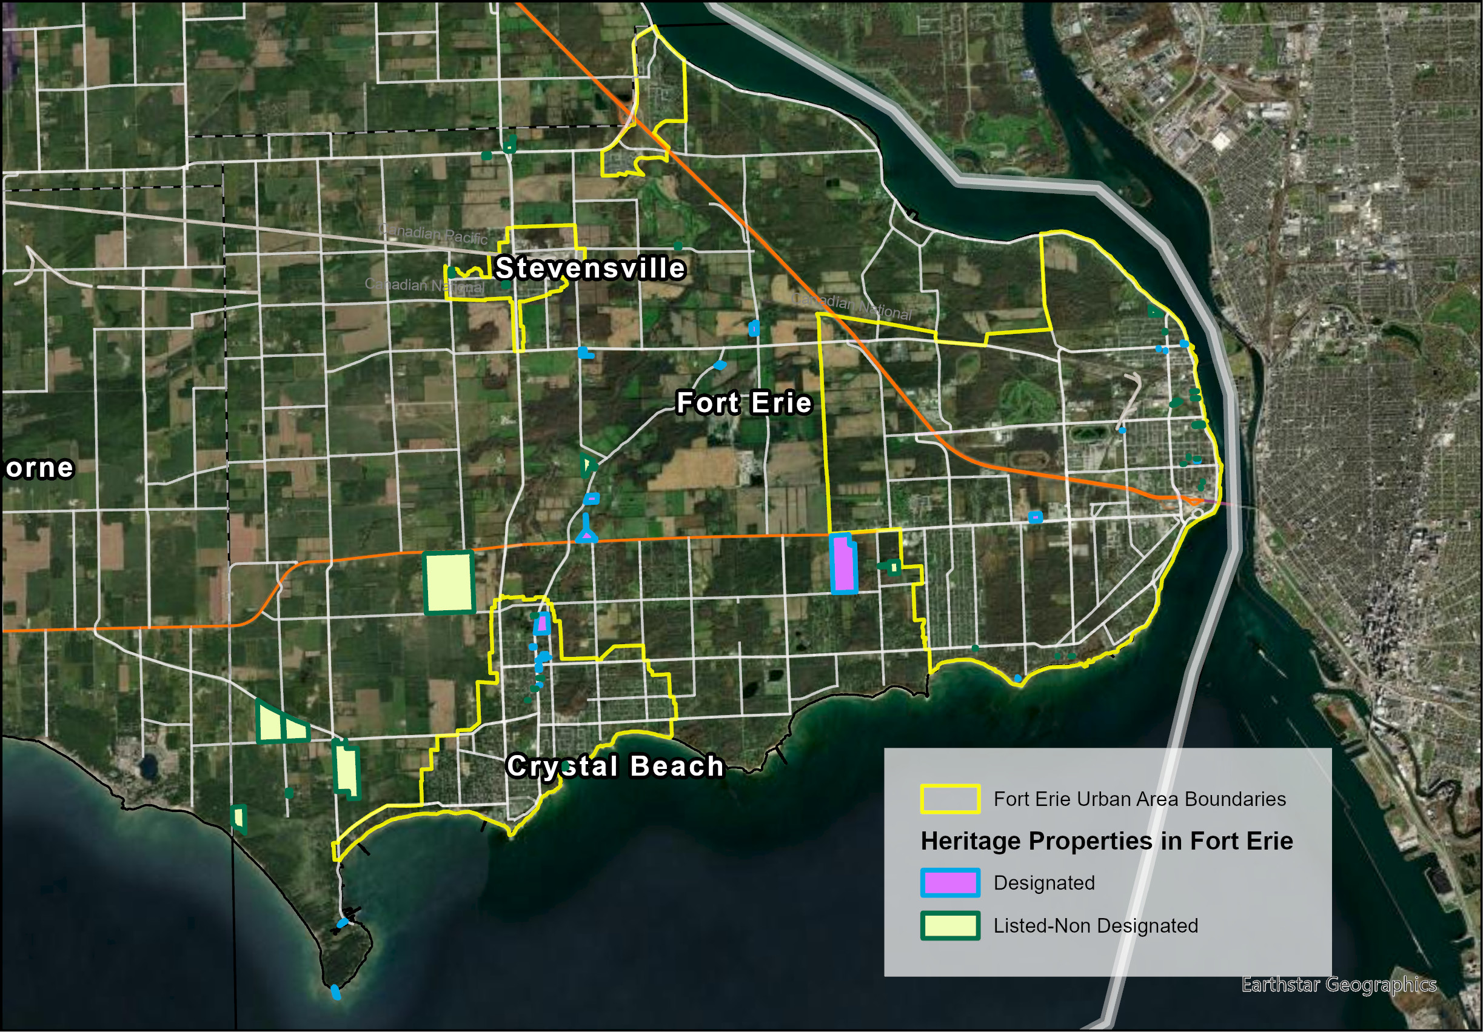
Heritage and Culture
  The Town of Fort Erie has a rich cultural history that holds significant value to the Town. The current Official Plan has five categories of cultural heritage which include:
  Cultural heritage landscapes
  Built heritage
  Archaeological sites
  Moveable heritage (artifacts and archives)
  Intangible heritage
Intangible heritage:
Material form of Cultural Heritage:
Intangible heritage is described in the current Official Plan as traditional skills, beliefs, folklore,
songs and dances.
Material Cultural Heritage is described in the current Official Plan as physical remains (buildings, structures and artifacts)
  Give your input!
  Write your ideas on sticky notes and place it in one of the boxes, below.
What heritage features or landscapes are in the Town that you value?
How can the Town protect and enhance its heritage features?
How do you think the Town balance historical buildings and forms with modern buildings and development?

Slide 14
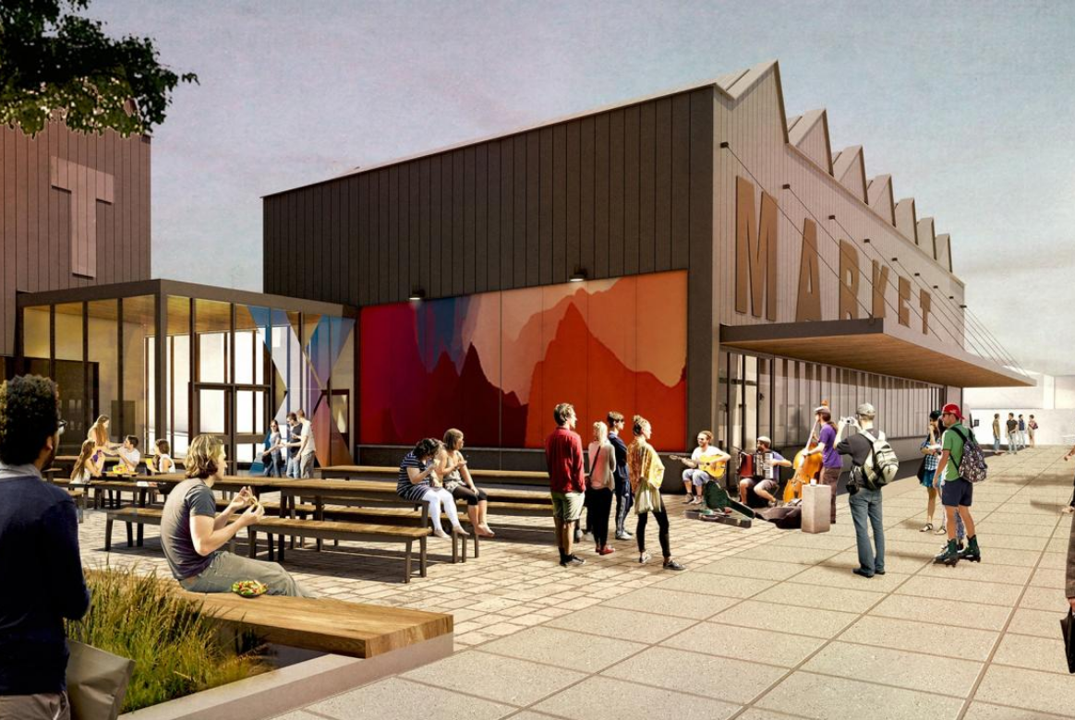

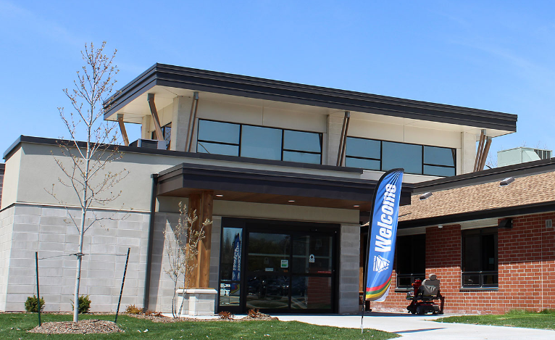
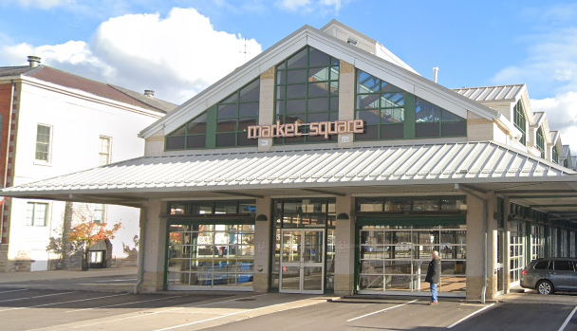
Heritage and Culture
Local Examples:
  Community hubs refer to physical locations or facilities that serve as focal points for community activities, community services, and social interactions.
  Flex streets are adaptable street spaces that can be temporarily or permanently transformed to accommodate various uses beyond traditional vehicular traffic.
  Community hubs and flex streets are gathering places that connect residents to each other and their community.
Niagara Falls Cultural Hub & Market
    Take a sticky note, write your thoughts, and add it here!
Should the Town consider community hubs or flex streets?
Yes
No
Unsure
Welland Community Centre
St. Catherines Market Square
Where would these be most suitable?
Notes:
—Should the Town consider community hubs or flex streets? Where would these be most suitable? Community hubs and flex streets are welcoming neighbourhood gathering places that connect residents to each other and their community.
Images from: Construction countdown to London's first flex street | CBC News
A Creative Hub for St. Catharines

Slide 15
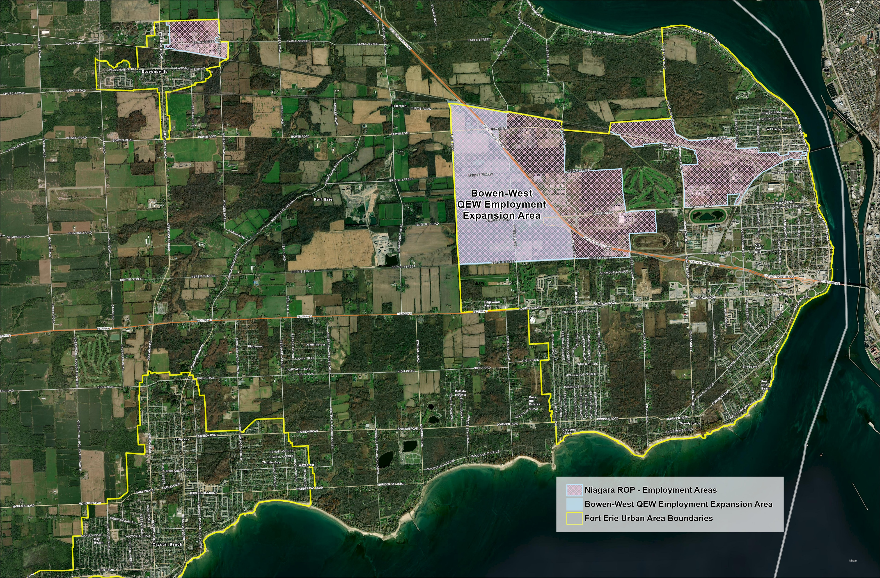
Employment, Industrial and Commercial
  Business and Employment in the Current Official Plan
  The current Official Plan encourages the expansion of industrial and commercial development, and the revitalization of existing main commercial areas to expand Fort Erie’s economy, support local business, and increase employment opportunities.
  Give your input!
  Write your ideas on sticky notes and place it in one of the boxes, below.
What are some goals and objectives that the Town may consider as they relate to the viability of office, retail, and employment uses?
Areas for Employment, Industrial and Commercial Uses
The Bridgeburg Central Business District is recognized as an area of community focus for future development of commercial, institutional.
Encourage the Ridgeway, Crystal Beach, South End Core Area and Stevensville Business Districts as the primary commercial areas.
Areas that are planned for employment uses are shown on the map above.
What could the Town do to attract more diverse employers?
Notes:
*Economic Development

Slide 16
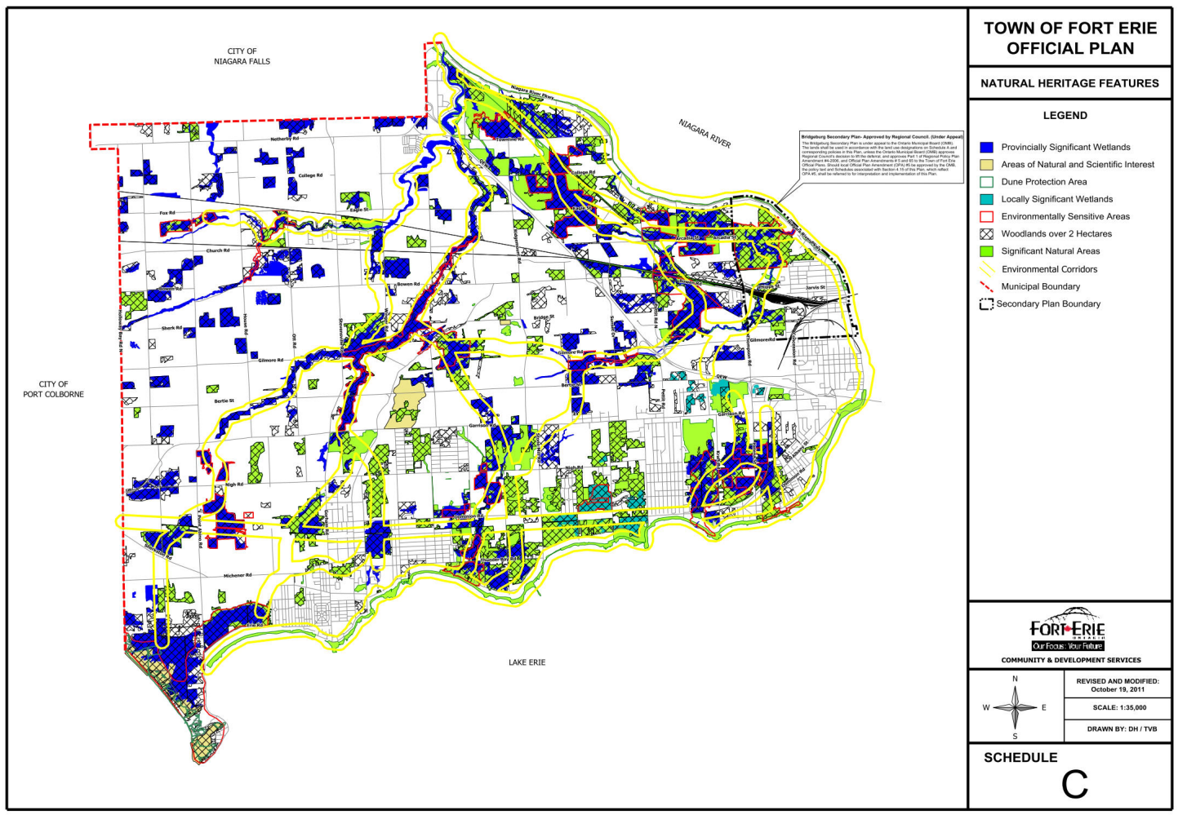
Natural Environment
  The policies in the current Official Plan aim to protect the Town’s natural heritage features and promote biodiversity, while having regard for protecting environment in accordance with Provincial and Regional land use plans and policies..
  Give your input!
  Write your ideas on sticky notes and place it in one of the boxes, below.
How can we protect and enhance Fort Erie’s environment and greenspaces?
Schedule “A” of the Town’s current Official shows the Natural Heritage Features shown as “Environmental Protection”
How do you currently experience parks and recreation in the Town? What are your likes and dislikes of the Town’s parks, recreation spaces and community amenities?
Schedule “C” of the Town’s current Official identities the natural heritage features in the Town, highlighting Provincially Significant Wetlands, Areas of Natural and Scientific Interest, Dune Protection Areas, Locally Significant Wetlands, Environmentally Sensitive Areas, Woodlands over 2 Hectares and Significant Natural Areas.
Notes:
How can we protect and enhance Fort Erie’s natural heritage system and greenspaces?

Slide 17
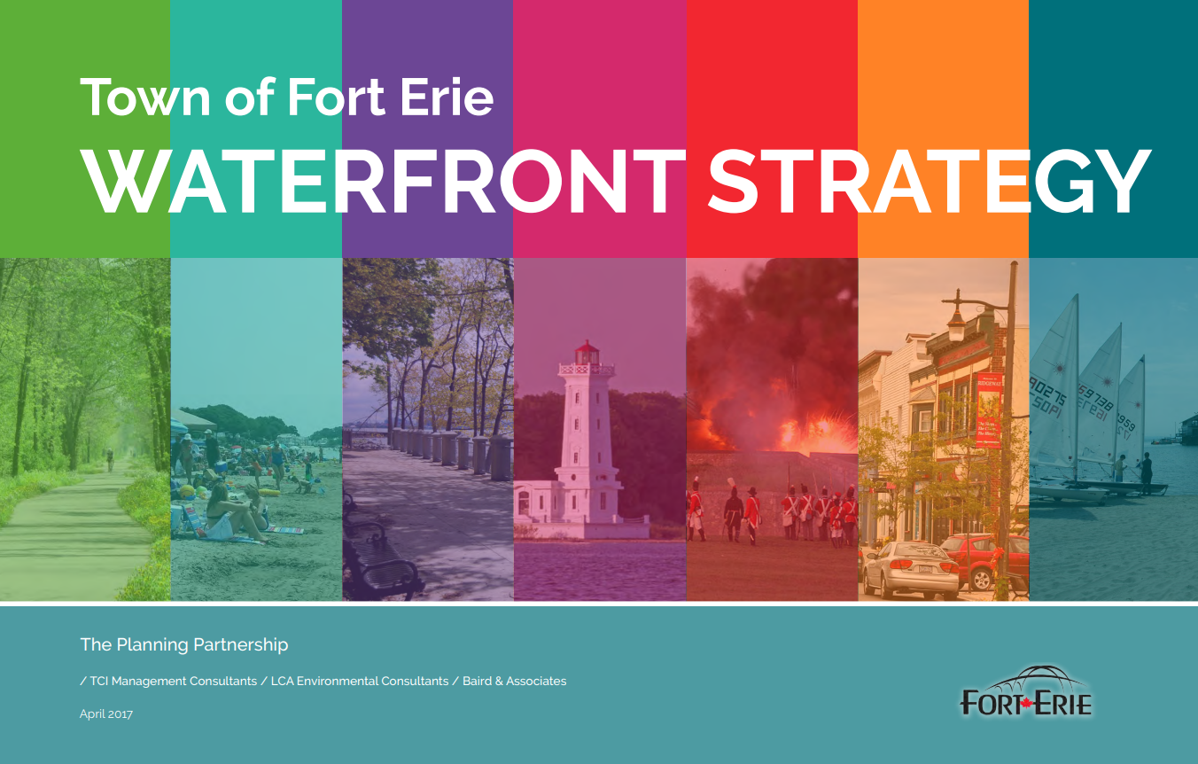
Natural Environment
    In 2017, The Town of Fort Erie approved The Waterfront Strategy, which sets a vision for 45 km of water’s edge land along Lake Erie and the Niagara River. The Town has achieved a solid foundation in working towards a vision of a network of beautiful parks, points of access and views, and enabling the waterfront to continue to be a catalyst for housing and commercial activities that contribute to Fort Erie’s economy.
  What do you think?
  Write your ideas on sticky notes and place it in the box, below.
What is the Town already doing well with the waterfront and how can we build on it?
The Waterfront Strategy
  Fort Erie’s Waterfront Strategy is intended to lay the foundation and a plan of action to transform Fort Erie’s waterfront. The Strategy has been informed through seven Frameworks which include:
  Natural Heritage Features & Hazards
  Waterfront Parks & Windows
  Ways to & Along the Waterfront
  Destinations & Tourist Attractions
  Culture and Heritage
  Neighbourhoods
  Boating Access
Notes:
How can we protect and enhance Fort Erie’s natural heritage system and greenspaces?
How do you currently experience parks and recreation the Town? What are your likes and dislikes of the Town’s parks, recreation spaces and community amenities?
How can we reduce greenhouse gases and respond to the impacts of climate change?
On the panel, we can include information regarding the Town's waterfront strategy: https://www.forterie.ca/en/town-hall/resources/documents/Fort-Erie-Waterfront-Strategy-Approved-compressed.pdf
The Town of Fort Erie in 2017 approved a The Waterfront Strategy, setting a broad based vision for Fort Erie’s 45 km of water’s edge land along Lake Erie and the Niagara River. The Town has achieved a solid foundation on which to continue to work towards a vision of a network of beautiful parks, points of access and views and where the waterfront continues to be a catalyst for housing and commercial activities that contribute to Fort Erie’s economy.
Question: What is the Town already doing well with the waterfront and how can we build on it?

Slide 18
Agriculture and Rural
Agriculture and Rural Designation:
  The Current Official Plan establishes the Agriculture and Rural designations:
    Agricultural lands as identified on Schedule “A” aim to prevent urban development in these designated areas for the preservation of agricultural uses.
    Prominent agricultural uses include: the growing of crops, nursery and horticultural crops; raising of livestock; raising of other animals for food, fur or fibre, including poultry and fish; aquaculture; apiaries; agro- forestry; maple syrup production; and associated on-farm buildings and structures.
    Non-agricultural development in Rural Areas is subject to specific criteria.
    Limited residential development is permitted within the Rural Area designation.
  Are intended for agricultural uses of all types including livestock and poultry uses, secondary and value-added uses.
Agriculture-related Uses:
  The current Official Plan defines Agriculture-related uses as:
  Farm-related commercial and farm-related industrial uses that are small scale and directly related to the farm operation and are required in close proximity to the farm operation.
  Give your input!
  Write your ideas on sticky notes and place it in one of the boxes, below.
What can the Town do to protect, enhance and support the agricultural sector?
What are some challenges facing the rural community?
On-Farm Diversified Uses:
  As per the Guidelines on Permitted Uses in Ontario’s Prime Agricultural Areas, on-farm diversified uses are:
  Located on a farm; Secondary to the principal agricultural use of the property; Limited in area; Includes home occupations, home industries, agri-tourism uses, uses that produce value-added agricultural products; Compatible with and not hinder, surrounding agricultural operations

Slide 19
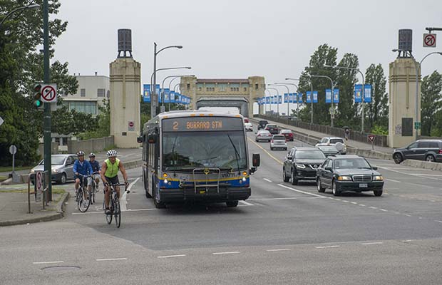
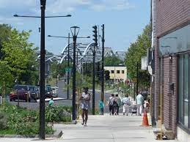
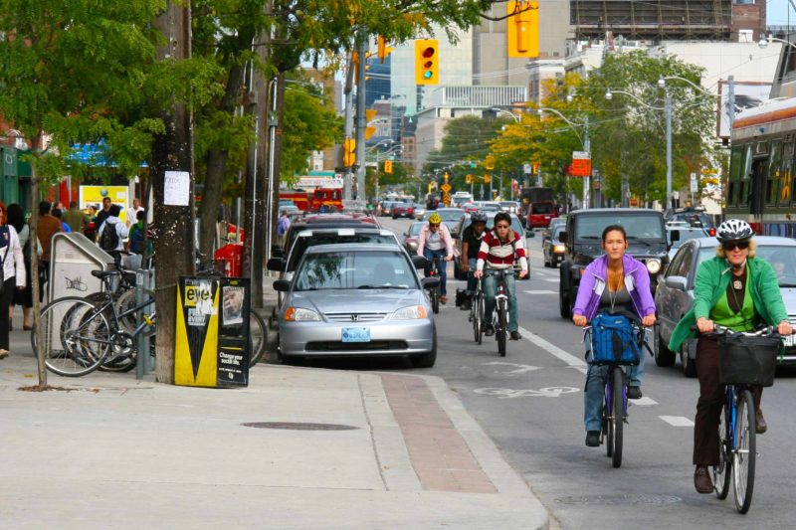


Transportation
  The Official Plan establishes goals and objectives for transportation in Fort Erie to ensure communities and neighbourhoods are well-connected to each other, as well as employment centres, commercial areas and community facilities in a manner that is safe and efficient, while providing opportunities for public transit, walking and cycling.
  What do you think?
  Write your ideas on sticky notes and place it in one of the boxes, below.
Which areas of the Town would benefit from greater connections to transit and active transportation networks? Are there obvious gaps?
What are your ideas about improving travel options and parking in the Town?
  The current Official Plan supports the concept of complete streets designed for vehicles, pedestrians and cyclists. Complete Streets are streets that are safe for all users, regardless of age, ability, or mode of travel. Do you support the concept of complete streets in your community?
How can the Town build on the current transit on demand services?

Slide 20
Vision for Fort Erie
  The Town’s updated Official Plan will guide the use of land use designations and policy and how and where the Town will grow and develop to the year 2051.
  A vision statement tells a story about a community’s long-term views and aspirations for the future. It reflects core values, qualities, and characteristics of a community.
  Help us develop a vision statement for the Town of Fort Erie’s Official Plan! The vision statement will apply to the Town as a whole and reflect the interests of the community.
Vision Statement
Guiding Principles
Official Plan Policies
  Give your input!
  Write your ideas on sticky notes and place it in the boxes, below.
In one word or phrase, share what you already love about Fort Erie or what your vision for the future of the Town is!
What else should be considered for the guiding principles?
Notes:
Would include a word cloud exercise and a ranking exercise.
Vision: Participants will be asked a question, the response to the question will be placed on a poster to create a word cloud.
In one word or phrase, share what you already love about Fort Erie or what your vision for the future of the Town is!
Guiding Principles: An opportunity to review the in-effect guiding principles will be available, participants will be asked the follow:
Do you believe that the current guiding principles reflect the Town of Fort Erie today and the Town of Fort Erie in the future?
Is there anything missing? Should anything else be considered for the Guiding Principles?

Slide 21

Developing Guiding Principles
  To realize the vision statement, guiding principles set out more specific directions or goals for enhancing or protecting the community’s core values, qualities, and characteristics over the long-term.
The Town’s current Official Plan has been developed based on the following principles:
  Providing for a mix of land uses;
  Taking advantage of compact building design where appropriate;
  Creating a range of housing opportunities and choices; creating walkable neighbourhoods
  Fostering distinctive, attractive communities with a strong sense of place;
  Preserving open space, farmland, natural beauty, and critical environmental areas;
  Strengthen and direct development towards existing communities;
  Making development decisions predictable, fair and cost effective; and
  Encouraging community and stakeholder collaboration in development decisions.
  What are Guiding Principles?
  Guiding principles set out specific directions or goals for enhancing or protecting the community’s core values, qualities, and characteristics over the long-term.
  Why do they matter?
  Guiding principles reflect community values that drive the implementation of Official Plan policies.
  As Fort Erie evolves overtime, it is important to ensure that the guiding principles reflect what the community feels is important.
  Feedback from today will be used to create a new vision and guiding principles for Fort Erie.
Please place a dot on whether you agree or disagree with the below statement:
  Do you believe that the current guiding principles reflect the Town of Fort Erie today and the Town of Fort Erie in the future?

