Slide 1
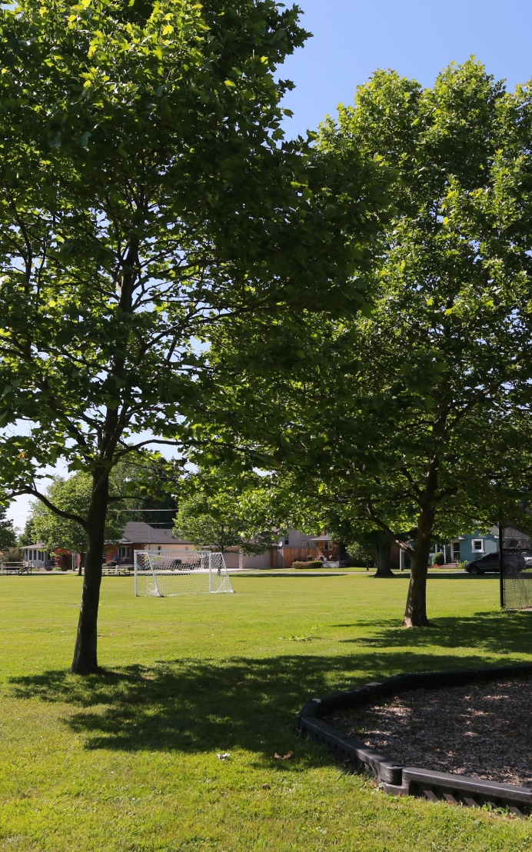
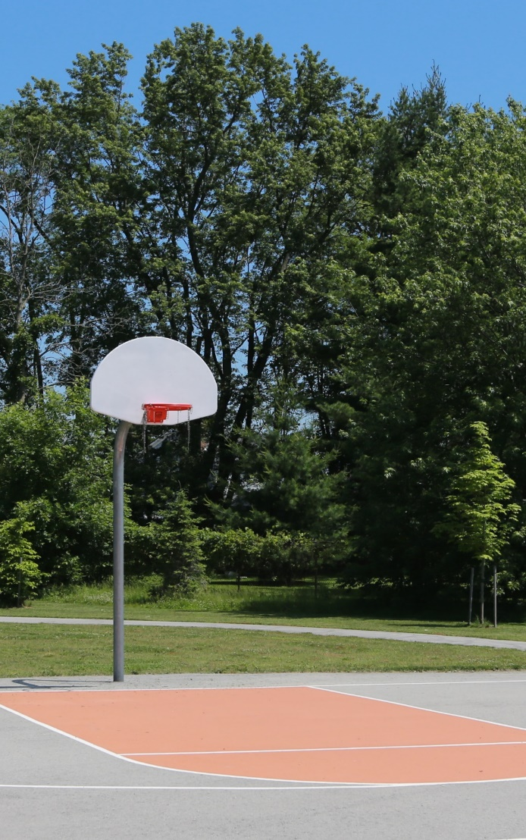
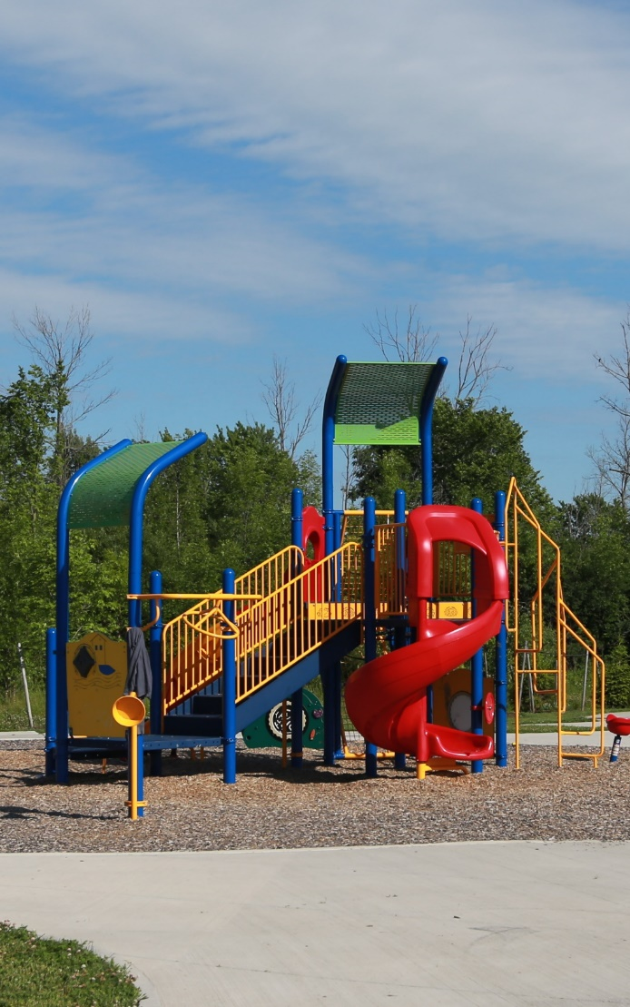
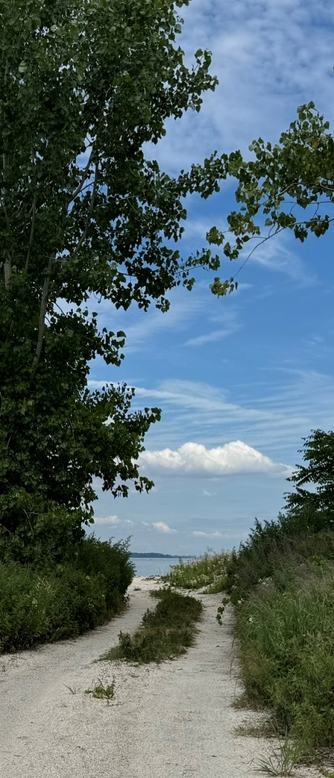
Fort Erie Parks & Open Space Master Plan
October 7, 2024

Slide 2
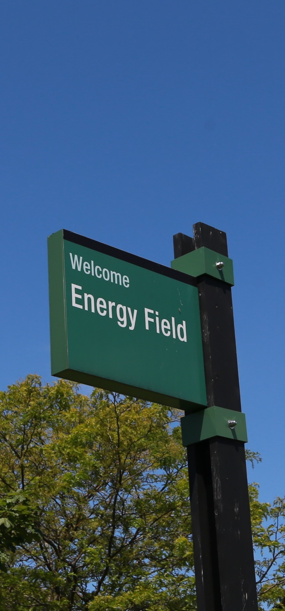
Outline
  Introduction — Purpose & Scope, Strategic Pillars
  Background & Context — 2006 Master Plan, Emerging Trends
  Community Consultation — Priorities & Expectations, Vision & Guiding Principles
  Existing Provision Levels
  Park Classifications & Standards
  Existing & Projected Needs (to 2031)
  Financial Strategy (Land Dedication / Cash in Lieu)
  Conclusion
Fort Erie Parks & Open Space Master Plan
October 7, 2024

Slide 3
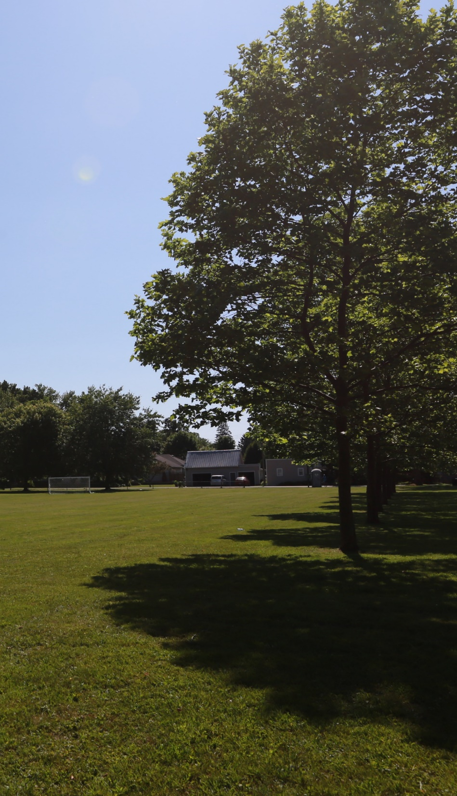
Purpose & Scope
Provides framework for making sustainable decisions about Town’s parks & open spaces.
Encompasses outdoor spaces & outdoor facilities owned, operated & maintained by Town.
  parkland, public open spaces, natural areas
  playgrounds & spray pads
  sports fields & outdoor courts
  trails
  Makes recommendations about classifications, asset management, addressing anticipated future needs, prioritizing renewals & repairs, cultivating partnerships.
Fort Erie Parks & Open Space Master Plan
October 7, 2024

Slide 4
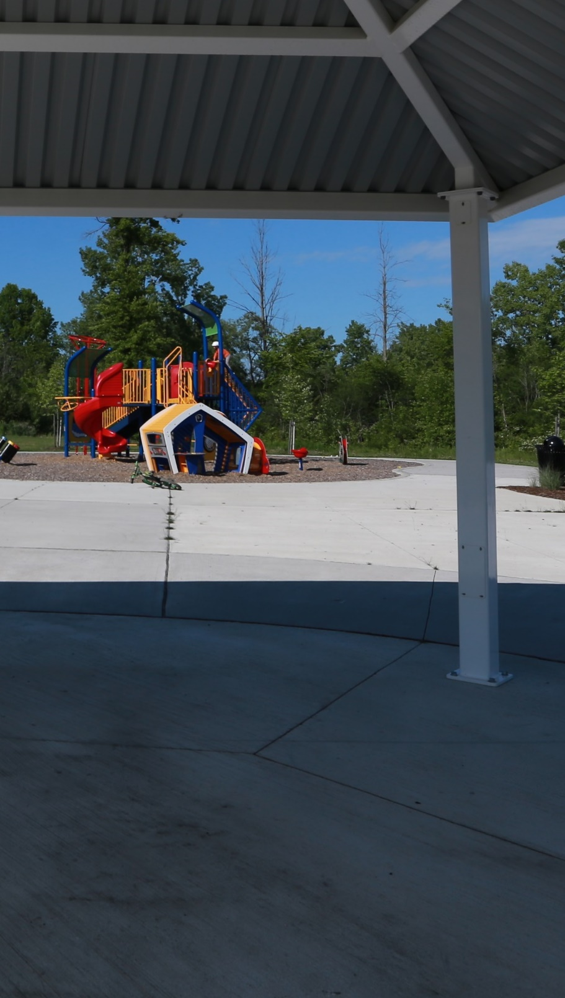
Strategic Pillars
Quality of Life & Community Well-Being
Local Health
Sustainable & Managed Growth
Environmental & Climate Change Resiliency
Economic Prosperity
Housing Options
Fort Erie Parks & Open Space Master Plan
October 7, 2024

Slide 5

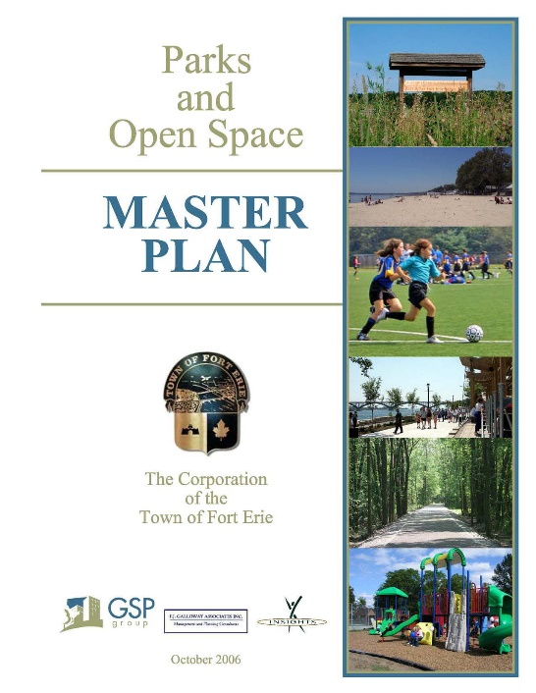
2006 Master Plan
Provide a balanced mix of park & open space venues.
Provide a geographically diverse range of venues.
Provide venues that are flexible in their uses.
Ensure that the system can respond to change.
Create venues that are sensitive to the environment, preserve natural & cultural heritage features, and support educational opportunities.
Provide fair & equitable opportunities.
Establish intensive & collaborative partnerships.
Recognize & fulfill Town’s leadership role.
Fort Erie Parks & Open Space Master Plan
October 7, 2024

Slide 6
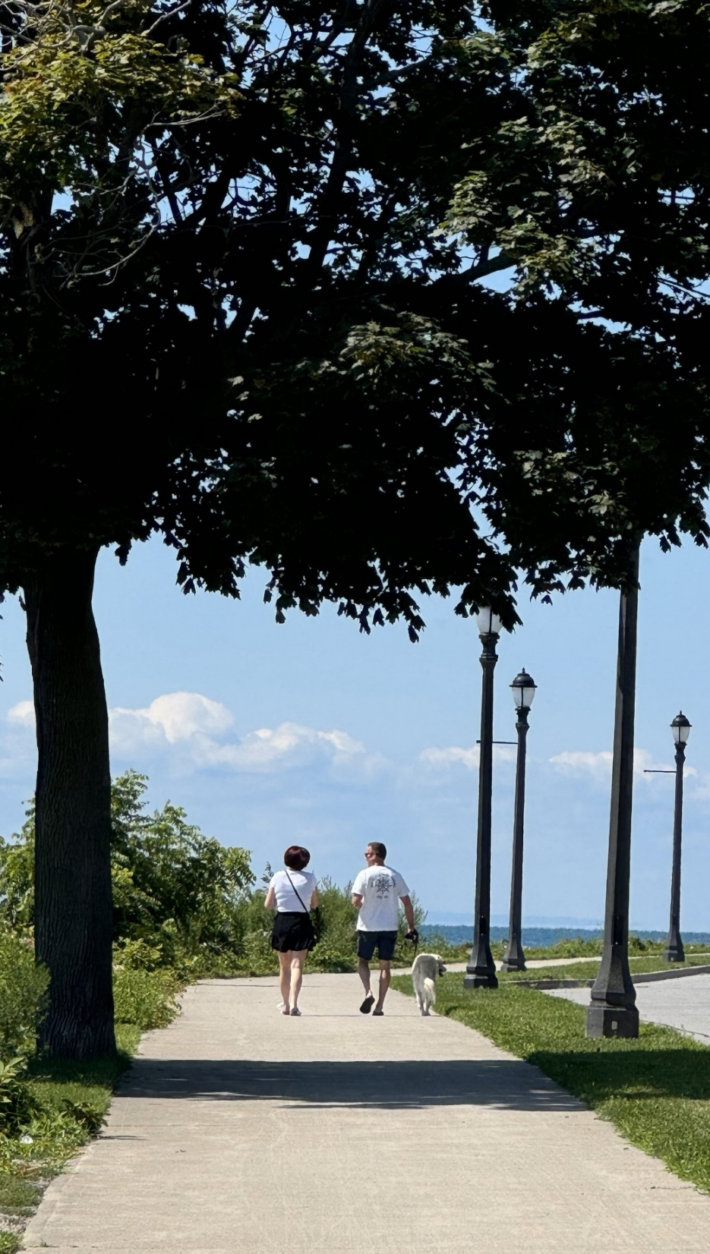
Emerging Trends
Impacts of a changing demographic profile.
Development of larger, multifunctional, more regionally oriented facilities.
Sustainability & protecting the natural environment.
Approaches to funding & asset management.
Post-pandemic recovery.
Fort Erie Parks & Open Space Master Plan
October 7, 2024

Slide 7
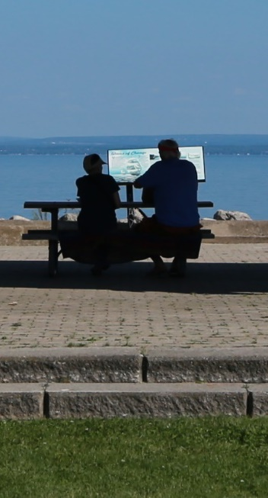
Community Consultation
Two rounds of consultation: during initial phase (2017–2018) & in early 2024.
Public open houses & online surveys (Feb. 2018 & March 2024).
Meetings with community groups, recrecation organizations, other stakeholders.
Results provided basis for priorities, vision & guiding principles for new Master Plan.
Fort Erie Parks & Open Space Master Plan
October 7, 2024

Slide 8
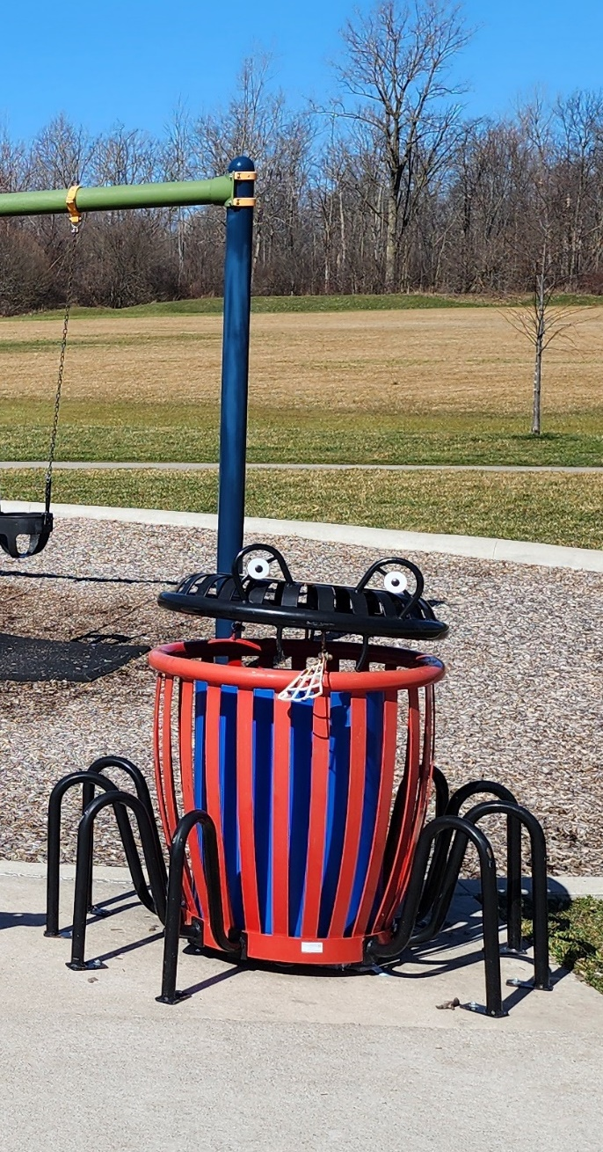
Priorities & Expectations
Ensure residents Town-wide have access to parks & recreation opportunities.
Maintenance, cleanliness, general up-keep are high-priority items.
Emphasis on role of features like benches, shaded areas in making parks & trails accessible & age-friendly.
Protection & preservation of natural areas.
Public access to nature, trails, waterfront.
Fort Erie Parks & Open Space Master Plan
October 7, 2024

Slide 9
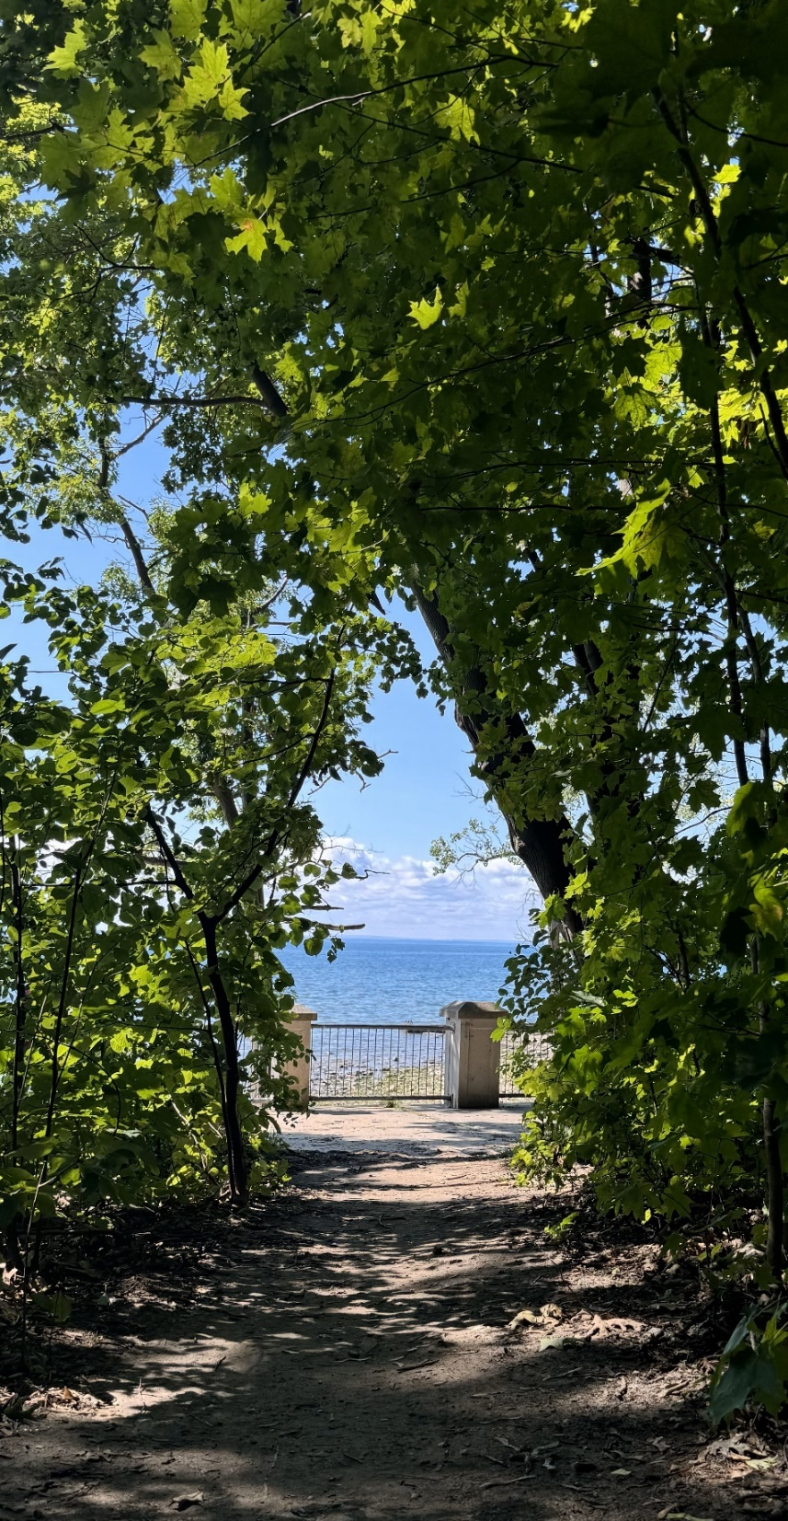
Vision & Guiding Principles
Attractive well designed, well cared for, well kept
points of community pride
safe, friendly & inclusive
Accessible for all ages & all abilities
offer equitable & affordable opportunities
Resilient support preservation of natural areas
flexible, can accommodate variety of activities
responsive to changes
Connected safe, convenient, well-maintained trails
opportunities to connect with nature, with
Town’s history, with each other
Fort Erie Parks & Open Space Master Plan
October 7, 2024

Slide 10
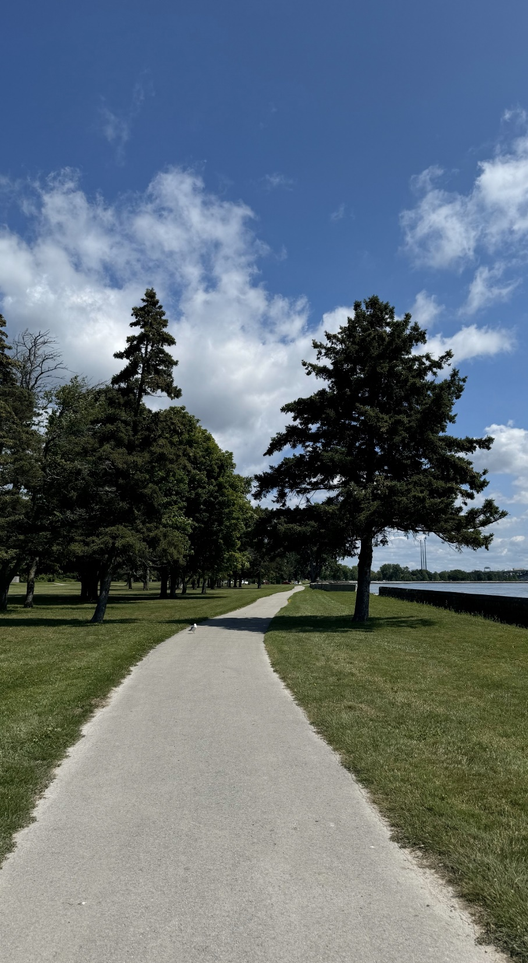
Existing Provision Levels
Existing parks have total area of 146.30 ha.
Population (in 2021) of 33,840 people.
Town-wide average of 4.32 ha / 1,000 ppl.
Provision rates vary across Town, based on locations of parks & open spaces.
Fort Erie Parks & Open Space Master Plan
October 7, 2024

Slide 11
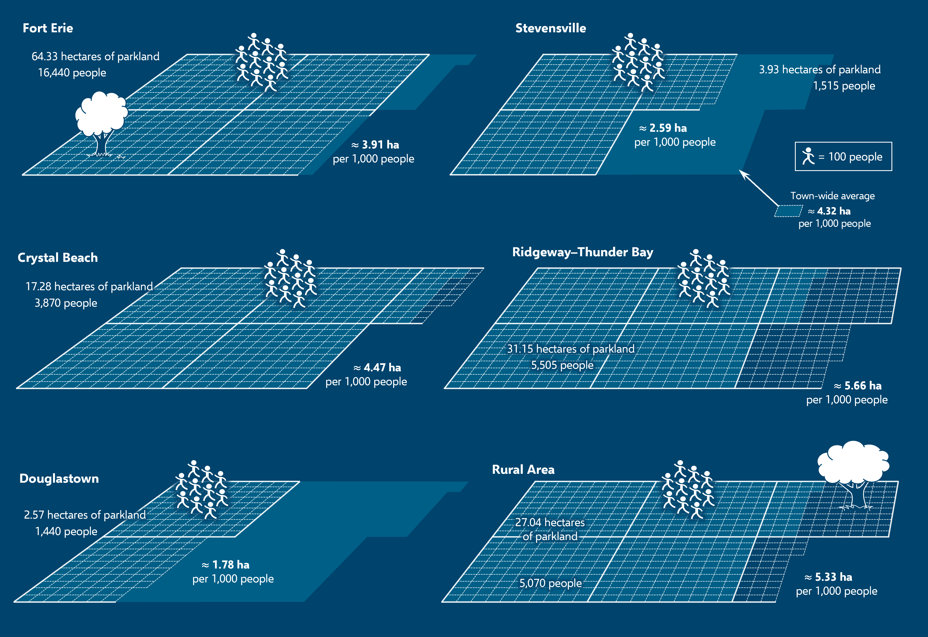
Existing Provision Levels

Slide 12
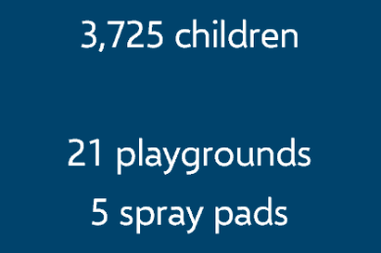
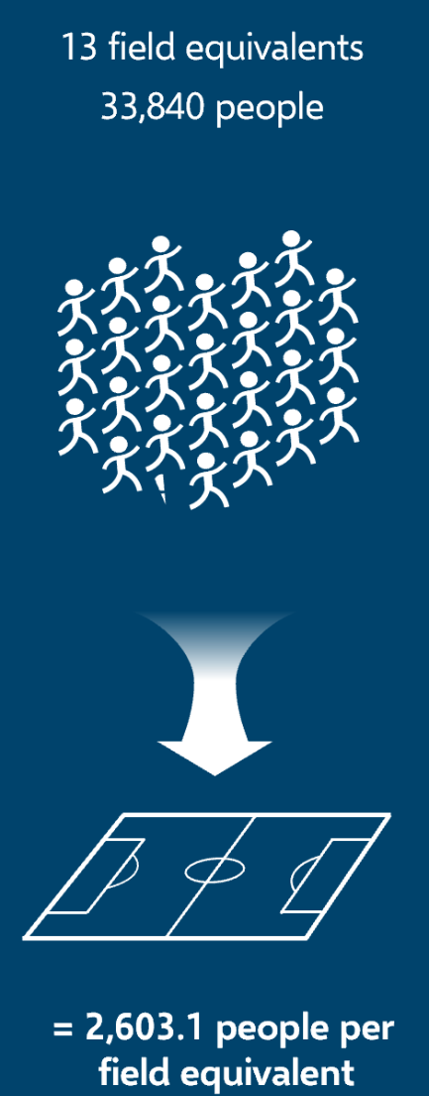
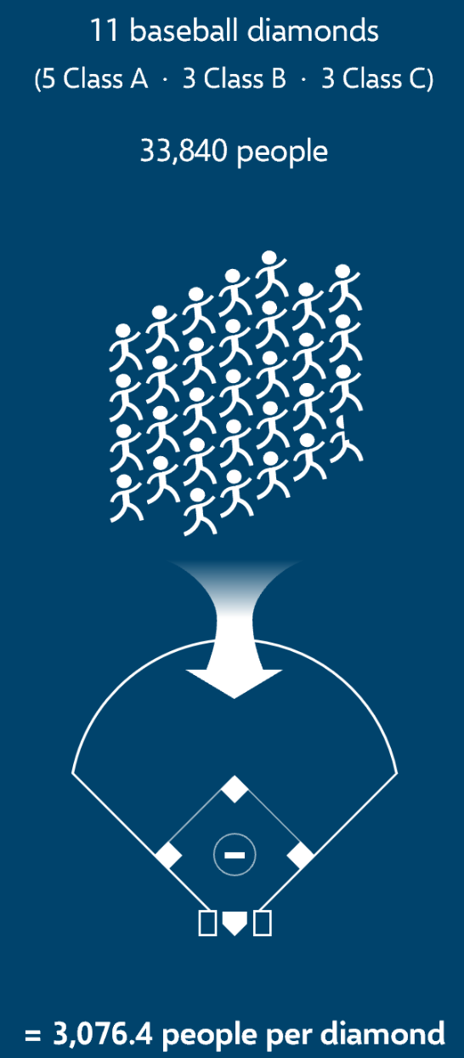
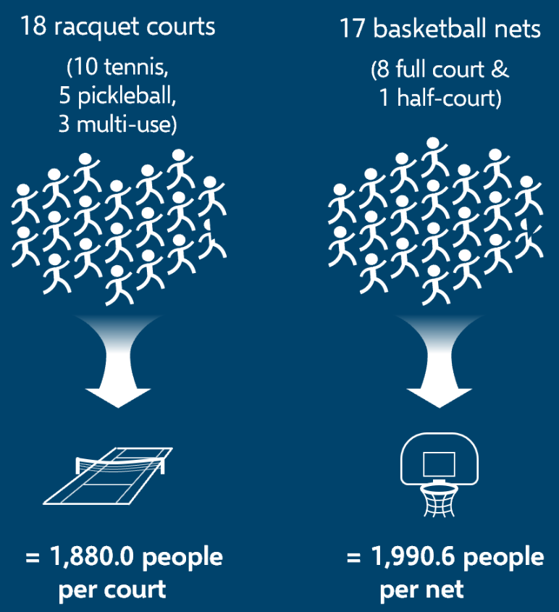
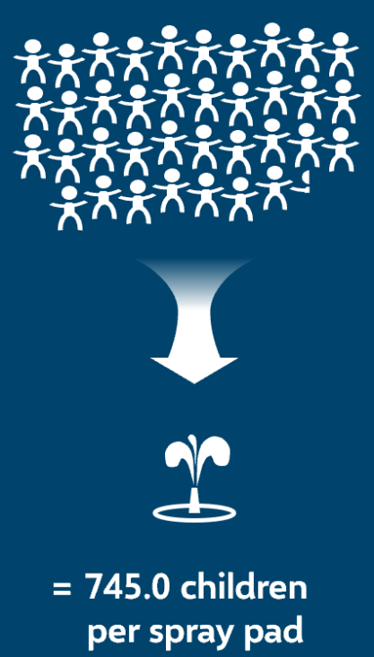


Existing Provision Levels
Playgrounds & Spray Pads
Soccer Fields
Baseball Diamonds
Racquet Courts
Basketball Courts

Slide 13
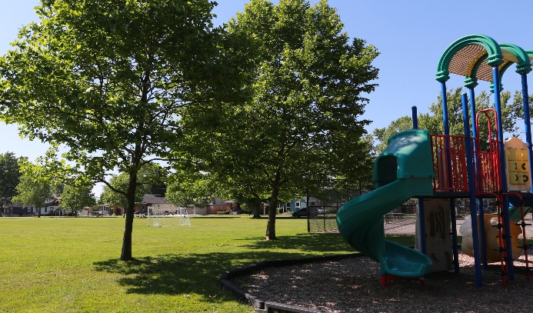
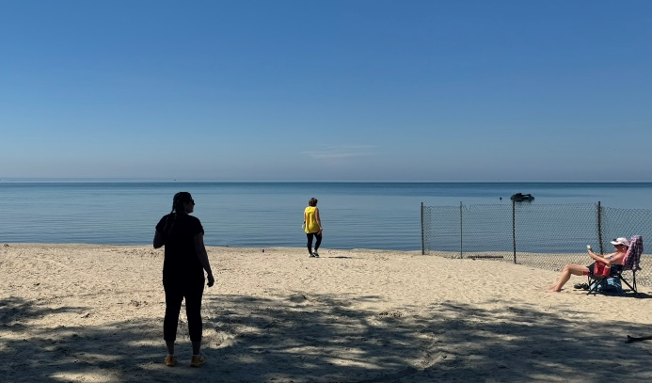
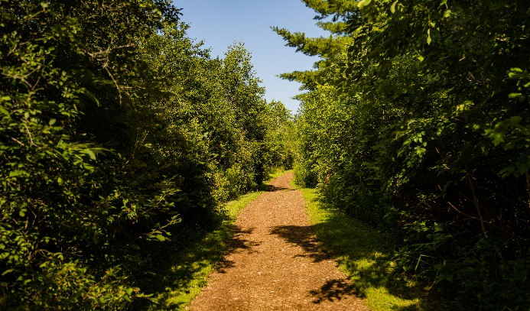
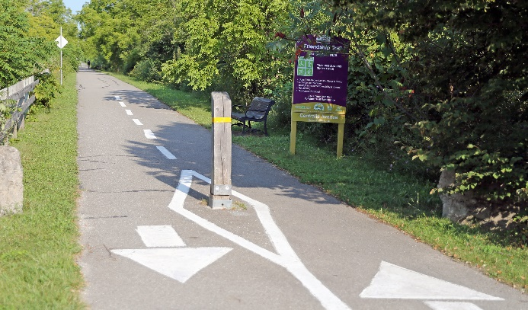
Park Classifications
Primary Categories:
Town Parks & Open Spaces — Provide park & open space amenities.
Waterfront Parks & Open Spaces — Provide residents & visitors with waterfront access.
Heritage Parks & Open Spaces — Preserve & promote Town’s natural & cultural heritage.
Linear Parks & Open Spaces — Provide connections between different destinations.
Fort Erie Parks & Open Space Master Plan
October 7, 2024

Slide 14
Park Classifications
Town Parks & Open Spaces:
Destination Parks
Community Parks
Neighbourhood Parks
Village Greens
Fort Erie Parks & Open Space Master Plan
October 7, 2024

Slide 15
Park Classifications
Waterfront Parks & Open Spaces:
Anchor Waterfront Parks
Urban Waterfront Parks
Waterfront Parks
Waterfront Windows
Fort Erie Parks & Open Space Master Plan
October 7, 2024

Slide 16
Park Classifications
Heritage Parks & Open Spaces:
Nature Parks
Cultural Spaces
Fort Erie Parks & Open Space Master Plan
October 7, 2024

Slide 17
Park Classifications
Linear Parks & Open Spaces:
Regional Trails
Community Trails
Nature Trails
Open Space Linkages
Fort Erie Parks & Open Space Master Plan
October 7, 2024

Slide 18
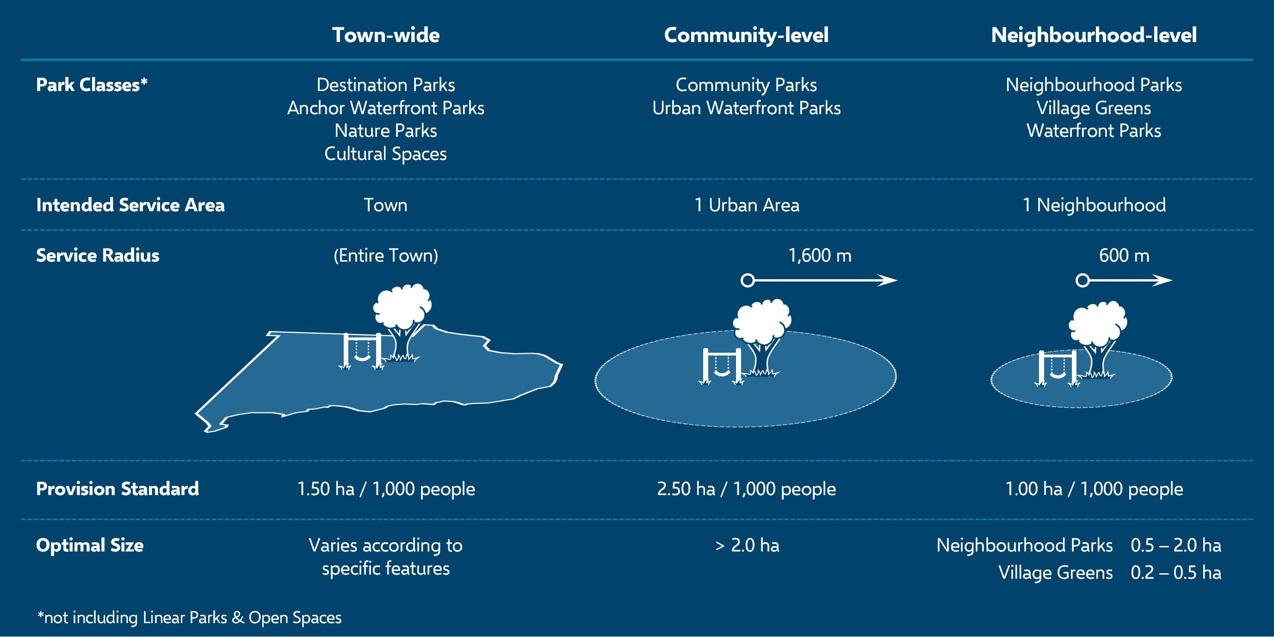
Park Standards & Service Levels
Fort Erie Parks & Open Space Master Plan
October 7, 2024

Slide 19
Park Standards
Linear Park Class | Functional Description | Surfacing & Recommended Features
Regional Trails | Primary features of trails network. Provide connections between destinations in Town and with neighbouring municipalities. | Usually paved or hard-surfaced to support higher levels of use. Benches at frequent regular intervals.
Community Trails | Secondary features providing connections within neighbourhoods and to Regional Trails. | Usually gravel, may be hard-surfaced in higher-traffic areas. Benches at regular intervals.
Nature Trails | Features within Nature Parks and other natural areas to facilitate access. Designed to be minimally intrusive with low maintenance requirements. | Minimal surface treatment, generally limited to natural materials (e.g., wood chips). Benches in select locations.
Pathways* | In-park connective features. | Surface treatment varies depending on park size, location, and anticipated levels of traffic.
Open Space Linkages | Naturalized corridors for wildlife movement. | Generally left in a naturalized state, with little to no human interference.
*In-park feature: not considered to be a separate class of parks.
Fort Erie Parks & Open Space Master Plan
October 7, 2024

Slide 20
Provision of Features & Facilities
Feature / Facility | Target Provision Rate | Current Provision Rate
Playgrounds | 1 playground / 180 children* | 1 playground / 177.4 children*
Spray Pads | 1 spray pad / 750 children* | 1 spray pad / 745.0 children*
Soccer Fields | 1 field equivalent / 2,500 ppl | 1 field equivalent / 2,603.1 ppl
Baseball Diamonds | 1 diamond / 2,800–3,250 ppl | 1 diamond / 3,076.4 ppl
Tennis / Pickleball Courts | 1 court / 1,800–2,000 ppl | 1 court / 1,880 ppl
Basketball & Multi-Use Courts | 1 basketball net / 200 youth** | 1 basketball net / 188.5 youth**
*“Children” refers to people between 0 and 12 years old.
**“Youth” refers to people between the ages of 10 and 19.
Fort Erie Parks & Open Space Master Plan
October 7, 2024

Slide 21
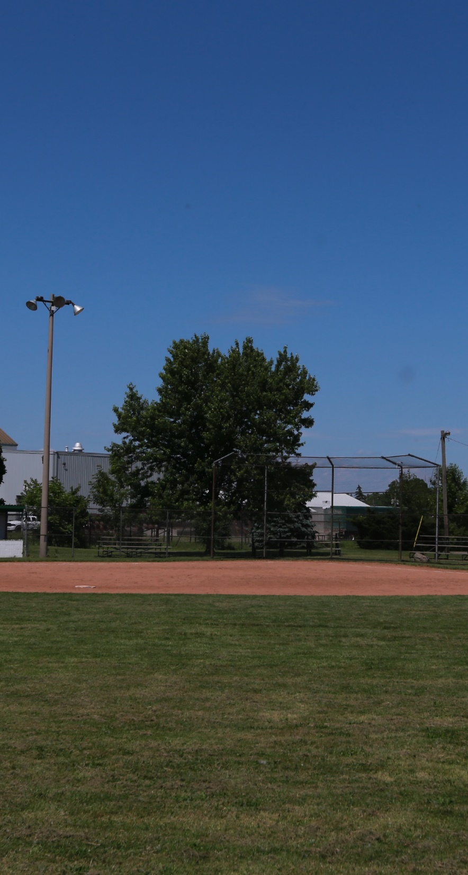
In-Park Facilities
Destination features — High-profile facilities & features constructed & maintained to highest standards (e.g., illuminated sports fields, illuminated outdoor courts).
Primary active features — Accommodate moderate to large numbers of users & motivate large number of visits (e.g., “Class B” sports fields & courts, water play areas).
Secondary active features — Accommodate low to moderate numbers of users, generally serve as supporting features.
Fort Erie Parks & Open Space Master Plan
October 7, 2024

Slide 22
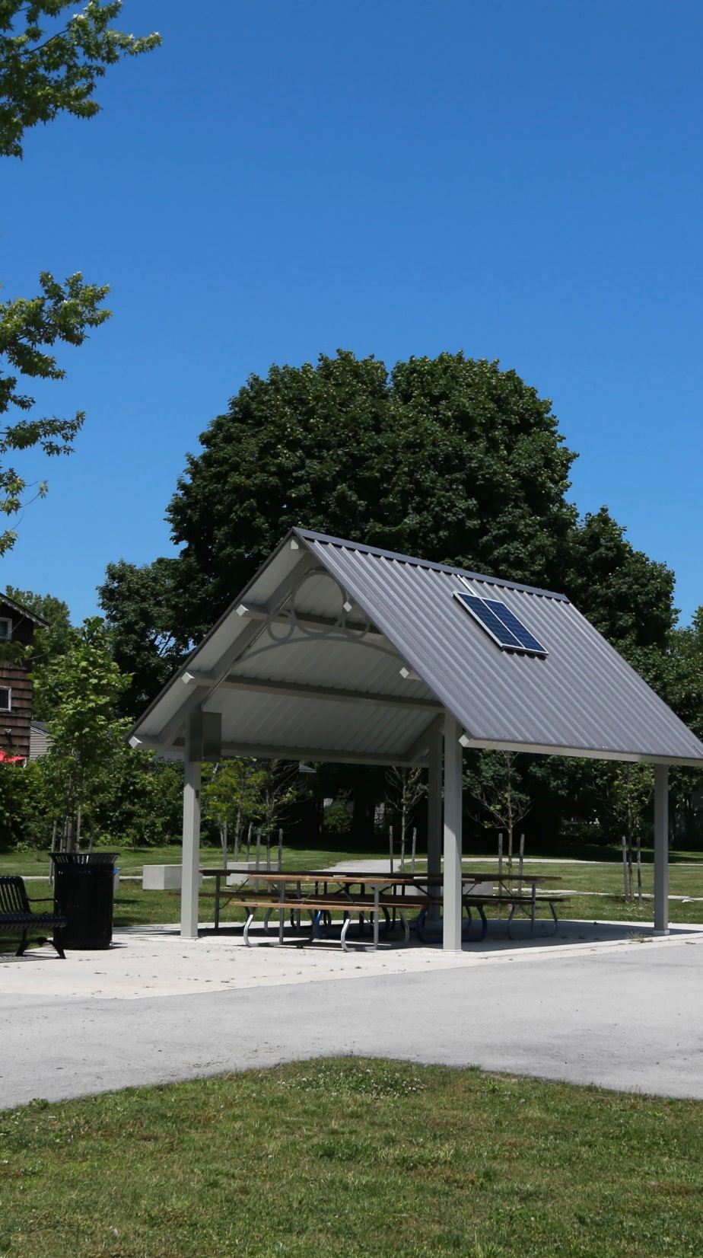
In-Park Facilities
Primary passive features — Features that attract moderate to large numbers of visitors (e.g. off-leash dog areas, natural areas, large pavilions).
Secondary passive features — Features generally intended to support other in-park activities; features that users appreciate, but that do not usually attract a large number of visitors on their own.
Fort Erie Parks & Open Space Master Plan
October 7, 2024

Slide 23
In-Park Facility Standards
Park Class | Basic Facility Requirements | Support Features
Destination Park | At least one destination feature. | Washrooms (permanent), parking lot, waste receptacles, bleachers / spectator seating, snack bar / concession stand.
Community Park | At least one primary active feature and multiple primary passive features. | Washrooms (permanent or temporary), pavilions or shade structures, benches, waste receptacles, parking lot.
Neighbourhood Park | At least one primary active feature or one primary passive feature plus one secondary active feature. | Washrooms (temporary), shade structures, benches, waste receptacles.
Village Green | At least one primary passive feature. | Shade structures, benches, waste receptacles.
Fort Erie Parks & Open Space Master Plan
October 7, 2024

Slide 24
In-Park Facility Standards
Park Class | Basic Facility Requirements | Support Features
Anchor Waterfront Park | Based on park’s specific focus, as defined in Waterfront Strategy. | Washrooms (permanent or temporary), parking lot, waste receptacles, snack bar / concession stand.
Urban Waterfront Park | At least one primary passive feature | Washrooms (temporary), waste receptacles.
Waterfront Park | Generally only secondary passive features. | Waste receptacles.
Waterfront Window | Boat launch (optional). | Minimal.
Nature Park | Natural area (defining feature). | Interpretative signage, waste receptacles, benches.
Cultural Space | Historic site or other feature of cultural heritage value (defining feature). | Commemorative plaques, interpretative signage, benches, waste receptacles.
Fort Erie Parks & Open Space Master Plan
October 7, 2024

Slide 25
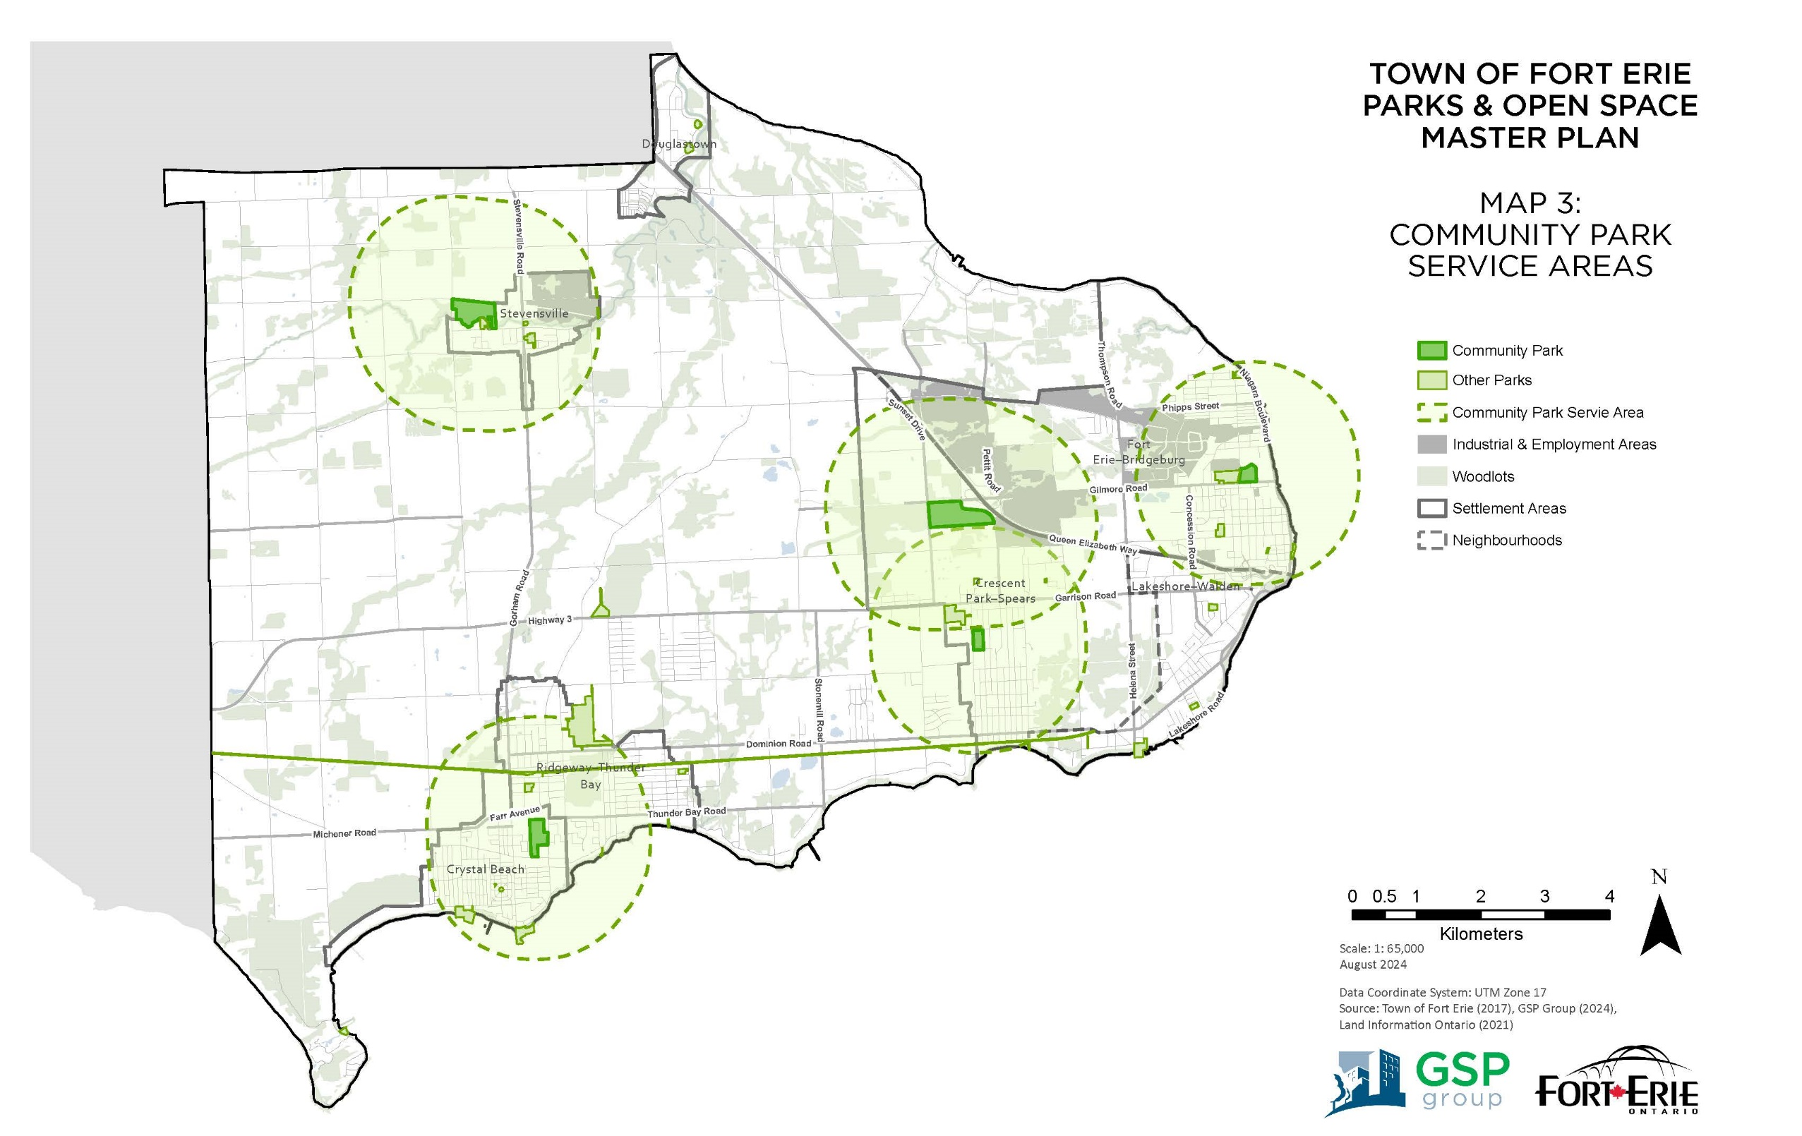
Gap Analysis

Slide 26
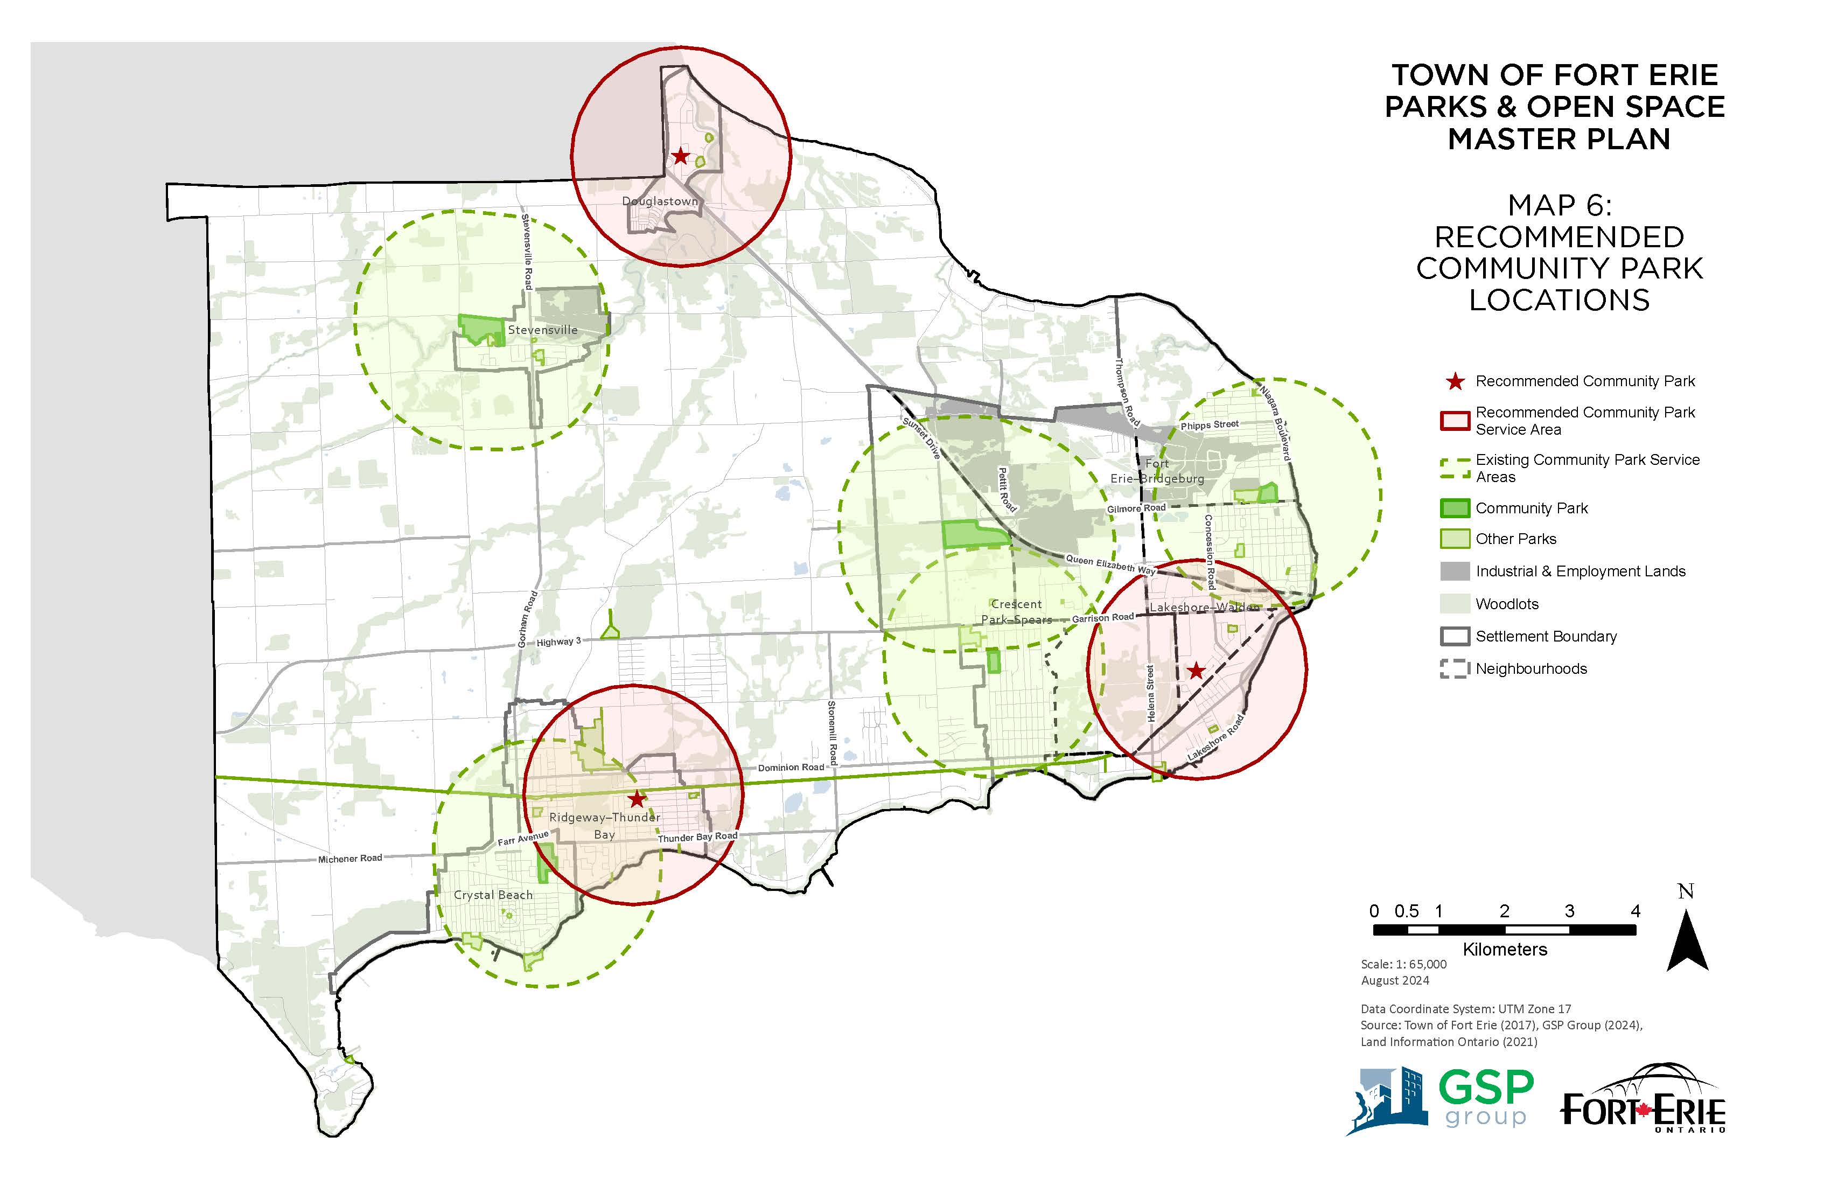
Gap Analysis

Slide 27
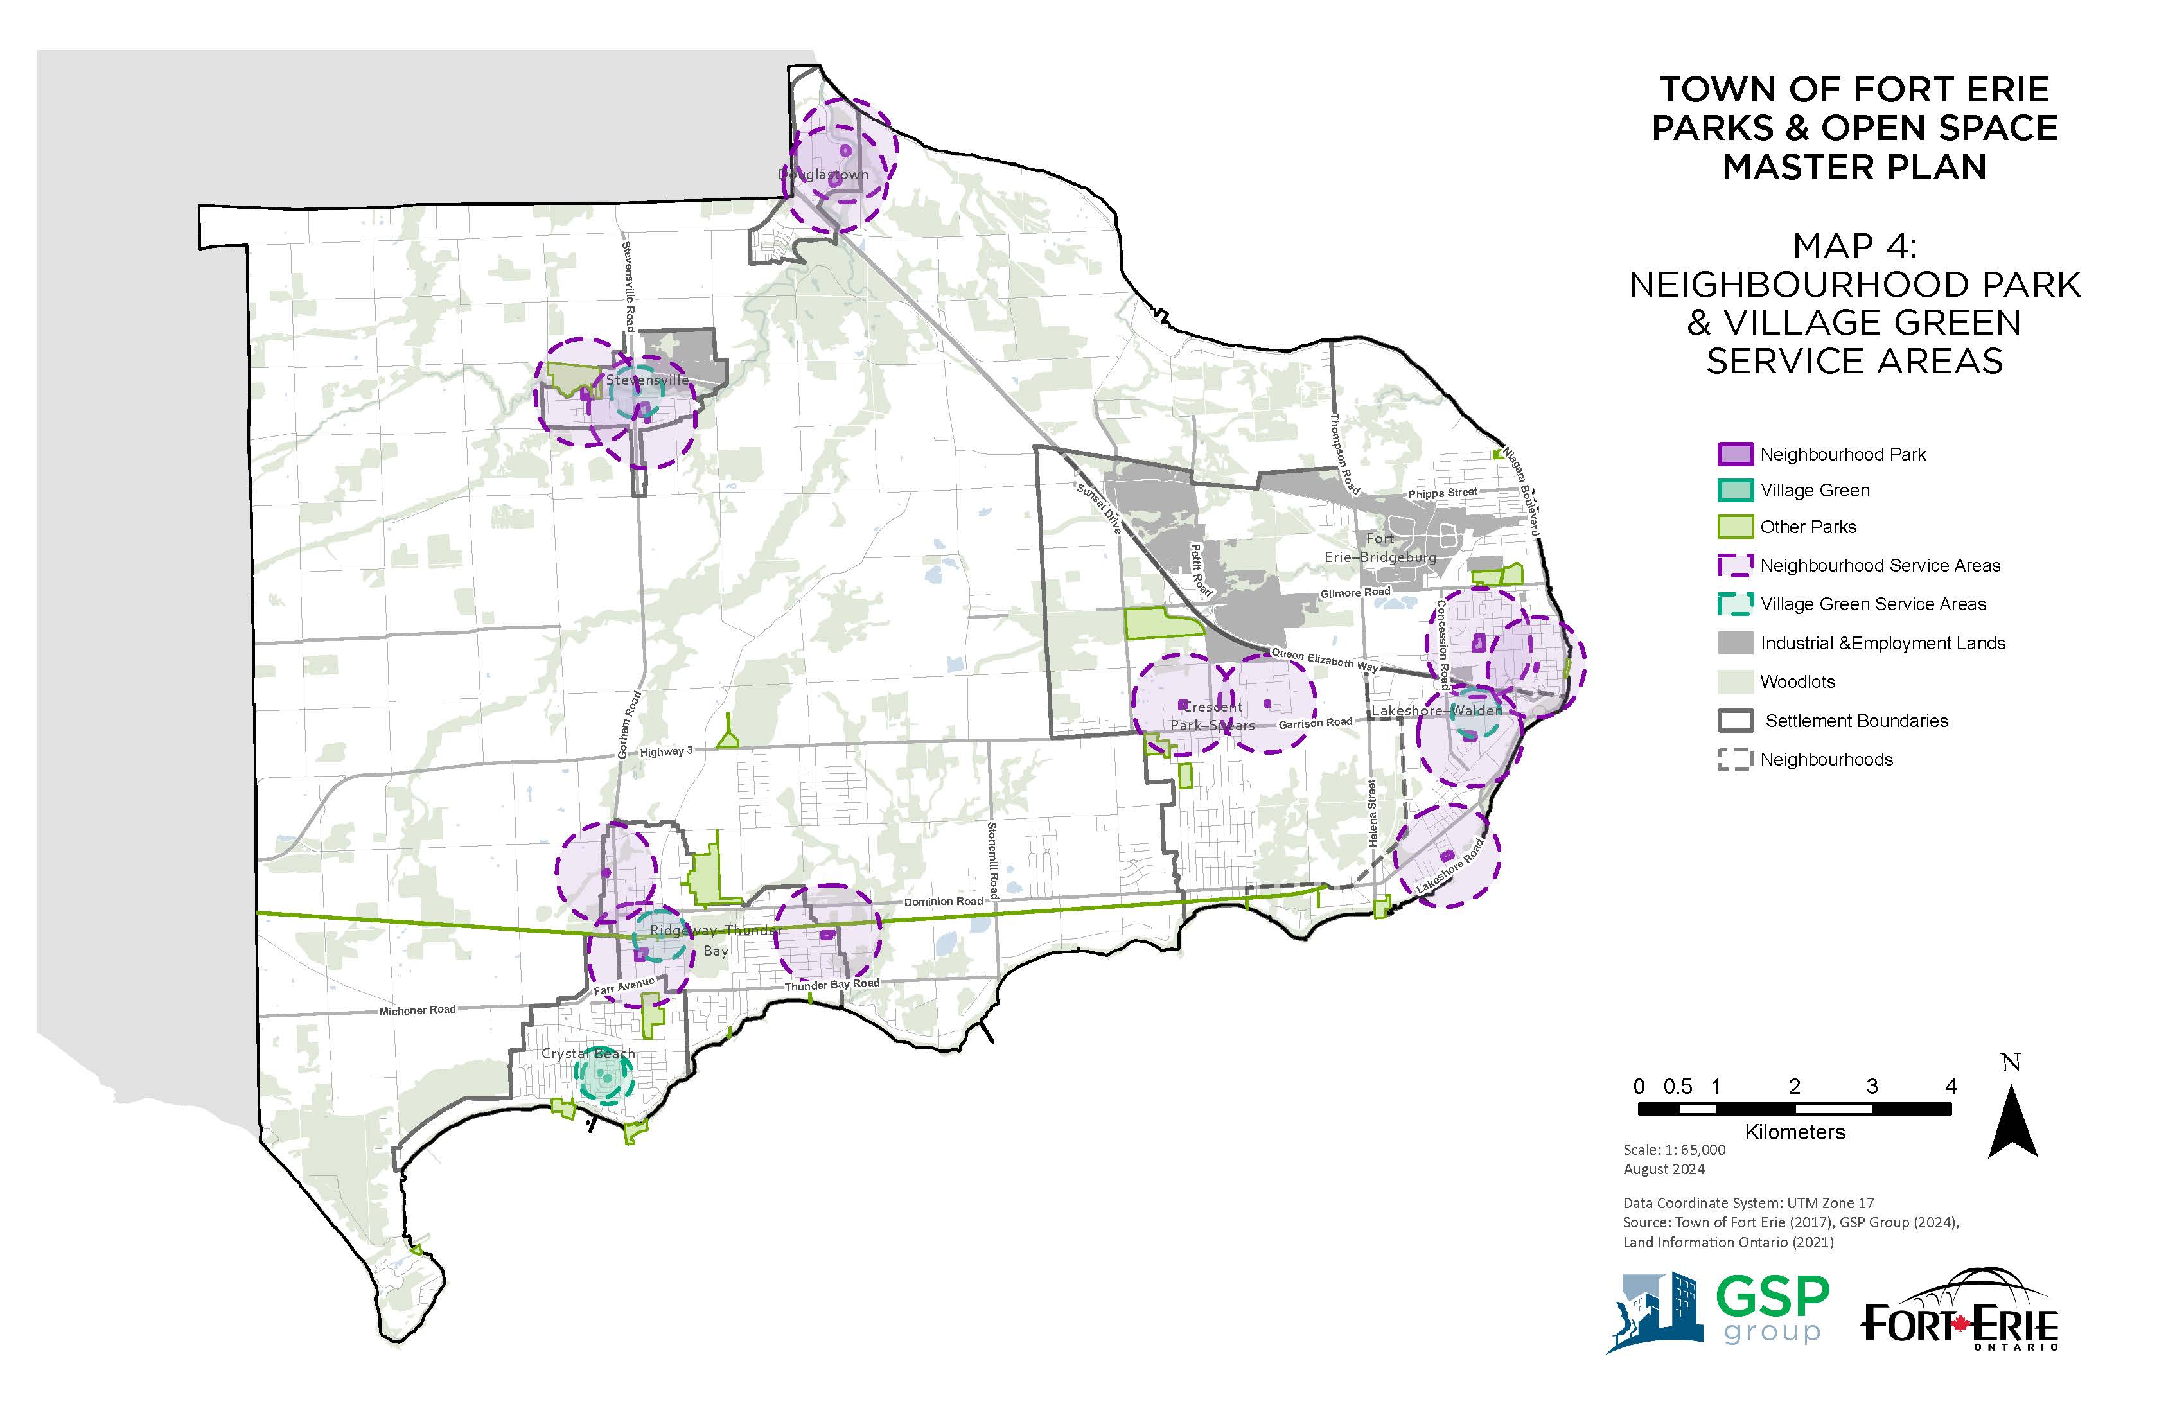
Gap Analysis

Slide 28
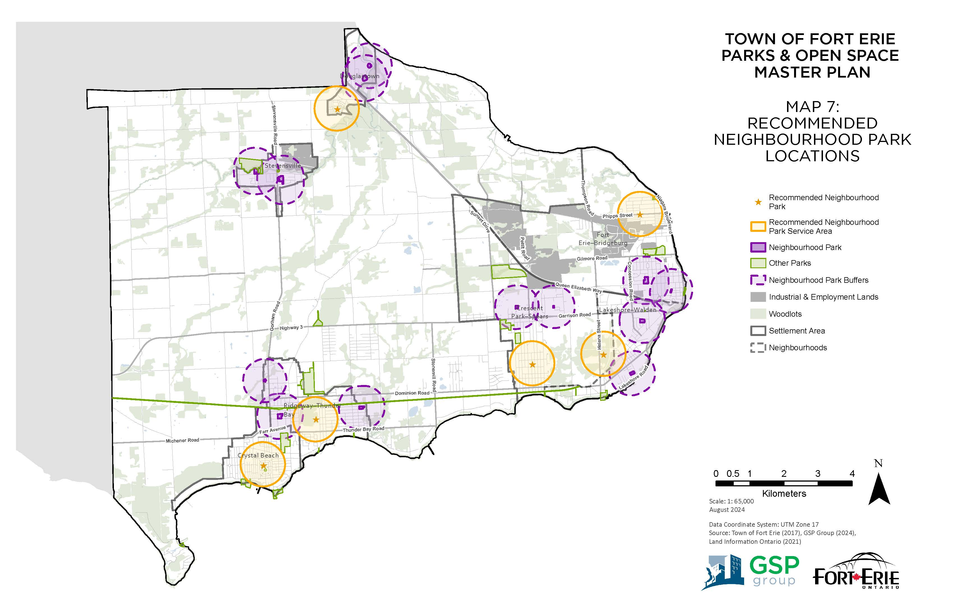
Gap Analysis

Slide 29
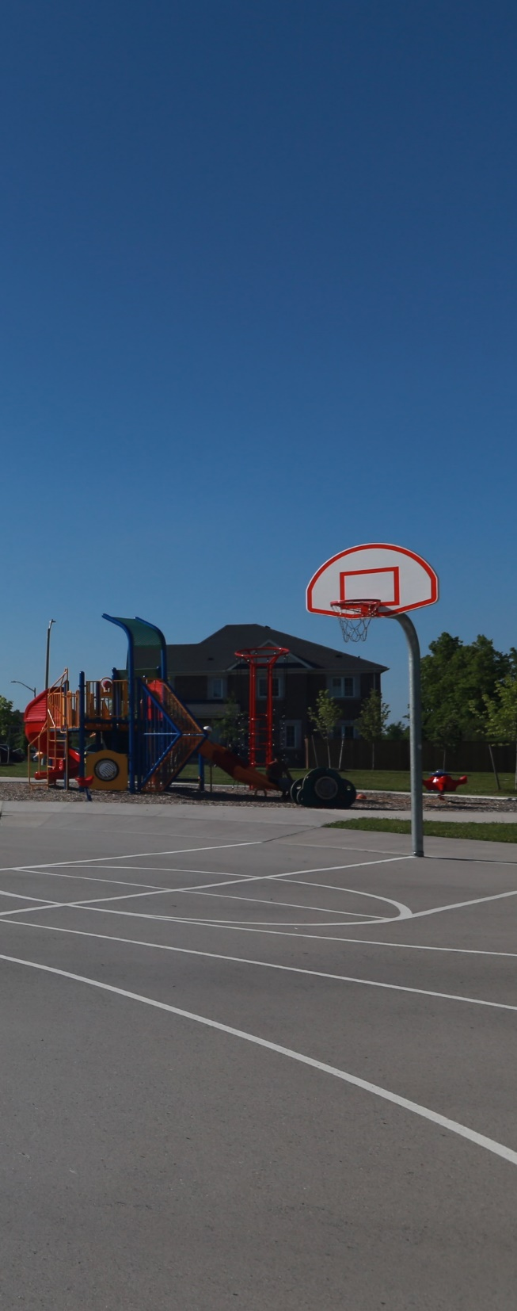
Facility Recommendations (to 2031)
1 junior playground
2 senior playgrounds
1 Class B/C junior/intermediate soccer field
2 Class B/C senior soccer fields
1 Class B baseball diamond
3 non-Class A tennis court equivalents
1 pickleball court equivalent
2 basketball nets (approx. 400 m² of court space)
Fort Erie Parks & Open Space Master Plan
October 7, 2024

Slide 30
Population Projections
Urban Area | 2021 | 2031 | 2041 | 2051
Fort Erie | 15,985 | 18,601 | 21,541 | 26,175
Crystal Beach | 3,765 | 4,260 | 4,817 | 5,695
Ridgeway–Thunder Bay | 5,355 | 5,680 | 6,046 | 6,622
Stevensville | 1,470 | 1,534 | 1,605 | 1,718
Douglastown | 1,400 | 1,585 | 1,793 | 2,120
Rural Area | 4,925 | 5,177 | 5,442 | 5,720
Total, Town of Fort Erie | 32,900 | 36,837 | 41,244 | 48,050
Fort Erie Parks & Open Space Master Plan
October 7, 2024

Slide 31
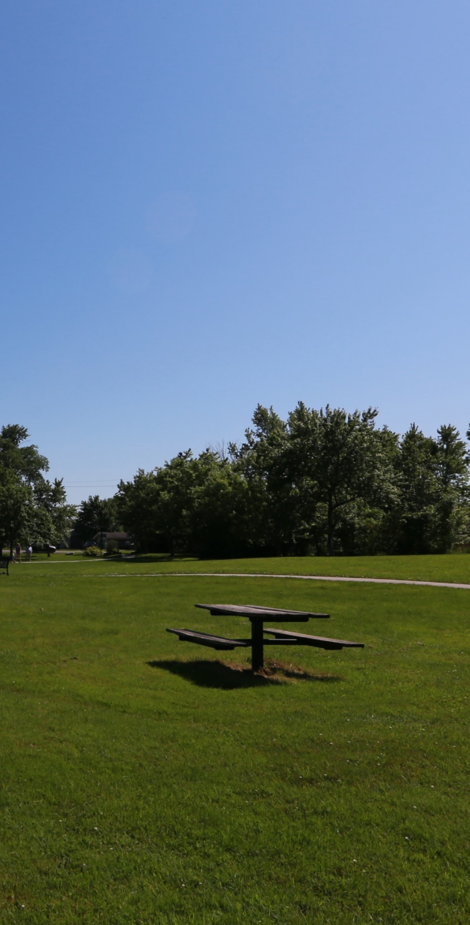
Projected Parkland Needs
to 2031:
Town-wide Parks | 3.014 ha
Community-level Parks | 7.248 ha
Neighbourhood-level Parks | 4.605 ha
Total, Town of Fort Erie | 29.735 ha
Fort Erie Parks & Open Space Master Plan
October 7, 2024

Slide 32
Overall Strategy for Dedication / Cash in Lieu
In general:
  require parkland dedication when opportunity to acquire land for Town-wide park class (e.g., Nature Park, Cultural Space) presents itself;
  require payment of cash in lieu for proposed development without a residential component.
  Fort Erie, Crystal Beach, Ridgeway–Thunder Bay — Require parkland dedication when opportunity to address identified area of need or when opportunity to acquire land along/near waterfront arises.
  Stevensville — Prioritize collection of cash in lieu of parkland dedication.
  Douglastown — Prioritize collection of cash in lieu, unless opportunity to address need for Community Park or opportunity to acquire land near/along waterfront arises.
Fort Erie Parks & Open Space Master Plan
October 7, 2024

Slide 33
Conclusion
New Master Plan builds on successes of previous (2006) Master Plan to provide recommendations for a park system that is sustainable, well maintained & equitably distributed.
  Recommended classification system recognizes diversity of Town’s parks & open spaces.
  Current overall park provision rate is 4.32 ha / 1,000 ppl (with some variation across the Town): strive to maintain current rate across entire Town.
  Maintain current provision rates for recreation facilities.
  Continue to pursue opportunities to address identified areas of need.
Fort Erie Parks & Open Space Master Plan
October 7, 2024

